Slide 1

Translated from Polish to English - www.onlinedoctranslator.com
Pre-conception care

Slide 2
Prepared by: Anna Kuter
Literature:
Nursing in modern obstetrics and gynecology Celina Łepecka-Klusek Wydawnictwo Polskie PZWL Warszawa 2010
Pre-conception care Grażyna Stadnicka Wydawnictwo polskie PZWL Warszawa 2009
Obstetrics and Gynecology Grzegorz H. Breborowicz
Polish Publishing House PZWL Warszawa 2007

Slide 3
The purpose of preconception care is to determine the health of the woman and her partner before the conception of the child.
It includes pregnancy risk assessment, health promotion and family planning.

Slide 4
Pre-pregnancy care is the simplest form of health promotion in society, the basic assumption of which is to make the community aware of the importance of maintaining optimal health conditions before conception, during conception and in the early stages of fetal development.

Slide 5
The health and condition of future parents have a significant impact on fertilization and fetal development. Therefore, when planning a pregnancy, it is worth analyzing their current lifestyle and eliminating all factors that negatively affect the course of pregnancy and fetal development.

Slide 6
Preparation for pregnancy should begin several months (3 to 6 months) before the planned date of conception, so that future parents can take care of their own health and thus increase the chance of optimal pregnancy development.

Slide 7
Factors influencing the proper course of pregnancy and fetal development
Individual characteristics of parents (age, body weight, education and level of culture, marital status)
Health behaviors (diet, smoking, psychoactive substances)
Living and working environment
Barriers hindering access to medical care

Slide 8
Prevention of developmental defects and genetic diseases
Prevention I°(primary prevention): preventing abnormalities in the development of the embryo (folic acid supplementation, iodine prophylaxis, prevention of rubella infections)

Slide 9
Folic acid supplementation
All women of childbearing age, especially before a planned pregnancy, should take 0.4 mg (up to 0.8 mg) of folic acid daily.
Women who have given birth to children with neural tube defects, suffer from epilepsy and take anticonvulsants should use folic acid at a dose of 4.0 mg daily under medical supervision before planning pregnancy.
Supplementation should continue until the 12th week after conception.

Slide 10
IODINE PREVENTION DURING PREGNANCY AND LACTATION
Taking 100-150 dailyµg of iodine in tablets
Using only iodized salt for food purposes
Regularly eating sea fish and drinking milk

Slide 11
Prevention of rubella infections
Women who were not vaccinated at the age of 13 or more than 15 years have passed since the primary vaccination should be vaccinated against rubella.
Women working with children should be especially vaccinated.
Such people should not become pregnant for three months after vaccination
You should also not get vaccinated during pregnancy. In pregnant women, it is recommended to routinely determine immunity against rubella during the first visit

Slide 12
Prevention of developmental defects and genetic diseases
Prevention II°(secondary prevention)
these are activities that reduce the degree of damage to the child or the social consequences of defects (genetic counseling, prenatal diagnosis).

Slide 13
Genetic counseling
It is a form of specialized medical assistance aimed at providing consultees with information about the risk of a genetic disease occurring in the family.
Genetic counseling services include: (establishing the causal diagnosis, determining the etiology of the disease and prognosis, determining the genetic risk of recurrence of the disease in the family, presenting possible prenatal diagnostics)

Slide 14
Prenatal diagnosis
It involves prenatal assessment of fetal development.
Prenatal diagnosis of genetically determined diseases includes screening tests performed in each pregnancy and diagnostic tests performed in high-risk pregnancies.

Slide 15
Methods of prenatal diagnosis
Non-invasive procedures (ultrasound, biochemical tests of fetal markers in the mother's blood serum, tests of fetal cells in the mother's blood).
Invasive procedures (amniocentesis, chorionic villus sampling, fetal blood collection, fetal tissue collection).

Slide 16
Indications for prenatal diagnosis:
- Age of the pregnant woman over 35 years of age
- Father's age over 55
- Incorrect screening test result
- Carrier of a structural chromosome aberration by one or both parents
- A loaded interview
- Indications of a psychological nature

Slide 17
Non-invasive procedures
Ultrasound screening for Down syndrome and trisomy 18,
involves the detection of nuchal translucency, measured by ultrasound in the fetus between the 11th and 13th week of pregnancy. An additional marker is the absence or underdevelopment of the nasal bones in the fetus. This assessment is possible between the 11th and 20th week of pregnancy.

Slide 18
Non-invasive procedures
Biochemical testing of fetal markers in the mother's blood serum involves the determination of fetal proteins present in the mother's serum throughout pregnancy at specific concentrations.
PAPP-A test, double test (10-14 weeks)
Triple test (14-21 weeks)

Slide 19
Amniocentesis
Amniotic fluid collection under ultrasound guidance. It is usually performed between the 15th and 17th week of pregnancy. 15-20 ml of amniotic fluid is collected. The so-called early amniocentesis at 11-14 weeks.
Complications include: short-term fluid leakage, miscarriage, and fetal injury.

Slide 20
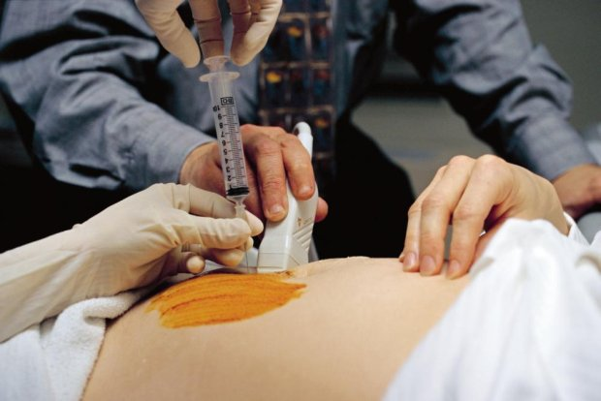

Slide 21
Chorionic villus biopsy
It is performed between the 9th and 12th week of pregnancy under ultrasound control. From 5 to 25 mg of chorionic villi are collected transabdominally or transcervically using a needle or catheter.

Slide 22
Cordocentesis
It involves puncturing the umbilical cord with a needle (through the pregnant woman's abdominal wall) and taking a blood sample.
This test is performed between the 17th and 18th week of pregnancy (and in some centers from the 12th week).
0.5 – 5 ml of umbilical cord blood is collected
Complications include bleeding from the injection site, fetal death, umbilical cord hematoma, and umbilical cord thrombosis.

Slide 23
Fetal tissue biopsy
Fetal tissue collection is derived from photoscopy. It is performed very rarely, most often when other tests fail.
Coelocentesis – involves transabdominal or transcervical aspiration of fluid from the extraembryonic body cavity.
Embryoscopy – direct viewing of the embryo through a fiberoscope.

Slide 24
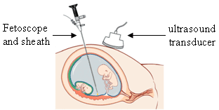

Slide 25
Prevention of developmental defects and genetic diseases
Prevention III°(tertiary prevention)
these are broadly understood interdisciplinary corrective and rehabilitation cooperation in people with congenital defects

