Slide 1

Translated from Polish to English - www.onlinedoctranslator.com
Nutritional treatment in chronic renal failure; applicable standards
Wiesława Łysiak-Szydłowska
Prof. Ph.D. n. med.

Slide 2
Classification of chronic renal failure(DOQI-NKF)
Stage | Description | GFR ml/min | Action
1 | Kidney damage with normal or↑GFR | >90 | Diagnosticianai therapy
2 | Slight↓GFR | 60-89 | Assessment of progression
3 | Moderate↓GFR | 30-59 | Assessment and treatment of complications
4 | Considerable↓GFR | 15-29 | Preparation for renal replacement therapy
5 | Kidney failure | <15 | Transplant or dialysis

Slide 3
Reasons for reduced food supply
Uremic toxins
Taste disturbances
Hormonal and metabolic disorders
Chronic and acute inflammation
Medicines
Psychosocial factors
Depression
Poverty
Alcohol/drugs

Slide 4
Disorders of nutrient metabolism in CKD
Decreased renal clearance of: water, sodium, potassium, calcium, magnesium, phosphorus, etc.
Accumulation of proteins, peptides, AA and their transformation products; glucose intolerance
Decreased intestinal absorption of calcium, iron, B-2, D-3, folic acid and some AA
Increased plasma clearance of B-6
Antagonistic effect of some vitamins with risk of deficiency
High intracellular calcium levels
Kopple, Massry: Nutr. Management of Renal Dis., 2004, 379

Slide 5
The impact of chronic protein-calorie malnutrition on kidney functions
Decreased renal plasma flow and glomerular filtration rate
Impaired thickening ability at normal dilution potential
Disturbed ability to secrete salt load
Disturbed ability to secrete acid
Correct ability to lower pH
Significantly reduced titratable acidity due to reduced phosphate excretion
Mitch WE, Klahr S: "Nutrition and Kidney Diseses, 1988

Slide 6
STANDARDS
NKF
Clinical Practice
Guidelines for
Nutrition in Chronic
Renal Failure
- Am. J. Kidney Dis. 35, S1-140, 2000
- Am. J. Kidney Dis. 44, 39-46, 2004
- Kopple JD, Massry SG: in "Nutritional management of renal disease". 2004
ESPEN
Expert Working Group
Report on Nutrition in
Adult Patients with
Renal Insufficiency
Toigo G. et al.: Clin. Nutr. 19, 197-207, 2000
Cano N. et al.: Clin Nutr. 25, 295, 2006

Slide 7
ESPEN Recommendations 2000 - 2006
Parameter | Stage 3 | Stage 4
Energy [kcal/kg/d] | 35
Carbohydrates [% energy] | 55 - 60
Fats [% energy] | thirty
Phosphorus [mg/d] | 600 - 1000
Sodium [g/d] | 1.8 – 2.5
Potassium [g/d] | - | 1.5 – 2.0
Protein [g/kg bw/d] | 0.55– 0.6 (2/3 high value) | 0.55 – 0.6 For selected VLPD 0.28 +EAA or +EAA+KK)
Calculations in relation to ideal body weight; unlimited fluids
Hypertriglyceridemia: exclusion of simple sugars and ethanol
Hypercholesterolemia: cholesterol <300 mg/day, saturated fatty acids <10%

Slide 8
NKF – 2000 and next
Stage 3 (GFR 30 – 70 ml/min)
The decision to limit protein is left to the individual - meta-analyses suggest the benefits of such restriction;important patient acceptance
Limit to 0.60 g/kg body weight/d and at least 50% protein of high biological value
LDL-C <100 mg/dl (for stage 1-4)

Slide 9
Dietary recommendations for CRF stage 4-5– GFR < 30 ml/min/1.73 m²(NKF-K/DOQI)
Component | Supply
Energy (kcal/kg/d) | < 60 years -35; > 60 years 30÷35; if mc > 120% of the due amount - restrictions
Protein (g/kg/d) | 0.55-0.60 to 0.75; including≥50% high biological value
Fat (% energy) SFA (%energy) PUFA (% energy) MUFA (% energy) | 25-35 <7% up to 10% up to 20%
Carbohydrates (% energy) Fiber (g/d) | Supplementing non-protein calories 20-30
Minerals Sodium (mg/d) Potassium (mEq/d) Phosphorus (mg/kg/d) Calcium (mg/d) Magnesium (mg/d) Water(L) | 1,000-3,000 40-70 (1500 – 2700mg/d) ≤10!!! 1,400-1,600 200-300 up to 3,000; according to tolerance

Slide 10
Vitamin supplementation
Vitamin | PNN supply(healthy man)
Thiamine mg/day | 1.1-1.2/1.2
Riboflavin mg/d | 1.1-1.3/1.3
Biotinμh/d | thirty/thirty
Pantothenic acid mg/d | 5/5
Niacin mg/day | 14-16/16
Pyridoxine –HCl mg/d | 5-10/1.7
Vitamin B-12μh/d | 2.4/2.4
Vitamin C mg/d | 75-90/75
Folic acid mg/d | 1-10/0.4
Vitamin A, K | DO NOT SUPPLEMENT/900μg; 90μg
Vitamin D | +/- symptoms/5μg
Vitamin E IU/d | 400 – 800/20?!

Slide 11
Low protein diet and phosphorus supply
Protein supply [g/kg/d] | Phosphorus supply [mg/d]
1.2 1.0 – 1.2 0.8 – 1.0 0.6 – 0.8 <0.6 | 1,353 1,052 938 831 598
Nephrol. Dial. Ther. 13, 65-67, 1999

Slide 12
Reduced protein supply
Hypoalbuminemia
Decreased plasma volume?
Decreased cardiac output
Reduced RR
Reduced RBF and GFR
Reduced peritubular
hydrostatic pressure
Increased
renin/angiotensin
Increased aldosterone
Increased tubularity
reabsorption of salt and water
Reduced load of filtered water and salt
Swelling
Kidney Intl. 1973, 3, 129

Slide 13
Low-protein diets
Natural 0.55÷0.60 g/kg bw/d
B. low protein~0.28 g/kg bw/d (16 – 20 g/d) – protein of unidentified quality
As above, supplemented with essential AA (His, Lys, Thr, Try) and keto- or hydroxy acids

Slide 14
AND
Low protein diet – MDRD study (NEJM 330, 877, 1994; Clin. Nephrol. 50, 273, 1998; J. Am. Soc. Nephrol. 1999)
Group A – "usual protein"
- GFR 25÷55ml/min/1.73m², protein supply 1.0→0.6 g/kg/d (average supply 0.73g/kg/d)
Group B – "low protein"
- GFR 13÷24ml/min/1.73m², protein supply 0.6→0.3 g/kg/d (+ supplementation with keto acids:average supply 0.46g/kg/d)

Slide 15
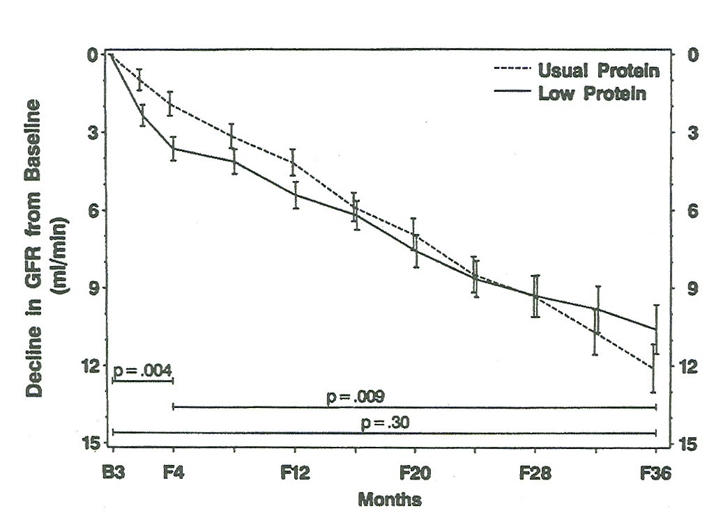
A-1
The influence of a low-protein diet on changes in GFR in CRF

Slide 16
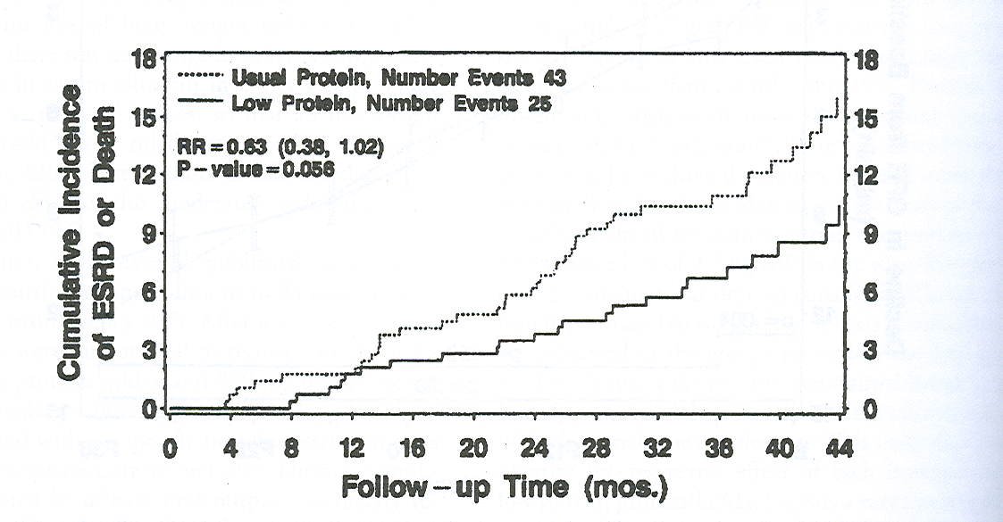
A-2
The impact of a low-protein diet on mortality

Slide 17
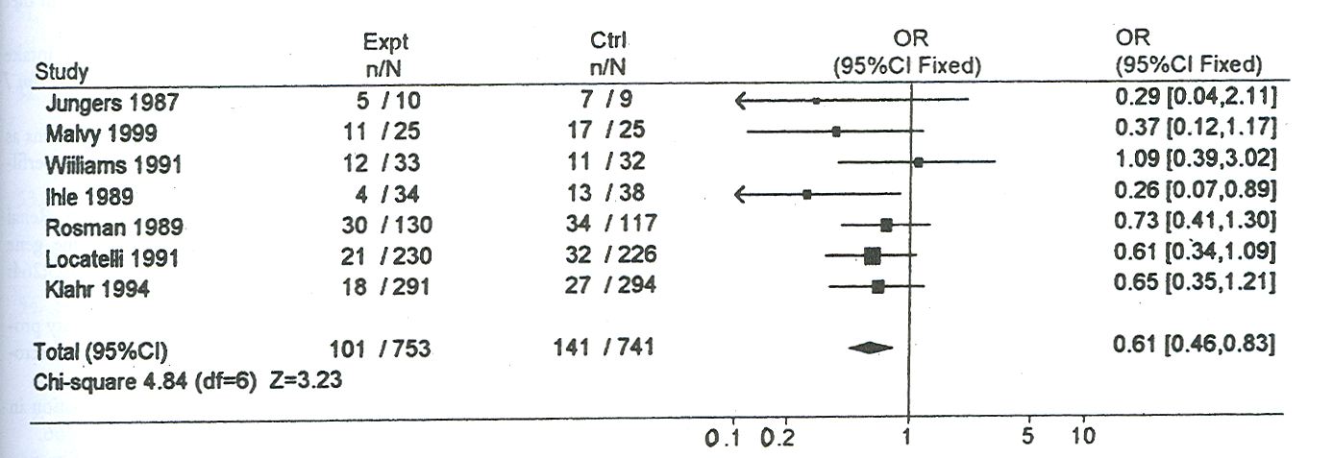
The impact of a low-protein diet on mortality in CRF (Nephrol. Dial. Transpl., 2000)

Slide 18
Minimum requirements for nutritional assessment
Every 1-3 months - Dietary consultation Laboratory tests: Hb, Ht, urea, creatinine, Na, K, Cl, HCO₃, albumin/prealbumin Expected weight [%], swelling Weight changes SGA (subjective global assessment)
Every 3-6 months Dietary consultation + 3-day food diary, nPI (g/kg/d)
Every 12 months Laboratory tests: T-Chol, LDL-Chol, HDL-Chol, TG, homocysteine, CRP Anthropometric tests

Slide 19
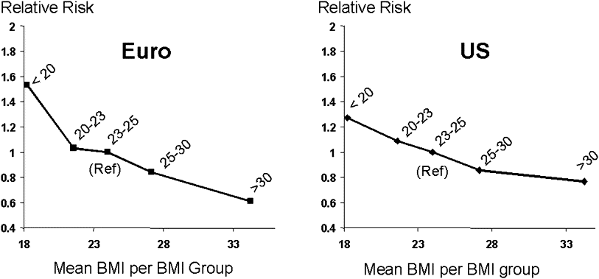
BMI and mortality in patients with CRF (dialysis therapy). Leavey et al., 2003

Slide 20
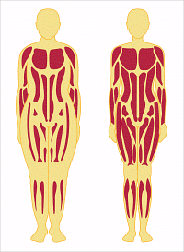
BMI and lean body mass (www.dana.farber.org)

Slide 21
The function of diet in CRF
Providing optimal amounts of nutrients and preventing malnutrition - maintaining lean body mass
Limiting the amount of end products of metabolism: phosphorus, sodium, fluids, urea - maintaining biochemical blood parameters close to physiology
Preventing the development of complications
atherosclerotic changes
anemia
osteoporosis
It gave a sense of freedom and allowed for a good quality of life

Slide 22
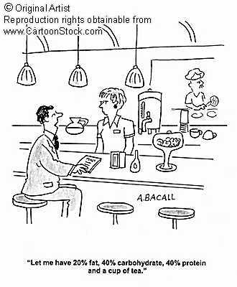

Slide 23
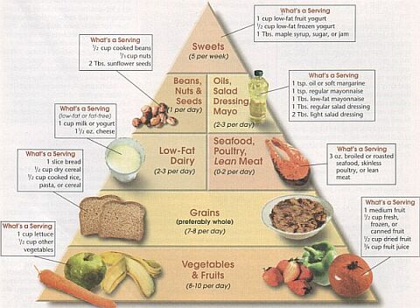
DASH pyramid

Slide 24
DASH recommendations – 2000 kcal/day diet DietaryANDpproah thatStopHypertension
Food group | Number of servings | Portion size
Cereals | 6 - 8 | 1 slice of bread, 28 g of flakes, ½ cup of cooked rice
Vegetables | 4 - 5 | 1 cup of raw, ½ cup of cooked, ½ cup of vegetable juice
Fruit | 4 - 5 | 1 medium size, ¼ cup dried, ½ cup fresh or juice
Fat-free dairy products | 2 - 3 | 1 cup or 40g of cheese
Lean meat (poultry or fish) | <6 | 28 g of cooked meat or 1 egg
Nuts, grains, beans | 4 – 5 /week | 1/3 cup of nuts, 2 teaspoons of peanut butter, ½ cup of cooked legumes
Fats, oils | 2 - 3 | 1 teaspoon (2 teaspoons of salad dressing)
Sweets | <5/ week | 1 teaspoon

Slide 25
FOOD PYRAMID FOR PEOPLE ON DIALYSIS
Low sodium•Low potassium • Low phosphate
Adapted from Cooking for David: A Cilinary Dialysis Cookbook
FATS
oil
butter
margarine
Mayonnaise
Tatar sauce
salad dressing
from 6 to 8 servings/day
1 serving = 1 teaspoon (5ml) to 1 tablespoon (15ml)
Symbol * identifies high-sodium foods that need to be limited
MILK PRODUCTS**
milk or yogurt ½ cup = 8 tbsp
ice cream or sorbet ½ cup = 8 tablespoons
cottage cheese = 2 tablespoons
condensed milk ¼ cup = 60 ml
sour cream ¼ cup = 4 tablespoons = 12 teaspoons
portion limit from 56 to 112 grams/day
from 2 to 3 servings/day
1 serving = ½ cup
from 2 to 3 servings/day
1 serving = 1 small piece or ½ cup
LOW POTASSIUM
VEGETABLES FRUITS
sprouts, peppers, green beans, apples, apple sauce, blueberries, cherries,
Cabbage, Carrots, Cucumbers, Eggplant (Eggplant), Cherries, Grapes, Tangerines, Plums,
Cauliflower, Onion, Vegetable Juice, Radish, Lettuce, Pineapples, Peaches, Watermelon, Canned Pears,
Fruit Cocktail, Grapefruit (1/2 small)
HIGH PHOSPHATE**FRUIT JUICES
Corn,
Green Peas, Cranberry, Raspberry, Apple, Grape,
Mushroom Lemonade, Pear or Peach
1 to 2 servings of juice
1 serving = ½ cup
From 6 to 10 servings/day
1 serving = 1 slice
or approx. 28g
BREAD GRAINS AND CEREALS CRACKERS AND SNACKS
Sourdough bread Rice or Pasta (8 tablespoons) Cookies, Waffles, Shortcrust Pastries,
White bread, Oat flakes (8 tablespoons), Biscuits, Fruit patties
Sweet Rolls, Prepared Rice (16 tablespoons), Pancakes, Apple pie
Bagels*Cereal Flakes (12 tablespoons)
Pita (avoid bran, nuts)
Donuts
**From 140 to 280g/day
¼ cup = 28 grams
HIGH PROTEIN PRODUCTS
*PROCESSED MEAT FRESH MEAT OTHER HIGH PROTEIN PRODUCTS
*Sliced ​​Meat,*Roast beef,*Ham, *Turkey, Beef, Pork, Lamb, Low Cholesterol Egg Products, Eggs,
*Chicken *Canned Tuna,*Salmon Turkey, Fish, Seafood*Cottage cheese, Tofu, Vegetarian meat analogues
**Protein portions vary depending on your weight, height and nutritional needs.

Slide 26
LIMIT OR AVOID THESE PRODUCTS
MILK PRODUCTS
Milk
Yogurt
Cheese
Ice-cream
LEGUMS SEEDS
VEGETABLES
Cereals
Green peas
Mushrooms
DRINKS
Coca-Cola
Pepsi
Cherry Cola
Drinking chocolate
Beer
Coffee with milk
MEAT and PROCESSINGS
Canned hams
Processed chicken, turkey or beef
Salami
Sausages
Hot Dogs
Canned meat
Cured meat
Smoked fish
OTHER
Sardines, Liver Nuts, Peanut butter, Seeds, Grains, Dried fruit, Chocolate, Avocado, Whole grain products, Buckwheat
VEGETABLES
Sauerkraut
Salted tomato juices
HIGH-
-PHOSPHATE
AFTER₄
OTHER
pickles
Salted pretzels
Crackers
Chips
Olives
Discuss your intake of these foods with your dietitian.
Potassium, phosphorus and sodium must be limited in the daily diet.
HIGH-
-SODIUM
On⁺
SPICES
Salt
Soy sauce
ketchup
BBQ sauce
ATTENTION
FAST FOOD
and most foods eaten in restaurants
HIGH-
-POTASSIUM
K⁺
FRUIT
Apricots
Bananas
Dried figs, plums and other dried fruits
Dates
Melons
Grapefruit (1/2)
Kiwi
Mango
Nectarines
Orange
Papaya, Pears
VEGETABLES
Bamboo shoots
Potatoes (baked, chips) unless soaked and twice cooked
Beetroot
Tomatoes
Tomato concentrate
Tomato juice
ketchup
Vegetable juices
OTHER
Nuts and seeds (pips)
Salt substitutes
Legume seeds
Chocolate
An avocado
MILK PRODUCTS
Milk
Yogurt
Cheese
From: "Cooking for David: A Culinary Dialysis CookBook"

Slide 27
Reasons for not following dietary recommendations
Depends on medical staff | Little emphasis on the role of dietary treatment by medical staff Insufficient nutrition education Too complicated dietary recommendations Lack of consistency in recommendations among different members of the treatment team
Depends on the patient | Dementia Depression Infirmity Addiction A different hierarchy of priorities Lack of trust in medical staff
Socio-economic | Poverty Cultural conditions Lack of support from loved ones

Slide 28
Functional food?
Carnitine – a conditionally essential ingredient
Linseed oil
Fish oil
Probiotics, prebiotics
Extracts: green tea, cranberries

Slide 29
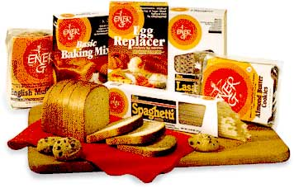
Low-protein products - Italy

Slide 30


Slide 31
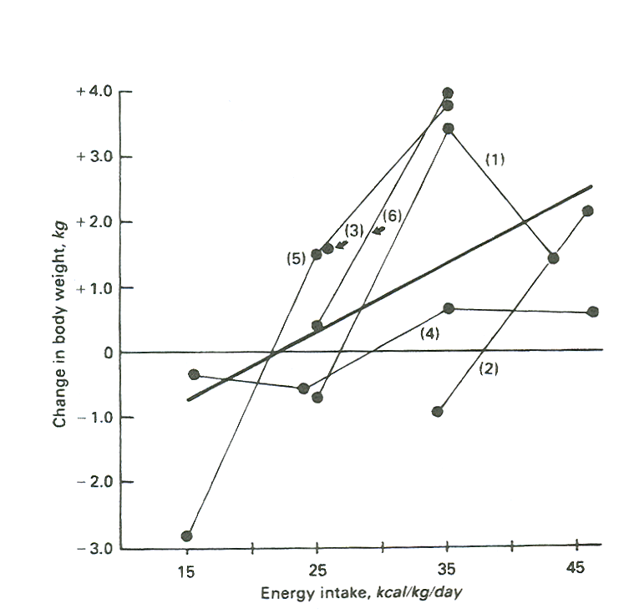
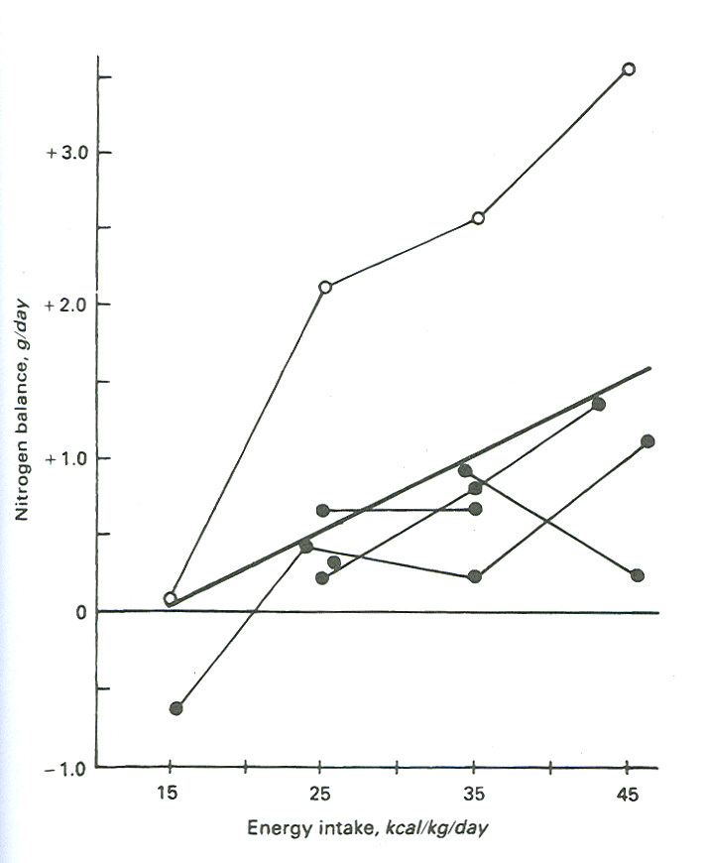
Kidney Int. 29, 734, 1986

