Slide 1

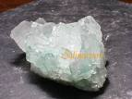
Translated from Polish to English - www.onlinedoctranslator.com
Salt – from macroeconomics to hypertension Wiesława Łysiak-Szydłowska prof. Ph.D. n. med..

Slide 2
Salt symbolism
Salt is a gift from God, it is holy
Thrown into the fire, it repels evil forces
Cleanses and protects food against spoilage
It symbolizes the female elements as opposed to sulfur which personifies the male elements
During baptism, it cleanses from original sin and makes it inaccessible to Satan
It means hospitality and good intentions
Spilling salt brings quarrels, misfortune (spilled salt under Judas' hand)

Slide 3
Symbolism related to fertility
According to the Romans "salax"A person with no salt is a person in love
English "salacious” – lustful
The Egyptians believed that eating salt aroused sexual desire
In France, the groom or bride carried salt in his pocket or shoes

Slide 4
Symbolism related to conservation
Preserving mummies in Egypt
In Judaism, immersing bread (God's gift) in salt preserves it
Sprinkling salt cleanses from original sin and gives wisdom.Sal Sapientia";
In Japanese tradition, salt destroys evil forces

Slide 5
The beginning of animal and plant breeding - agriculture - is also the beginning of a new function of salt as a commercial article, a monetary system, the creation of industries and a state monopoly.

Slide 6
China
6,000 BC - China - Yuncheng salt lake
China - salt in the regulation of lactic fermentation - soy sauce, fish sauce, kimchi vegetables
China - the first state salt monopoly

Slide 7
Egypt
Preserving meat and fish with salt
Edible olives soaked in brine
Natron and salt in the mummification process

Slide 8
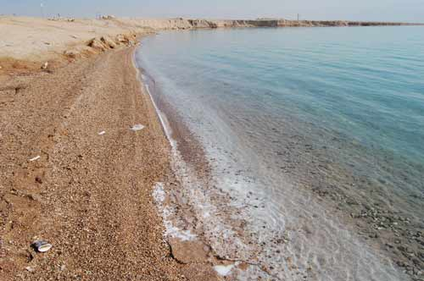
Dead Sea – salt deposits

Slide 9
Dead Sea – salt composition [g/L]
Depth [m] | Ca | Mg | On | K | Cl | Br | S.O₄ | HCO₃ | Sum
0 - 40 | 16.4 | 36.2 | 38.5 | 6.5 | 197 | 4.6 | 0.6 | 0.23 | 300
40 100 | 16.6 | 40.6 | 38.5 | 7.2 | 211 | 5.,2 | 0.5 | 0.22 | 319
100 - 400 | 17.2 | 42.4 | 39.7 | 7.6 | 219 | 5.3 | 0.4 | 0.22 | 332
On average 330 | 16.9 | 40.6 | 39.2 | 7.3 | 212 | 5.1 | 0.5 | 0.22 | 322
EJGE Paper-2004

Slide 10
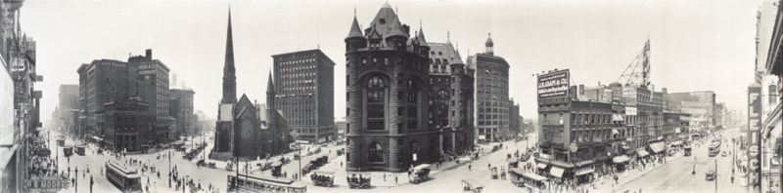
Salt from sea water

Slide 11
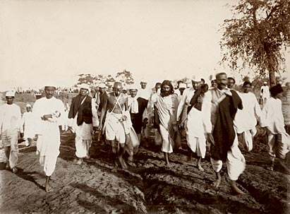
Murcia – Spain: salt production

Slide 12
Europe
Gauls – salt people – Greek hals(Halle, Hallstatt, Halicz)– mummies in the Halstatt mine 400 BC – inventors of cured ham
Romans – salt price control; subsidies for the poor to buy salt. Salt from seawater by evaporation (Ostia, Dead Sea)
Sal – salted products, paid with salt, e.g.soldier, salary, salsamentum(later garum) – fermented fish sauce (sardines)
Venice - salt trade was the basis of power in the Middle Ages, the Doge's navy controlled trade
Marco Polo - trade with China - pasta

Slide 13
Western Europe
Fishing - demand for salt, Labrador fisheries - herring and cod
Sauerkraut – choucroute – a delicacy of Marie Antoinette

Slide 14
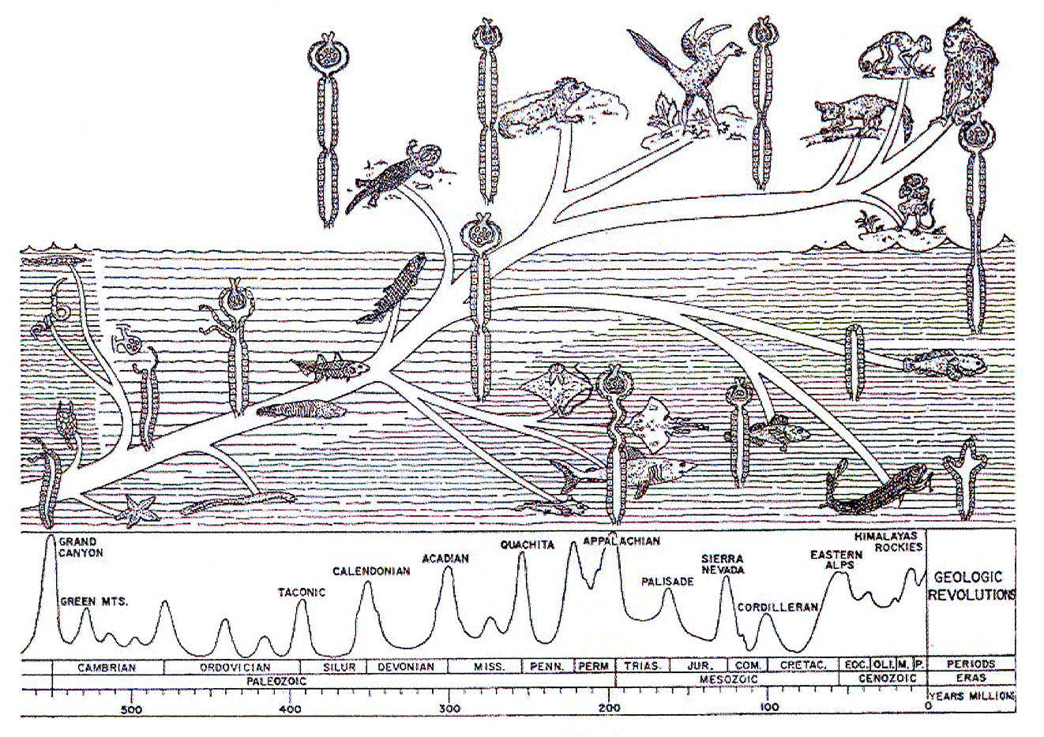
The Great French Revolution
the "gabelle" salt tax as tribute to the state
Lavoisier the collector

Slide 15
Poland
The mines in Bochnia and Wieliczka provide 30% of the Crown's annual income
Lithuanian god Roguszys - protector of pickles

Slide 16
America
Cities are built on animal trails leading to salt licks, e.g. Buffalo on Lake Erie (view from 1911)

Slide 17
Colonial policy
American Revolutionary War
- monopolization of salt supplies by Great Britain
- trade in salted products: meat, leather, fish (fight for fishing grounds with the French) restricted by Great Britain
- breaking the monopoly - production of salt from seawater by John Sears
- economic differences North/South salt production 12,000,000 bushels/2,300,000 bushels; abolition of slavery

Slide 18
Colonial policy - India
Britain's monopoly on salt production - destroying the local economy
Gandhi's protest march 1930 - passive resistance and breaking the ban on collecting sea salt
1931 signing of the Irwin-Ghandi Agreement - every citizen's right to salt
1947 - independence of India

Slide 19
Mahatma Ghandi - "salt" march

Slide 20
Is salt necessary?
Hunting tribes do not buy or produce salt
The Maasai drink the blood of farmed animals because it contains salt
Agricultural peoples on all continents search for salt

Slide 21
Sodium distribution in the body
Intracellular space – approx. 20 mM
Extracellular space – approx. 140 mM
Concentration gradient maintained by ATP-dependent enzymatic mechanisms

Slide 22
Sodium function
The main ion in the extracellular space - maintaining water in this compartment
Sodium management is closely related to the body's water management;
Nerve conduction: polarization and depolarization of cell membranes

Slide 23
H.W. Smith: Evolution of the kidney lectures. 1943,

Slide 24
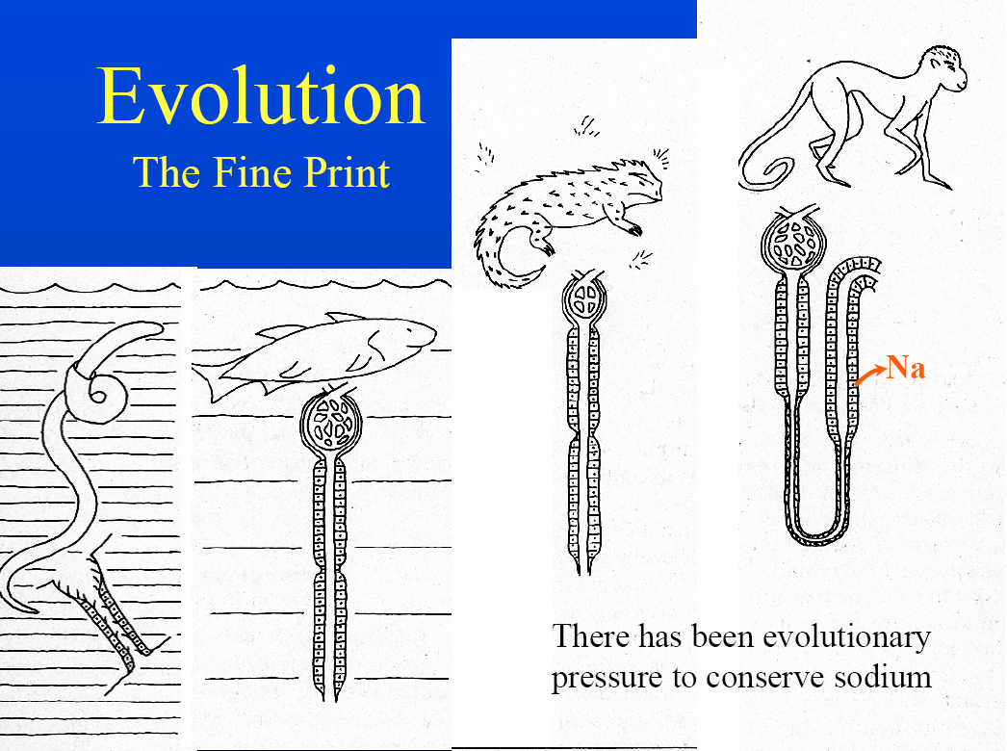

Slide 25
Kidneys - evolution
The development of kidneys made it possible to inhabit land waters.
Marine fish excrete urine with the same osmotic concentration as plasma. Similarly, some seabirds (albatrosses, penguins) and sea turtles have special glands around their eyes that excrete excess salt.
Seals and whales rarely drink; the salt in their diet comes from the bodies of the animals they eat; fish protein metabolized into urea, which must be excreted
Some animals only need metabolic water - they excrete very concentrated urine

Slide 26
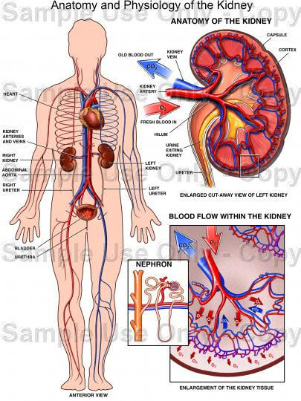
Kidneys are the most important organ in regulating mineral metabolism

Slide 27
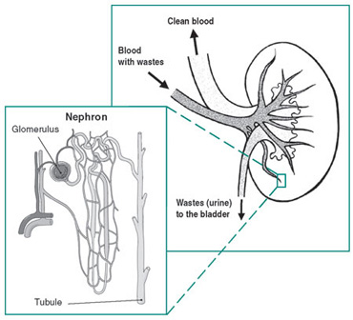

Slide 28
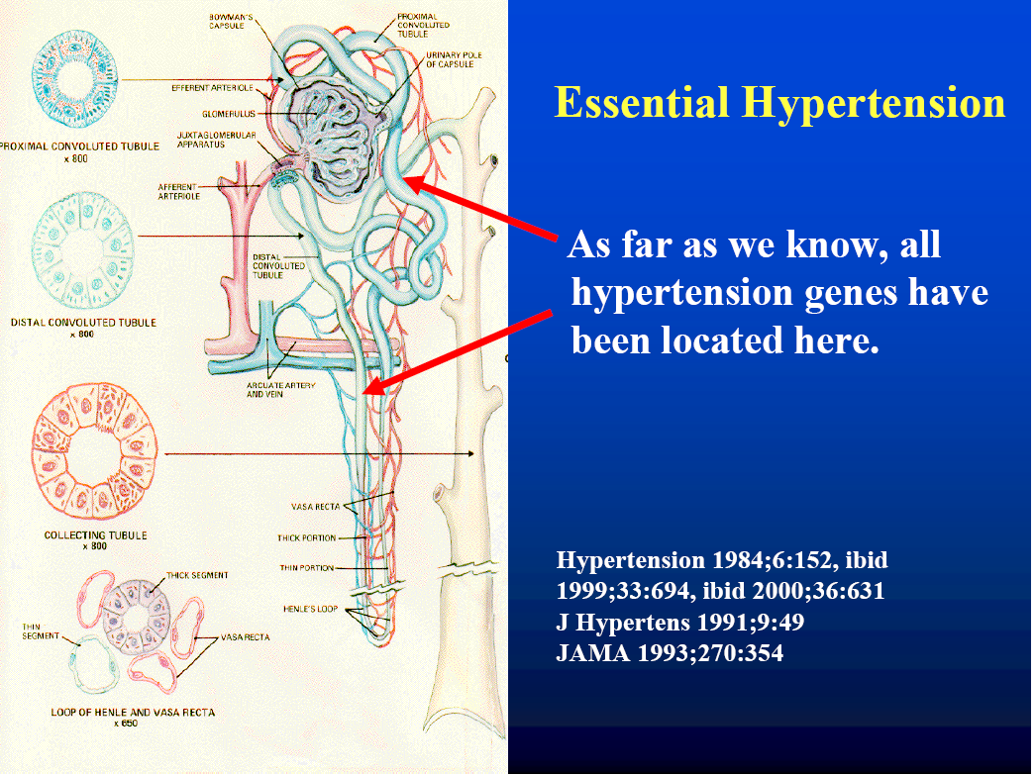

Slide 29
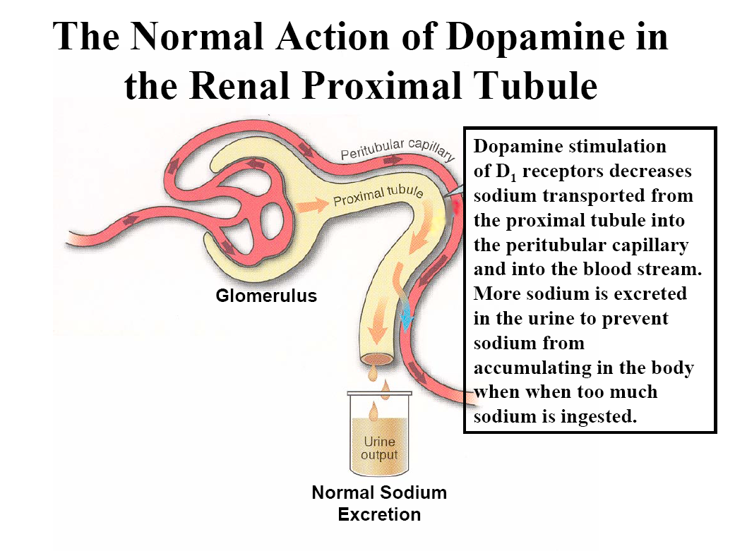

Slide 30
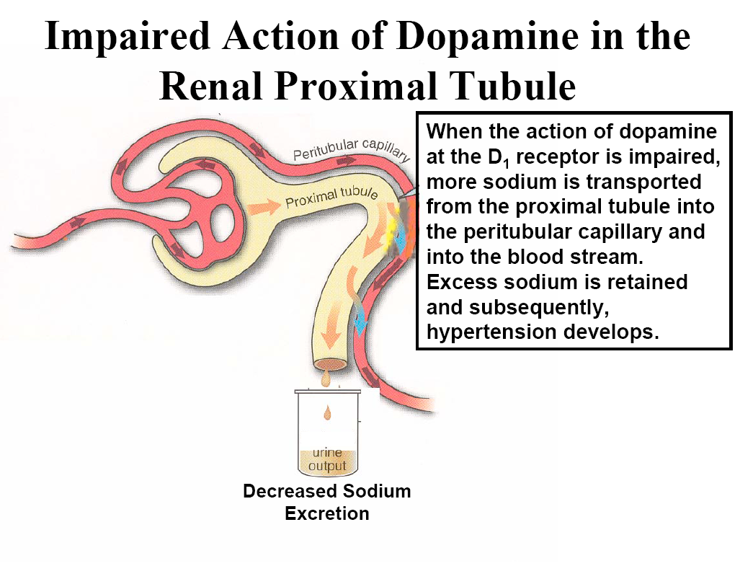

Slide 31
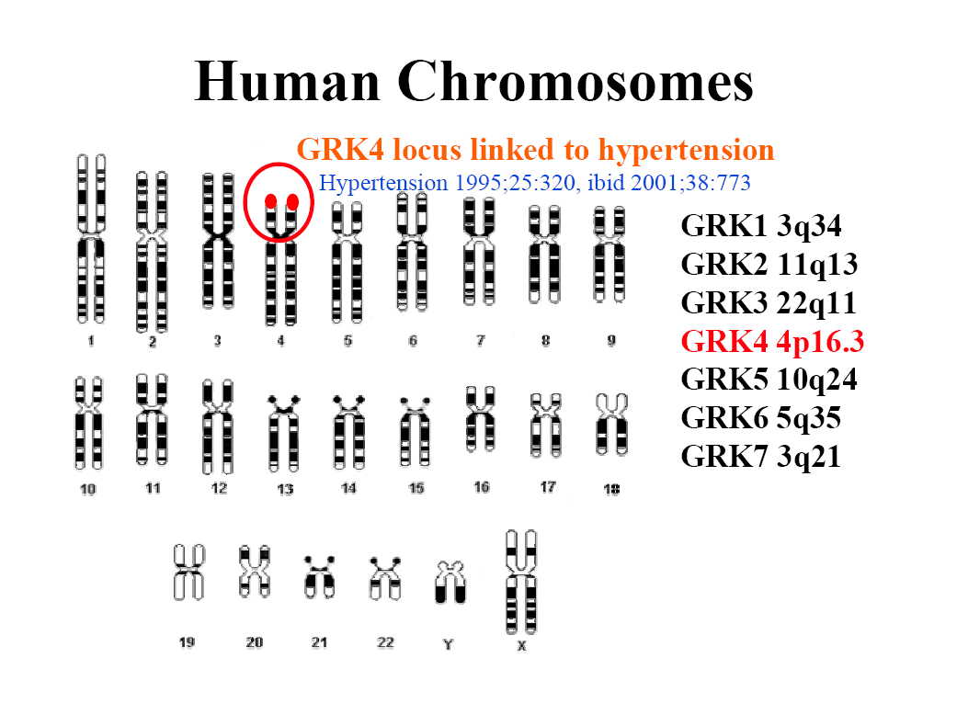

Slide 32
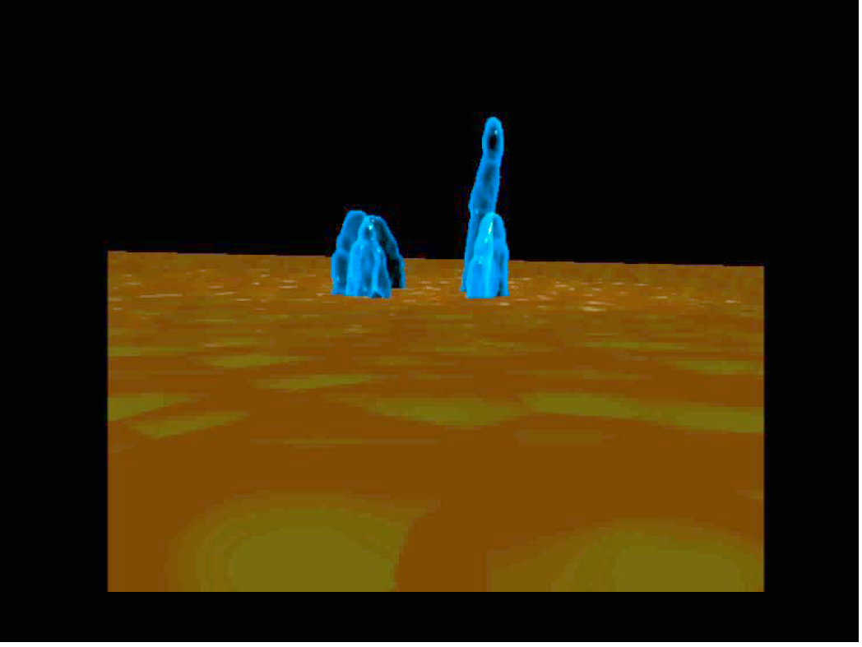

Slide 33
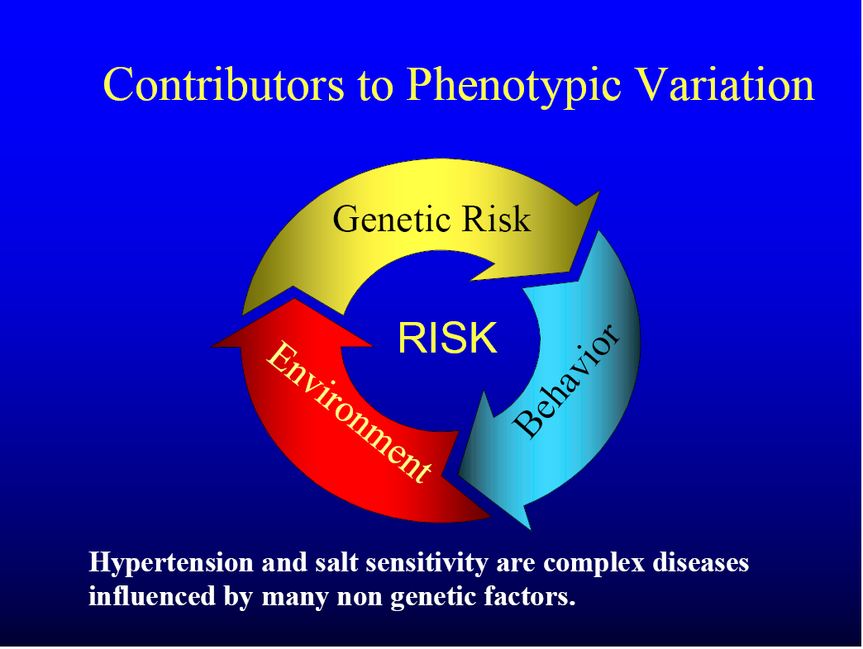

Slide 34
Salt sensitivity – 10% increase in blood pressure after a salt-rich meal
High sodium intake, regardless of hypertension, is a cardiovascular risk factor in obese people
Salt-sensitive men have the same risk of cardiovascular morbidity and mortality as people with hypertension
Morbidity and mortality in salt-sensitive normotensives are higher than in sodium-resistant normotensives (Lancet 1997, 350, 1734; Hypertension 2001, 37, 429)

Slide 35
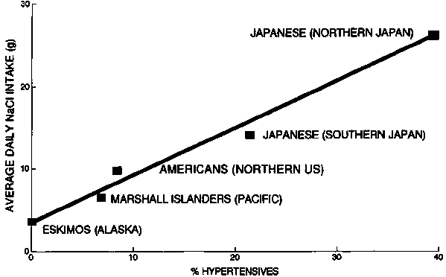

Slide 36
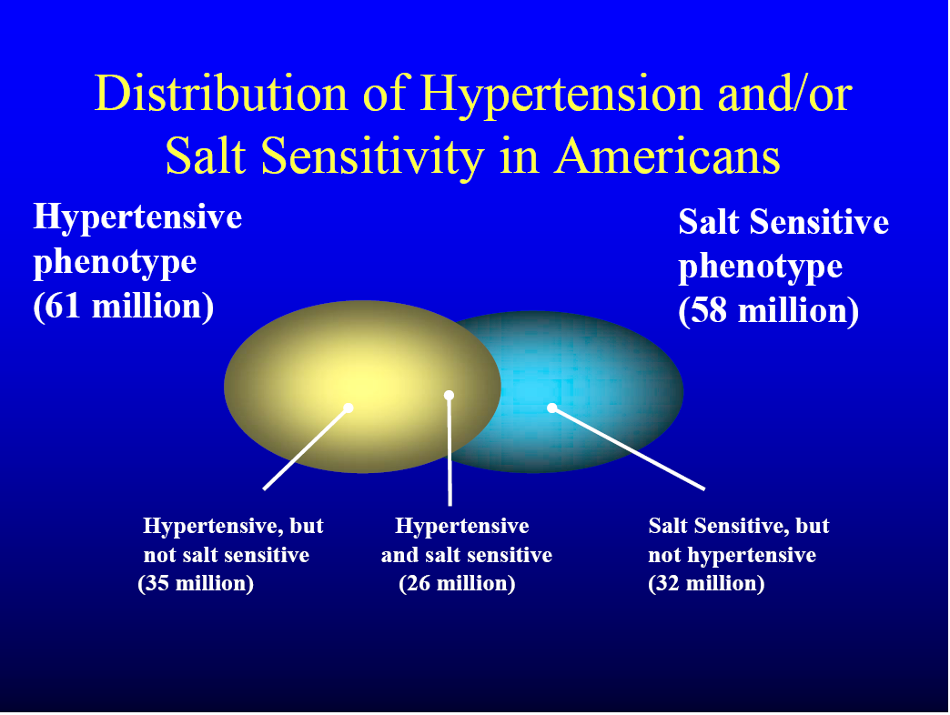

Slide 37
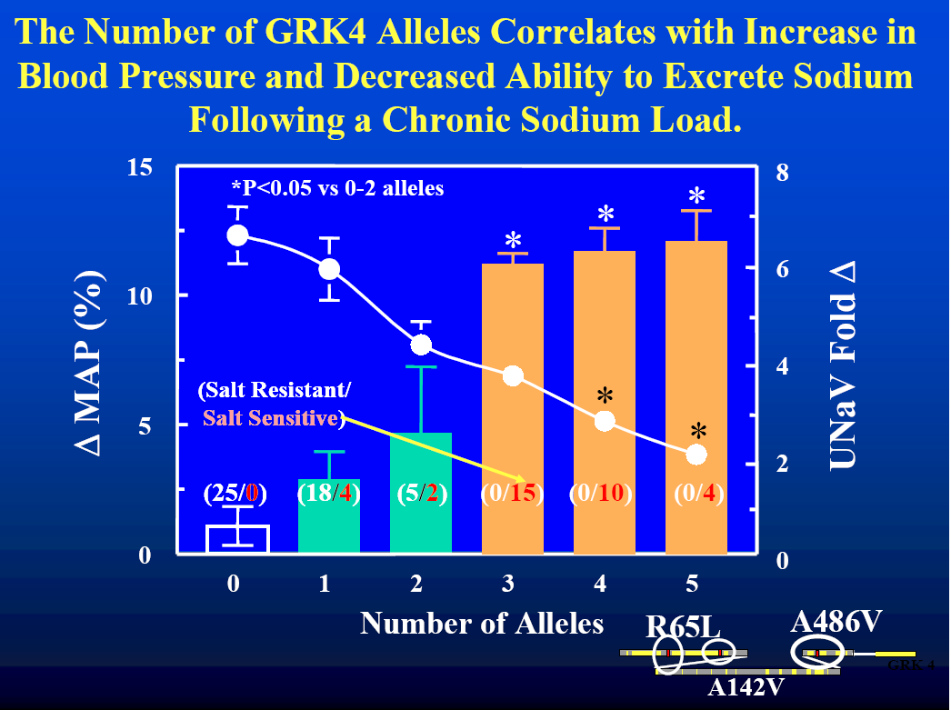

Slide 38
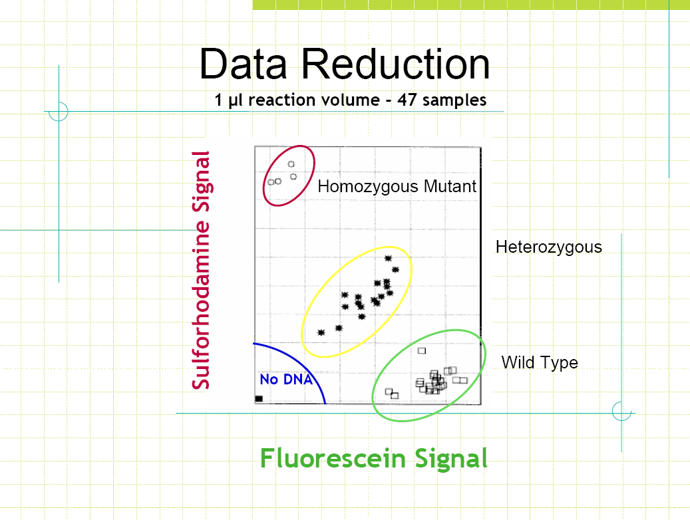

Slide 39
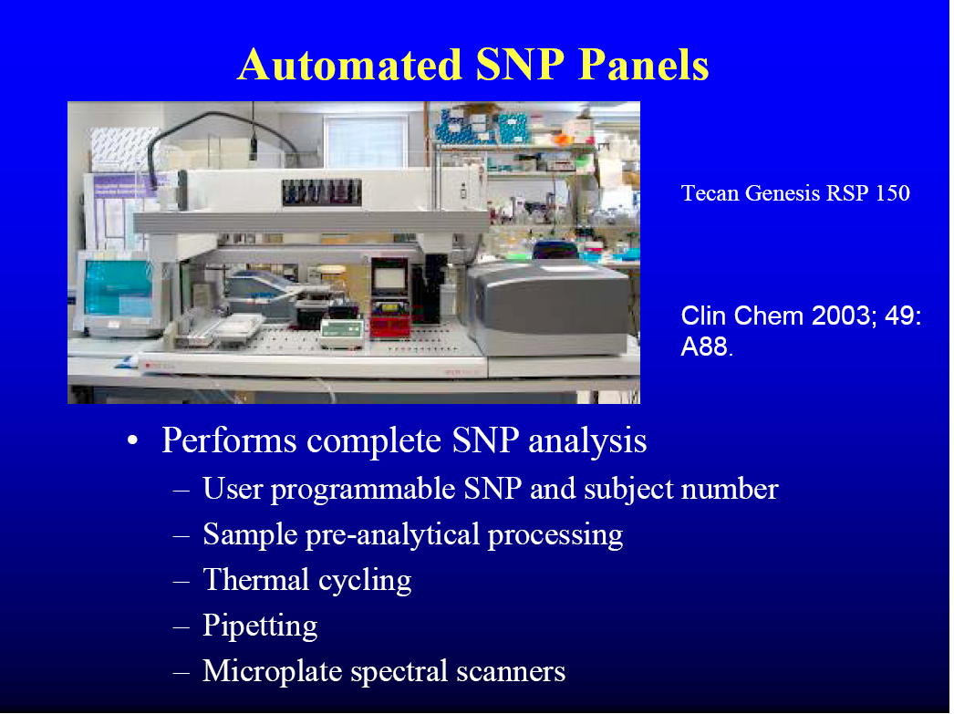

Slide 40
Dopaminergic regulation
75% of renal sodium excretion
Intestinal sodium transport
Brain appetite centers; active centers of the cardiovascular system
Secretion of hormones and humoral factors

Slide 41
Hypertension
Complex cardiovascular disease and not just elevated blood pressure
120/80 mm Hg

Slide 42
Classification of hypertension
Category | Pressure [mm Hg]
 | systolic | diastolic
Optimal | <120 | <80
Correct | 120-129 | 80-84
High correct | 130-139 | 85-89
Hypertension Grade 1 Grade 2 Grade 3 | 140-159 160-179 >180 | 90-99 100-109 >110
Isolated systolic hypertension | ≥140 | <90

Slide 43
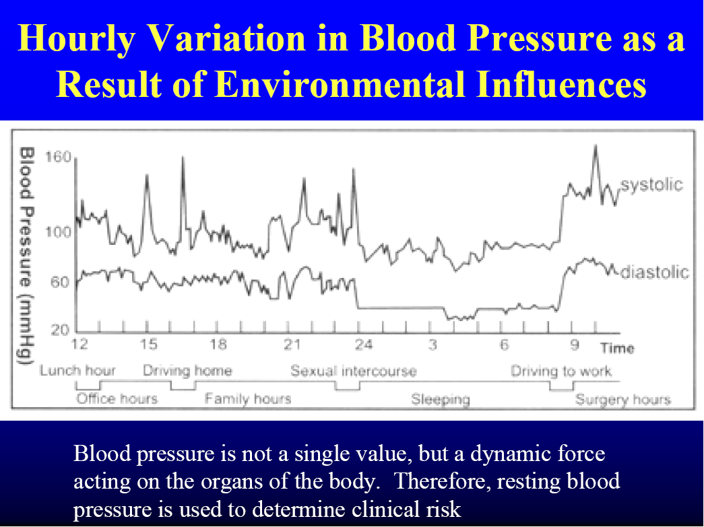

Slide 44
Primary (essential) hypertension
Complex genetic and environmental causes
It affects 25% of the adult population
30-50% of cases of essential hypertension are hereditary - purposeful genetic testing
Scientific research focuses on the kidneys as the organ responsible for maintaining blood pressure.

Slide 45
Main cardiovascular risk factors
Hypertension
Smoking tobacco
Obesity; BMI >30kg/m²
Lack of physical activity
Dyslipidemia
Diabetes
Microalbuminuria >20mg; GFR<60ml/min
Age (M>55 years; F>65 years)
Family history of early cardiovascular disease
(M<55 years; F<65 years)

Slide 46
Risk of cardiovascular disease
The higher the blood pressure, the greater the risk of heart attack, heart failure, stroke, blindness, and kidney failure
For a person aged 40-70, an increase in systolic blood pressure of 20 mmHg and diastolic blood pressure of 10 mmHg doubles the risk of cardiovascular disease over the entire blood pressure range between 115/75 and 185/115 mmHg

Slide 47
Benefits of lowering blood pressure
35-40% reduction in strokes
20-25% reduction in heart attacks
50% reduction in heart failure
Maintaining a drop in systolic blood pressure of 12 mmHg for 10 years saves the life of 1 out of 11 treated patients and 1 out of 9 in the case of concomitant cardiovascular diseases or organ damage.

Slide 48
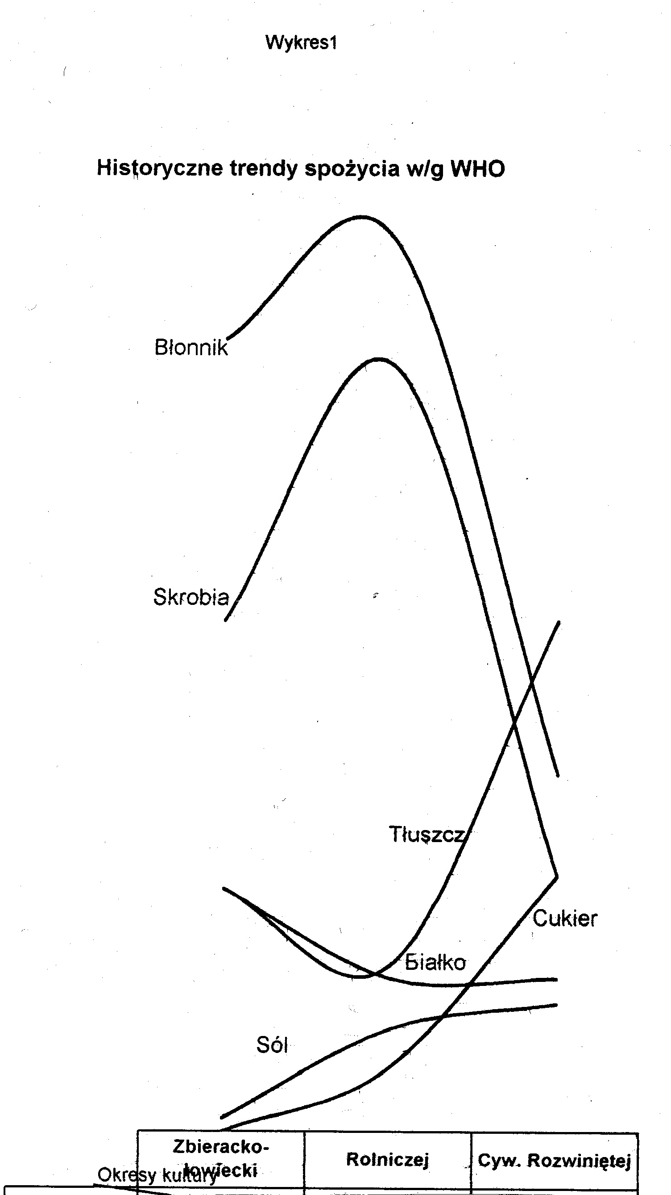

Slide 49
DASH diet – dietary approach to stop hypertension The purpose of the diet: reducing the supply of sodium, saturated fats, animal protein - lowering blood pressure Ann. Internship Med.. 2001, 135, 1019-1028

Slide 50
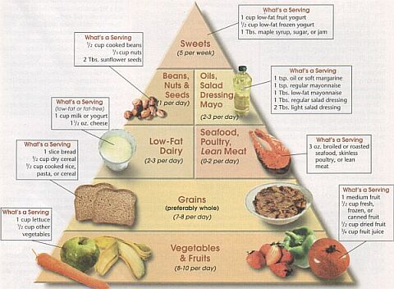
DASH pyramid

Slide 51
DASH diet (Dietary approach to stop hypertension) – level 2000 kcal/day
Products | Daily portions | Portion size
Cereals | 6-8 | 1 slice; 28 g groats, flakes ½ cooked (rice, pasta, groats)
Vegetables | 4-5 | 1 cup raw leafy greens ½ cup raw or cooked or juice
Fruit | 4-5 | 1 medium; ¼ dried ½ fresh, frozen, canned or juice
Low-fat dairy | 2-3 | 1 cup of milk or yogurt; 40 g of cheese
Lean meat | 6 or less | 28 g of meat, poultry or fish; 1 egg
Nuts, grains, legumes | 4-5/week | 1/3 cup of nuts 2 tablespoons of seeds or peanut butter ½ glass of legumes
Fats, oils | 2 - 3 | 1 teaspoon of margarine, vegetable oil; 1 tablespoon of mayonnaise
Sweets, sugar | 5 or less/week | 1 tablespoon of sugar; 1 tablespoon of jam ½ cup of sorbet; 1 glass of lemonade

Slide 52
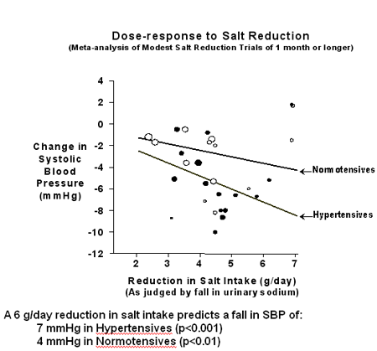

Slide 53
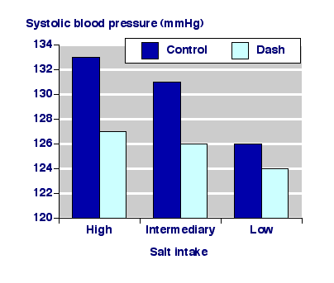

Slide 54
DASH study result changes in mm Hg
Group of patients | High supply of Na (150 mmol/d) | Low supply of Na (50 mmol/d)
Hypertensive Normotensive | -6.6 -5.4 | -11.5 -7.1
Women Men | -6.6 -5.1 | -10.5 -6.8
BMI >30 BMI<30 | -.6.0 -5.8 | -7.8 -9.5
Education <Average >Average | -5.6 -5.7 | -8.5 -8.7
Ann. Intr. Med.. 2001

Slide 55
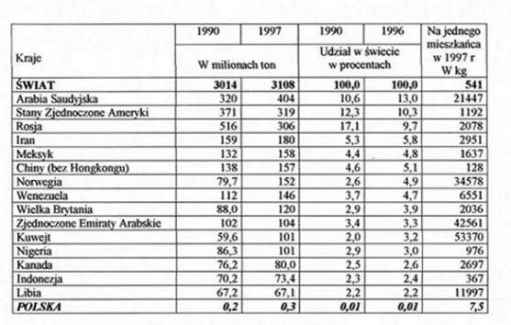
World salt production [GUS]

Slide 56
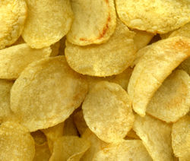
Fast food

Slide 57
Lifestyle modification
Type of modification | Recommendations | Lowering SBP
Weight reduction | BMI 18.5-25.0 | 5-20 mmHg/10 kg
DASH diet | A diet rich in vegetables and fruits; lowering fat consumption | 8-14 mmHg
Limit sodium intake | No more than 2.4 g sodium (6 g salt) | 2-8 mmHg
Physical activity | Regular aerobic exercise 30 min/day | 4-9 mmHg
Limiting alcohol consumption | No more than 2 drinks/day (M), no more than 1 drink/day (K) | 2-8 mmHg

Slide 58
Atherogenicity and thrombogenicity coefficients
some products.
Product | I.A | IT
Butter | 2.03 | 2.07
Hardened margarine | 0.56 | 1.26
PUFA margarine | 0.35 | 0.53
Sunflower oil | 0.07 | 0.28
Beef | 0.72 | 1.06
Pork | 0.60 | 1.37
Chicken | 0.50 | 0.95
Mackerel | 0.28 | 0.16
WG Human Nutrition

Slide 59
Salt sources
Preserved food | 77%
Natural occurrence | 12%
Adding at the table | 6%
Adding while cooking | 5%

Slide 60
Sodium restriction steps (1 g Na = 2.5 g NaCl)
Na supply | Limit
5 - 6 g | -
4 g | No table salt
3 g | No chips, crackers, olives, pickles
2 g | No salting of dishes or food preserved
1 g | Cno bread salted
0.5 g | Only in hospital

Slide 61
Sodium and potassium content in some foods. ________________________________________________
Product Sodium Potassium
__________________ in mg/100 product_______________
cow's milk 2.0% 45 145
low-fat cottage cheese 32 177
whole egg 141 133
pork loin 42 343
beef tenderloin 52 382
Herring in oil 238 243
smoked bacon 78 163
buckwheat groats 3 443
4-egg pasta thirty 212
Rye bread 466 116
white beans 19 118
horseradish 9 677
Red cabbage 11 269
parsley root 49 562
potatoes 7 557
tomatoes 8 282
apples 2 134
oranges 3 183
hazelnuts 2 616

Slide 62
How to reduce the amount of sodium in your diet
Fresh or frozenvegetables instead of canned ones
Fresh meatinstead of preserved (smoked, cured)
Limiting the consumption of smoked and cured meats
Avoiding highly processed food
Draining preserved products from the brine
Choosing low or reduced sodium products

Slide 63
Low-sodium products
Sodium-free or salt-free products– less than 5 mg/serving
Very low sodium– 35 mg/serving or less
Low sodium– 140 mg/serving or less
Low sodium meal– 140 mg/1000g or less
0 reduced sodium content– at least 25% less sodium than a standard meal
Light– 50% less sodium than in the standard product
No salt– no salt added in the production process

Slide 64
What to replace salt with?
Low sodium salt(potassium!!!)
Lemon juice, tomatoes
Garlic, chives
Herbs spices
vanilla, cinnamon
cloves, cumin, dill, black cumin
parsley leaves, celery, lovage, tarragon, marjoram, sage, allspice, bay leaf
Monosodium glutamate, ready-made spices such as vegeta, vinegar, mustard, soy sauce, Maggi are not recommended

Slide 65
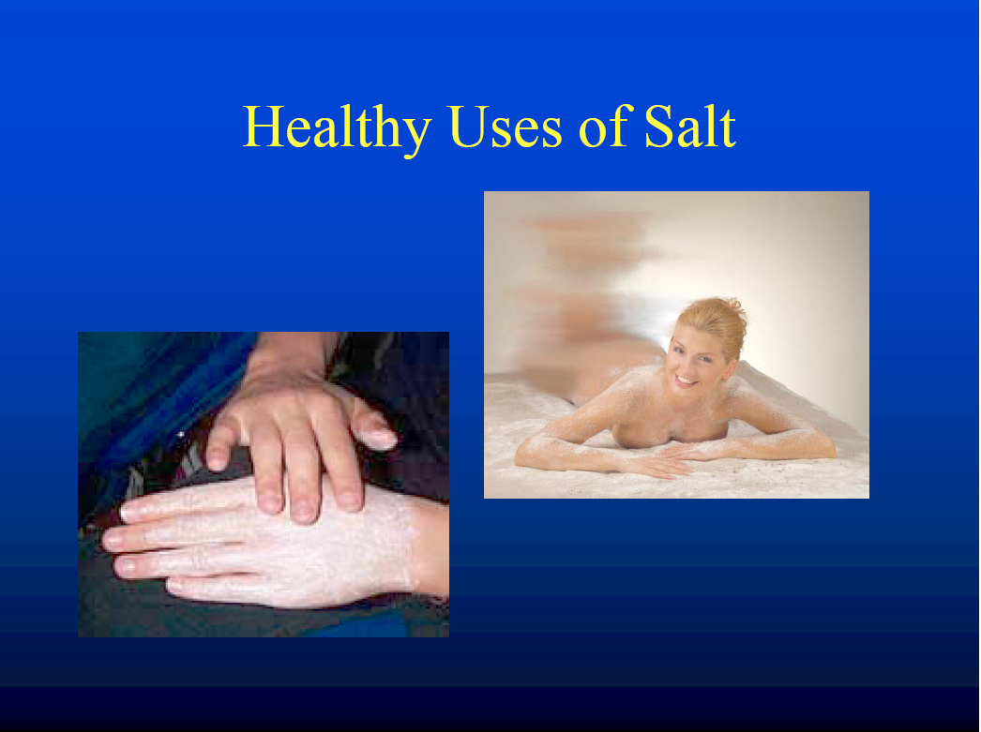

Slide 66
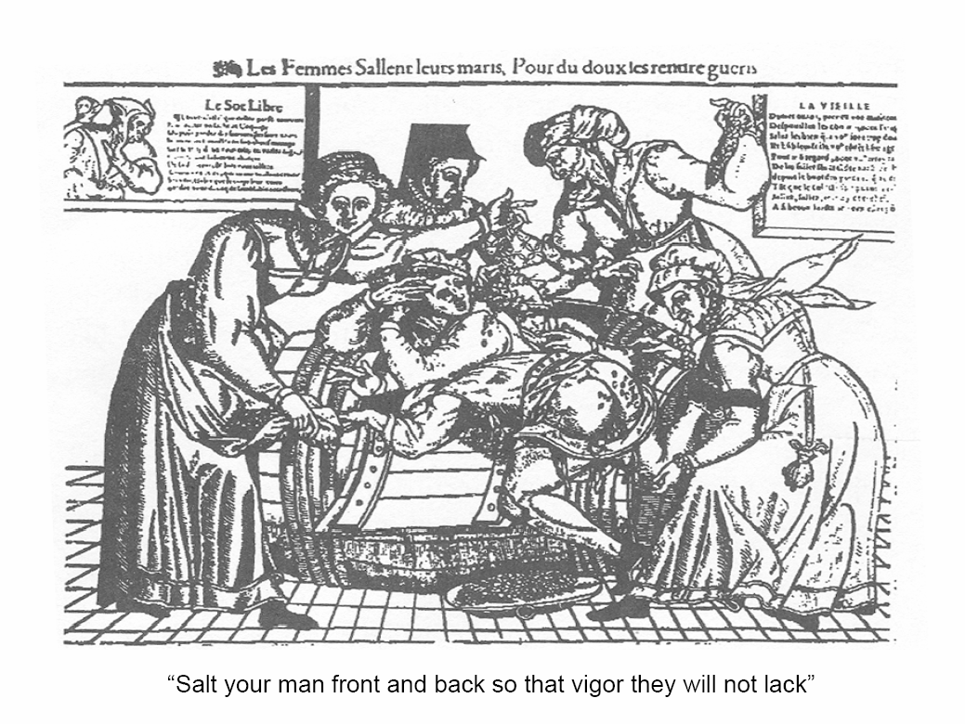

Slide 67
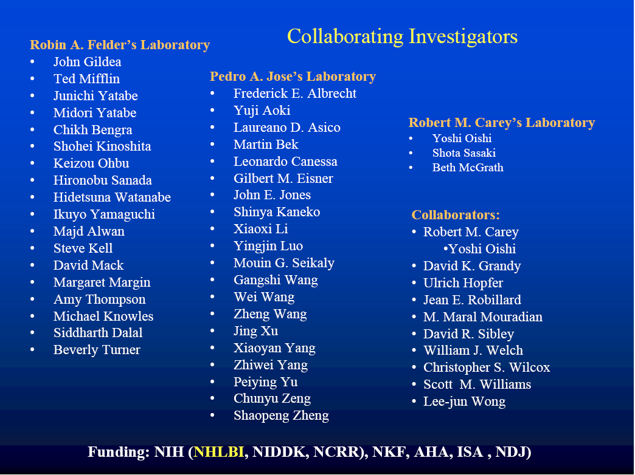

Slide 68
"The History of Salt” – Mark Kurlansky
"Diet – an underestimated method of treating hypertension” – Danuta Gajewska, SGGW

Slide 69
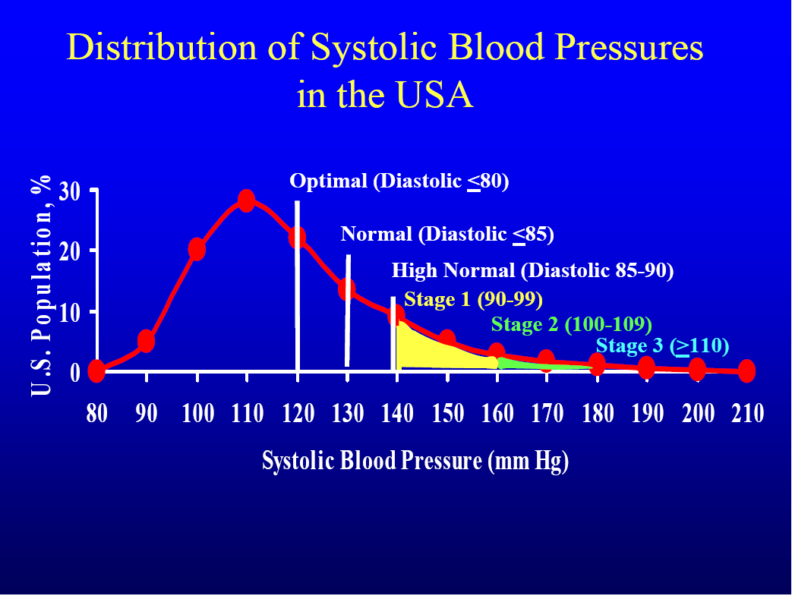

Slide 70
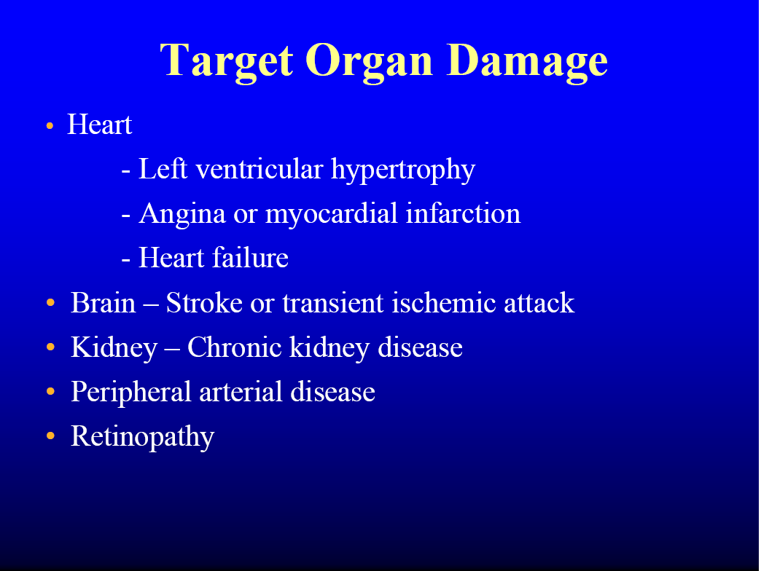

Slide 71
