Slide 1

Translated from Polish to English - www.onlinedoctranslator.com
Normal pregnancy: diagnosis, course
Antenatal care for a pregnant woman

Slide 2

Prepared by: Anna Kuter
Literature:
Nursing in modern obstetrics and gynecology Celina Łepecka-Klusek Wydawnictwo Polskie PZWL Warszawa 2010
Pre-conception care Grażyna Stadnicka Wydawnictwo polskie PZWL Warszawa 2009
Obstetrics and Gynecology Grzegorz H. Breborowicz
Polish Publishing House PZWL Warszawa 2007
Care for a pregnant woman Agnieszka M Bień Wydawnictwo Polskie PZWL Warszawa 2009

Slide 3
Diagnosis of pregnancy
Probable symptoms:
stopping menstruation,
nausea, tendency to vomit,
change in appetite,
dizziness, fainting,
frequent urination,
constipation,
changes in the reproductive organs, mammary glands,
new stretch marks, white line pigmentation.

Slide 4
Pregnancy symptoms
Certain symptoms:
Ultrasound confirmation the presence of a fetal sac,
Visibility of fetal heart rate during ultrasound examination
Feeling fetal parts or fetal movements

Slide 5
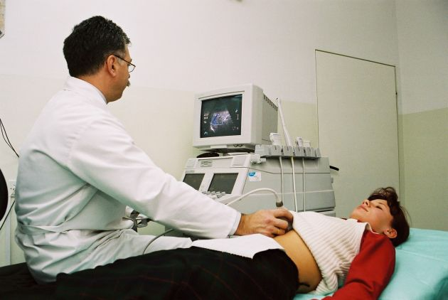
Ultrasound examination

Slide 6
Changes in the sexual organs
Vaginal symptoms:
Chadwick
Increasing the stretchability and width of the vagina,
Velvety roughness of the vagina,
Noble's sign

Slide 7
Changes in the sexual organs
Uterine symptoms:
Enlargement of the corpus and entire uterus;
Change in consistency,
Piskack's sign
Hegar's sign

Slide 8
Changes in the sexual organs
Changes in the cervix:
- Bruising,
loosening,
The stick-towel symptom
Mucus change.
Increased discharge.
Changes in the mammary glands.

Slide 9
Systemic changes during pregnancy
They are an expression of the mother's body adapting to the increased requirements that are determined by the growth and development of the fetus

Slide 10
Circulatory system
Increase in circulating blood volume by 30 – 40%
Increase in cardiac stroke volume (from 64% to 70% in mid-pregnancy)
Increase in heart capacity (on average from 4.5 to 6.0 liters per minute)
Increase in pulse rate (from 70 bpm before pregnancy to 78 bpm in the 12th week of pregnancy, maximum approx. 85 bpm in advanced pregnancy.
Greater blood flow through organs, especially the uterus, kidneys and skin
Blood pressure does not change during normal pregnancy
Venous pressure in the upper limbs does not change, but increases in the lower limbs.

Slide 11
The hematopoietic system
Increased plasma volume
An increase in the number of red blood cells (however, it is proportionally smaller than the increased amount of plasma, leads to a decrease in hemoglobin concentration and a lower hematocrit value, which causes a relative physiological anemia,marked most clearly around 28 - 32 weeks of pregnancy.

Slide 12
The hematopoietic system
Increase in white blood cell count (7,000 to 10,000)
The sedimentation rate of blood cells and the activity of the coagulation system increase
Physiological anemia and blood hydration should not result in lowering the hemoglobin concentration below 11.0g/% and red blood cells below 3.5mil in 1mm3

Slide 13
Urinary tract
Under the influence of progesterone, the muscles of the walls of the urinary bladder, ureters and renal pelvis relax, which may cause urine stasis in the urinary tract, reverse flow of urine (reflux) and promotes urinary tract infections.
Increases glomerular filtration and reabsorption of sodium and water.
Lower relative density of urine.
Increased excretion of glucose, amino acids, proteins and water-soluble vitamins.
Higher concentrations of glucose and amino acids cause more frequent urinary tract infections.
Proteinuria in amounts up to 300 mg is not considered a pathological symptom

Slide 14
Digestive system
Increased secretion of salivary glands and lower salivary pH.
Hyperplasia of blood vessels in the periodontium
Reducing the tension of the muscles of the stomach and intestines (nausea, flatulence, constipation)
Relaxation of the gastric cardia causes the regurgitation of food content (gastroesophageal reflux) and the development of heartburn.
Slowed down gastrointestinal motility.

Slide 15
Digestive system
Increased secretion of salivary glands and slowing down intestinal motility (better digestion).
Reduced peristaltic activity of the large intestine (secondary absorption of water - may lead to constipation).
Decreased muscle tone of the gallbladder and its ducts leads to bile retention (due to the action of progesterone, bile stasis may develop in the intrahepatic bile ducts).- cholestasis

Slide 16
Respiratory system
Changing the breathing pattern from costal to diaphragmatic.
Increasing lung capacity and gas exchange.
As a result of the increase in inspiratory capacity and respiratory volume, cardiac output also increases (approx. 40% at the end of pregnancy).
The pregnant woman's increased demand for oxygen is compensated by increased lung ventilation.
At the end of pregnancy, half of a pregnant woman's oxygen requirement is devoted to meeting the needs of the fetus.

Slide 17
The osteoarticular system
The increase in the elasticity of connective tissue and collagen fibers due to the action of relaxin and steroid sex hormones causes increased mobility in the pelvic joints.
The growth of the uterus changes the location of the center of gravity of the body - the lumbosacral curvature increases, the tension of ligaments and muscles in the middle and lower sections of the spine increases.

Slide 18
Skin
Skin changes are the result of excessive pigmentation due to the deposition of pigment - melanin on the breast nipples and in the alba line of the abdomen.
Brown spots may appear on the face (chloasma gravidarum)
Stretch marks appear during pregnancy.

Slide 19
Metabolism
The basic metabolic rate increases by 20-25% (this is a condition for the proper development of the fetus and the adaptation of the pregnant woman's body).
Energy needs gradually increase - at the end of pregnancy they are higher by approximately 500 kcal per day than at the beginning of pregnancy.
The increase in metabolism increases the demand for nutrients.

Slide 20
Endocrine organs
Pituitary gland - the secretion of tropic hormones from the anterior pituitary lobe (STH, ACTH, TSH) increases, and oxytocin is stored in the posterior lobe, the activity of which increases significantly during pregnancy.
Ovary - during the first three months of pregnancy, their volume increases significantly under the influence of chorionic gonadotropin.
Thyroid function increases - it is a consequence of increased iodine loss during renal filtration.

Slide 21
Endocrine organs
Parathyroid glands - their activity increases (increased secretion of parathyroid hormone, which influences the increased absorption of calcium in the digestive system).
The secretion activity of the adrenal cortex increases (the concentration of free cortisol in the blood serum increases
An additional endocrine gland appears - the placenta, which produces protein hormones (chorionic gonadotropin - hCG, placental lactogen - hPL, placental corticotropin and thyrotropin, and steroid hormones: progesterone and estrogens.

Slide 22
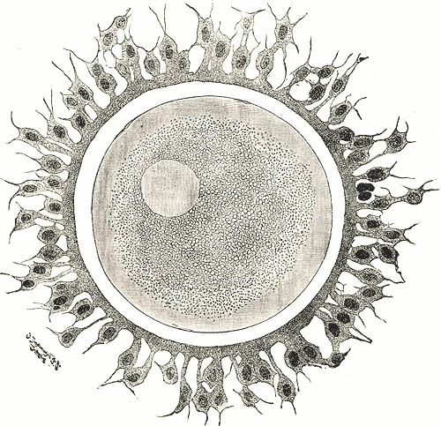
The course of physiological pregnancy

Slide 23
A child's development before birth is divided into three periods
Implantation period (from fertilization to the 11th day of pregnancy).
Embryonic period (from complete implantation to the end of the 7th week).
Fetal period (from 8 weeks to birth).

Slide 24
Care for a pregnant woman
The list of recommended preventive services, diagnostic tests and medical consultations performed in the case of physiological pregnancy is specified in the regulation, the so-called standard of perinatal care (Journal of Laws No. 187 of October 7, 2010, item 1259), which enters into force on April 7, 2011.

Slide 25
Antenatal care for a pregnant woman
The aim of this care is to undertake promotional, preventive and therapeutic activities aimed at:
mother and child health protection,
monitoring the proper course of pregnancy, early detection of complications and their treatment,
improving a woman's well-being,
development of parental characteristics.

Slide 26
Follow-up visits
According to the recommendations of the Main Board of the Polish Gynecological Society from 2005, regarding antenatal care during pregnancy, medical examinations should take place:
The first one to the 10th week of pregnancy (preferably between the 7th and 8th week), subsequent visits: between the 11th and 14th week; 15 – 20; 21 – 26; 27 – 32; 33 – 37; 38 – 39 and after 40 weeks.
(Calendar room)

Slide 27
First follow-up visit
During the first visit, more time should be devoted to the pregnant woman in order to recognize and present to the patient the general conditions related to her health and determine possible threats to the development of the fetus, based on a carefully collected interview combined with a general and obstetric examination.

Slide 28
Elements of an interview
Obstetric interview (facts related to the current pregnancy and obstetric history).
Gynecological interview (data on menstruation, sexual life, information on vaginal discharge, sphincter function, cervical smear, previous surgeries within the reproductive organs).

Slide 29
Elements of an interview
General history (developmental diseases, organ diseases, previous surgeries, focal inflammatory processes, chronic infectious diseases, mental diseases).

Slide 30
Examination
Skin
mouth
Thyroid gland
Lymphatic vessels
Eye
Mammary glands
Respiratory system, circulatory system
Abdominal integuments
Structure of the bony pelvis

Slide 31
Gynecological examination
Preparation:
explanation of the essence of the study,
informing about the need to urinate and wash.
help in positioning yourself correctly in the chair

Slide 32

Gynecological examination, engraving from 1822

Slide 33
Stages of gynecological examination
Viewing (abdominal and genital organs)
Examination in specula
Bimanual examination combined
Movie

Slide 34
Cytological and bacteriological examination during pregnancy
Collecting a smear from a pregnant woman should ideally be performed:
during the first visit (if it was not collected during the preconception period),
at least 48 hours after using the vaginal pessary and the last intercourse

Slide 35
Cytological examination
Currently, cytological evaluation of cells originating from the cervical epithelium is performed using the Bethesda system. This system was introduced as a cytological examination method in 1988. The test results are presented in a descriptive manner. It involves specifying the morphotic elements present in the smear, both dysplastic or atypical cells, as well as components corresponding to particular types of infection.

Slide 36
Cytological examination
Historically, the primary system for grading cytological smears was the Papanicolau classification. It is based on a five-point numerical scale. In Poland, it is still used in parallel with the Bethesda system.

Slide 37

One of the best on the market in Poland is the Cervex-Brush toothbrush developed by Rovers.
It allows you to collect cells from the disc and the cervical canal (from the border of the epithelia).

Slide 38
Procedure in the event of an abnormal result in a pregnant woman
lSIL (in histopathological examination CIN 1 - repeat the smear every 12 weeks.
HSIL (CIN 2 / CIN 3) – repeat the smear every 8 weeks.
Colposcopy every 8 weeks by the same doctor
Biopsy when the colposcopic image or smear undergoes unfavorable changes

Slide 39
In the case of cervical cancer in a pregnant woman, the treatment depends on the trimester of pregnancy and the stage of pregnancy

Slide 40
Bacteriological examination
Degrees of vaginal cleanliness according to Mau of Hauerlin:
I degree (numerous lactobacilli)
Stage II (lactic acid bacteria and individual bacteria and white blood cells)
Stage III (few lactobacilli, numerous bacteria and a large number of blood cells)
IV degree (no acid-producing bacilli, bacteria, trichomonas vaginalis and fungi)

Slide 41
Preventive visits in advanced pregnancy
The obstetric examination includes an assessment of:
Bone pelvis
The size and shape of the abdomen,
Mammary glands and nipples,
skin condition,
The condition of the lower limbs,
Fetal heart activity,
Mother's body weight, heart rate and blood pressure

Slide 42
Regardless of the established follow-up schedule, the woman should be informed that she should see a doctor if:

Slide 43
Bleeding or spotting from the genital tract
Constant abdominal pain
Increased amount of vaginal discharge
Constant, severe headache
Blurred vision
Swelling that does not go away after rest
An increase in body temperature above 37.5*C
No fetal movement felt for the last 6-8 hours

Slide 44
Additional tests during pregnancy
Determination of blood group and Rh factor
Wr, at the beginning and end of pregnancy
HIV, HCV testing, toxoplasmosis testing
Blood count every month
Urine test every month
Blood glucose concentration in the first trimester of pregnancy
Ultrasound between 9 and 12 weeks of pregnancy, 18 -22, 29 - 32 weeks of pregnancy
Glucose tolerance test between 24 and 28 weeks of pregnancy
Presence of Hbs antigen in the third trimester of pregnancy
Vaginal culture for GBS

Slide 45
Prenatal diagnosis
It involves prenatal assessment of fetal development.
Prenatal diagnosis of genetically determined diseases includes screening tests performed in each pregnancy and diagnostic tests performed in high-risk pregnancies.

Slide 46
Methods of prenatal diagnosis
Non-invasive procedures (ultrasound, biochemical tests of fetal markers in the mother's blood serum, tests of fetal cells in the mother's blood).
Invasive procedures (amniocentesis, chorionic villus sampling, fetal blood collection, fetal tissue collection).

Slide 47
Prenatal testing
Indications for prenatal diagnosis:
- age of the pregnant woman over 35 years of age
Father's age over 55
Incorrect screening test result
Carrying a structural chromosome aberration by one or both parents
A loaded interview
Indications of a psychological nature

Slide 48
Prenatal diagnosis methods are divided into:
Invasive procedures (amniocentesis, chorionic villus sampling, fetal blood collection, fetal tissue biopsy, coelocentesis, embryoscopy)
Non-invasive procedures (ultrasound, biochemical tests of markers in the mother's blood serum, examination of fetal cells in the mother's blood)

Slide 49
Non-invasive procedures
Ultrasound screening for Down syndrome and trisomy of chromosome 18,
involves the detection of nuchal translucency, measured by ultrasound in the fetus between the 11th and 13th week of pregnancy. An additional marker is the absence or underdevelopment of the nasal bones in the fetus. This assessment is possible between the 11th and 20th week of pregnancy.

Slide 51
Non-invasive procedures
Biochemical testing of fetal markers in the mother's blood serum involves the determination of fetal proteins present in the mother's serum throughout pregnancy at specific concentrations.
- PAPP-A test, double test (10-14 weeks)
- Triple test (14-21 weeks)

Slide 52
Amniocentesis
Amniotic fluid collection under ultrasound guidance. It is usually performed between the 15th and 17th week of pregnancy. 15-20 ml of amniotic fluid is collected. The so-called early amniocentesis at 11-14 weeks.
Complications include: short-term fluid leakage, miscarriage, and fetal injury.

Slide 53
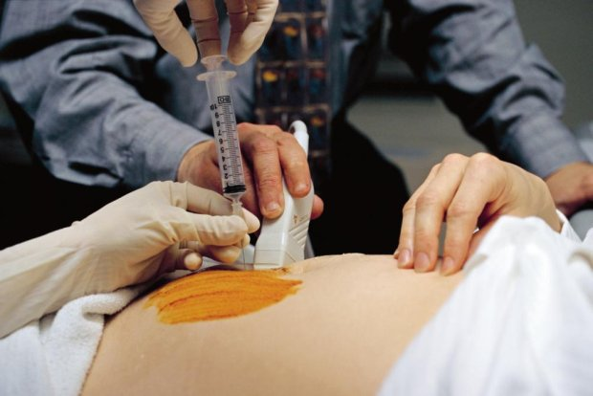

Slide 54
Chorionic villus biopsy
It is performed between the 9th and 12th week of pregnancy under ultrasound control. From 5 to 25 mg of chorionic villi are collected transabdominally or transcervically using a needle or catheter.

Slide 55
Cordocentesis
It involves puncturing the umbilical cord with a needle (through the pregnant woman's abdominal wall) and taking a blood sample.
This test is performed between the 17th and 18th week of pregnancy (and in some centers from the 12th week).
0.5 – 5 ml of umbilical cord blood is collected
Complications include bleeding from the injection site, fetal death, umbilical cord hematoma, and umbilical cord thrombosis.

Slide 56
Fetal tissue biopsy
Fetal tissue collection is derived from photoscopy. It is performed very rarely, most often when other tests fail.
Coelocentesis – involves transabdominal or transcervical aspiration of fluid from the extraembryonic body cavity.
Embryoscopy – direct viewing of the embryo through a fiberoscope.

