Slide 1
Anatomical and functional differences of developmental age
Dominika Karpińska
d.karpinska@powislanska.edu.pl

Slide 2

Clasification
Anatomic differences
Physiological and systemic differences
Pathological changes
Graphic: Google graphic

Slide 3
Musculoskeletal system
size of a child’s body, the head is large and heavy, balanced on a neck poorly supported by weak muscles and ligaments, The normal skull is approximately circular in cross-section, whereas many premature skulls develop elliptical cross-sections. This can mean that measurements of head circumference, used as a surrogate for brain volume, may overestimate volume. Head circumference is serially measured, as an abnormally enlarging head could indicate the development of hydrocephalous . Poor head growthmay indicate poor nutrition or neurological impairment.
the bones of all children have an important haematopoietic function, which in adults is limited to the red marrow of the ribs, sternum, vertebrae and proximal ends of the humerus and femur.
biomechanical maturation of the spine is a progressive process that only starts to resemble the adult spine after age 8–9 years old,

Slide 4
Musculoskeletal system
Fontanelles is the junction between the calvarial bonen , ossification has not reached the suture lines of the skull at birth . During parturition the calvarial bones of the neurocranium are displaced and may even overlap at the suture lines to allow passage of the head through the birth canal.
Upper limbs - are well developed and long compared to the neonatal lower limbs. The elbow is unable to fully extend at birth by about 15. The neonate has a relatively strong grasp reflex and is able to support its own weight within the first days of life.
Lower limbs -are under-developed and remain in a flexed and abducted position in the neonate. They appear bowed due to the relative immaturity of the medial head of gastrocnemius compared with the lateral. The general musculature for walking is also not well developed at this stage, giving a rather flat appearance to the buttocks.

Slide 5
Skin
infant subcutaneus tissue is 30%, and infant epidermis 20% thinner than in adults,
baby's body surface to volume/weight ratio is higher than that of adults,
fat tissue is higher in infants and less in adults, fat mass as a proportion of body weight is also higher in infants,
nails are soft and thin in childhood, hard and thick in adults;

Slide 6
Cardiovascular system - adult
average 5 litres of blood - 8 % of body weight,
cardiac output is approximately 5 litres/min,
80 % of circulation volume is in the systemic veins, right side of the heart, pulmonary circulation
deoxygenated blood returns to right atrium via the vena cavae, after pass through the right ventricle, the entire cardiac output passes via pulmonary arteries to the lungs, where is gas exchange performed. Oxygenated blood returns via the pulmonary veins to the left ventricle and allows entire cardiac output to enter the systemic circulation via the aorta;

Slide 7
Cardiovascular system - featus
gas exchange is provided by the placenta,
„duct dependent”,
adaptations:
- 2 umbilical arteries,
- umbilical vein,
- ductus venosus – in the liver
- foramen ovale – located between right and left atrium
- doctus arteriosus – conneting pulmonary atery and aorta

Slide 8
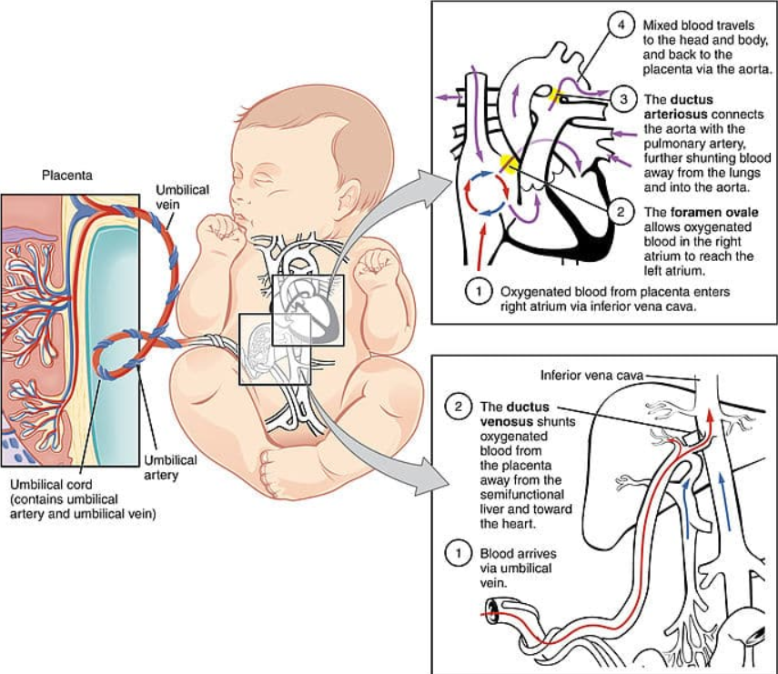
https://www.youtube.com/watch?v=EIfCa0OUbPA&ab_channel=RegisteredNurseRN
https://www.youtube.com/watch?v=v3HRUnPKFS8&ab_channel=ZeroToFinals
Graphic: https://teachmesurgery.com/cardiothoracic-surgery/general-principles/foetal-vs-adult-circulation/

Slide 9
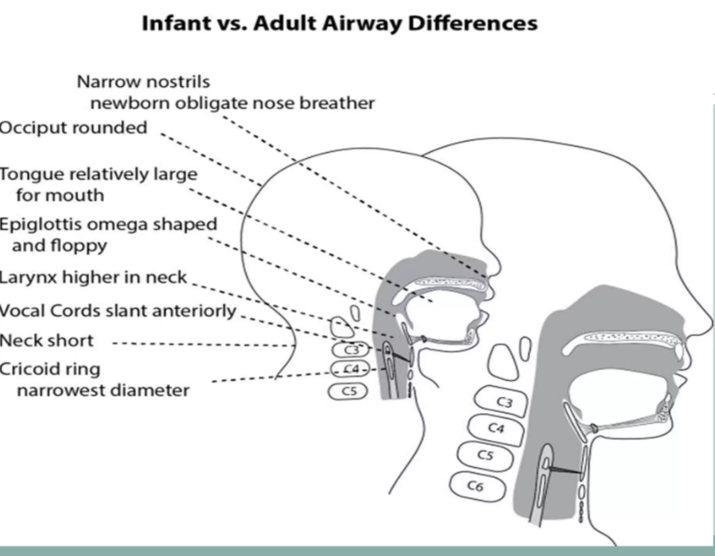
Airway and respiratory system
https://www.youtube.com/watch?v=d0hdatqGuHg&ab_channel=LecturioNursing

Slide 10
Gastrointestinal system
Oesophagus - at birth the oesophagus is approximately 8e10 cm long and possesses the same constrictions as that of the adult.
Abdomen - In the adult the abdomen is generally rectangular with the long axis vertical and the most common open surgical approaches are made through vertical incisions. In babies the abdomen is broader than it is long and open procedures are generally made through transverse supraumbilical incisions.
Stomach – is very small at birth and lies under the liver The stomach distends fivefold in the first few days once swallowing and feeds commence. Acid secretion begins during the first day of life. Its size increases rapidly from 30 ml in a term baby to 100 ml by the fourth week. An adult’s stomach has a capacity of approximately 1 litre

Slide 11
Gastrointestinal system
Small and large intestine
The small intestine has fewer and less marked circular folds than are seen in adults. The mesentery contains very little fat. The small intestine is between 300 and 350 cm long in a term baby. The small intestine lies in a more transverse orientation than in the adult due to the abdominal bladder. The large intestine is approximately 60 cm long and has a very poorly developed muscularis.
Liver - relatively large in the neonate being 4% of body weight compared to the adult where it constitutes only 2.5 - 3%.

Slide 12
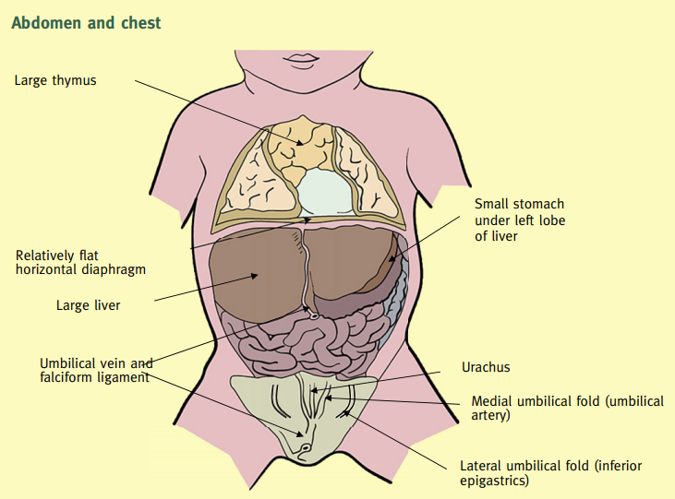

Slide 13
1. Size of the head - In infant head is bigger than body, in adulthood head is smaller than body
2. Tears - no tears in infacy
3. Cell division - during childhood cel division is faster then in adildhood
4. Integumentary system – apocrine glands in axilla, areola and genital are non functional and smmal from birth to preschool, activater at 8-10 tear
5. Hematological system – life span of RBC in adult 100- 120 daysand in infants 60 -80 days
6. Fluid and electrolytes – total body water in infants is 750 ml/kg and in adults 550 ml/kg body weight. In infants water constitutes about 75 – 80 % in adults 60 %

Slide 14
Genitourinary system
In children, the bladder is in the abdominal cavity when empty and full. The bladder is an abdominal organ and is less protected by the pelvis in young children. 6. at age the bladder begins to enter the pelvis major. In puberty the bladder takes its place in adults. It is inside the pelvis minor when the bladder is empty. Urinary bladder capacity is low and affected by stress in childhood. Urinary bladder capacity in adults is 500 cc maximum and is not affected by stress

Slide 15
Genitourinary system
Renal function in early infancy:
Glomerular filtration & absorption are low
Do not reach adult values until 1-2 years of age
-> inability to excrete excess water & solutes
Urea synthesis & excretion are slower
- Retain large amount of nitrogen & electrolytes
Hydrogen ion excretion, acid secretion & bicarbonate levels are lower
- Newborn is prone to develop severe metabolic acidosis
Kidneys are less able to adapt to sodium deficiencies & excesses
- Prone to dehydration & fluid overload
During infancy the bladder is emptied spontaneously
Gain control of detrusor & sphincter function by 4 years of age

Slide 16
Sourses
https://teachmesurgery.com/cardiothoracic-surgery/general-principles/foetal-vs-adult-circulation/
https://www.ncbi.nlm.nih.gov/pmc/articles/PMC6761775/
https://ijsrm.net/index.php/ijsrm/article/view/2696/2059
https://www.sciencedirect.com/science/article/abs/pii/S0263931913000033
https://www.nursingtimes.net/roles/older-people-nurses-roles/anatomy-and-physiology-of-ageing-4-the-renal-system-02-05-2017/

