Slide 1

Radiotherapy and chemotherapy
Translated from Polish to English - www.onlinedoctranslator.com
Basic issues

Slide 2
Radiotherapy – characteristics.
Radiotherapy involves the use of ionizing radiation to destroy cancer cells. The use of irradiation requires precise setting of the dose and radiation field to minimize damage to healthy tissues.
Radiotherapy is divided into teletherapy and brachytherapy, which differ in the type of radiation source used.
Radiation is divided into doses, i.e. fractions, the doses are the same every day, the radiation dose is expressed in Grays.

Slide 3
Teletherapy– the radiation source is away from the patient's body (generally 30-150 cm), beams of external rays are used, generated from medical accelerators (linear accelerators) or cobalt devices (cobalt bombs).
Radiotherapy at various stages of cancer development is used in more than half of patients and is a local or loco-regional treatment.
Brachytherapyinvolves placing the radiation source directly in the cancer tissue or in its immediate vicinity. Various radioactive sources are used in brachytherapy, e.g. iridium, cesium, palladium.

Slide 4
The goals of radiotherapy may vary:
Complete recovery and enabling the patient to live a normal life expectancy
Limiting the growth and spread of the disease, thereby enabling the person to live without symptoms for some time
Preventing the microscopic spread of the disease (as a complementary treatment)
Alleviating and/or reducing the severity of symptoms associated with advanced cancer.

Slide 5
The above symptoms include:: :
Pain caused by distant bone metastases
Bleeding from the tumor
Obstruction in the tumor area, major blood vessels, gastrointestinal area, kidneys, ureters, trachea
Spinal cord compression (compression by a metastatic lesion to the vertebrae of the spine or spinal cord)
Symptoms associated with brain metastases(applicationpalliative radiotherapy allows to extend survival time by approximately 3 months) is aimed at reducing neurological symptoms, steroids

Slide 6
6. Teamvena cavaupper j (set of symptoms resulting from the presence of a tumor in the mediastinum with pressure on the main bronchi and vessels in order to reduce the volume of the tumor)
7. Tumorssolid primary unresectable or recurrence after primarytreatment
(cause symptoms resulting from pressure on organs and pain, analgesic effect and reduction of pressure symptoms)
8. Primalskin cancer, advanced breast cancer or metastasesskin in the form of ulcers or tumors accompanied by heavy bleeding.

Slide 7
BRACHYTHERAPY – TYPES AND METHODS
Brachytherapy – possibility of administering a large dose of radiation in a strictly limited volume with the simultaneous effect of sparing healthy tissues
Brachytherapyinterstitial– involves the implementation of radioactive sources directly within the tumor. The method is usedconsistingin the first stage, on the direct introduction of the applicators and their control, and in the second stage, on the proper application of the appropriate radiation;

Slide 8
Brachytherapyintracavitary– involves introducing radiation sources into the body cavity, in the immediate vicinity of the tumor;
Systemic brachytherapy– involves the systemic administration of a radioactive substance. Classic indications are thyroid cancer, in which radioactive iodine is used, or in bone metastases, where radioactive strontium or samarium is used - quarantine

Slide 9
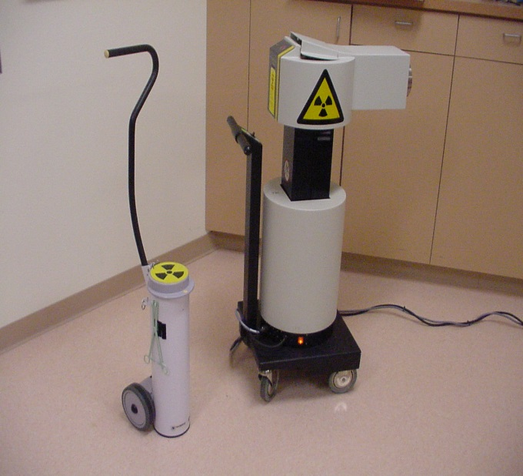
Indications for palliative brachytherapy:
1. Endobronchial in lung cancer, in the case of tumors located at the mouth of large bronchi. The goal is to obtain patency of the bronchial tree or stop bleeding.

Slide 10
2.Intraesophagealin esophageal cancer, in case of mechanical obstruction of the upper gastrointestinal tract. In this situation, in addition to the rapidly developing cachexia syndrome, pain symptoms occur. The goal is to obtain patency of the esophagus and reduce pain.
3. Vaginally in case of cancer recurrence in the vaginal stump or locally advanced cervical canceruterus.

Slide 11
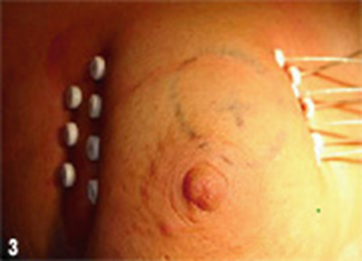
Side effects of brachytherapy
Of courseas with any therapy, some side effects may occur after brachytherapy.
First of allIt may all be bleeding at the injection site, as well as inflammation in the area around it.
SometimesBreast swelling may occur as wellskin peeling.
Dangerousmay be a complicationbreast abscess.

Slide 12
A late, serious side effect may be fibrosis of the subcutaneous tissue, which may lead to breast deformation, as well as to necrosis of fat tissue - but this happens very rarely.

Slide 13
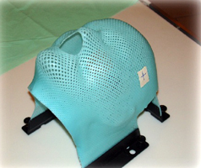
Treatment planning.
First, it is necessary to select the optimal radiotherapy method and then define the area planned for irradiation. The main part is the localization procedure, which is usually carried out using a surgical device simulator.

Slide 14
Depending on the area being treated, various CT and MRI scans can help determine the exact area of ​​the body requiring treatment. The entry fields of the beams are marked with various markers and small tattoos.
Special plastic or plaster molds or casts help the patient maintain accurate positioning during each fraction.

Slide 15
Way of treatment.
Teletherapy is conducted every day, from Monday to Friday except Saturdays and Sundays, for 1-2 to 8 weeks. The actual treatment takes 2-5 minutes, a lot of time is required to position the patient on the treatment table.
In everyday practice, fractional doses of 1.8-2.0 are used as radical treatmentGy.
The total dose depends on the type of cancer, previous treatment, location of the cancer and tumor size.
In palliative radiotherapy, larger dose fractions are generally used 3-8Gy, in a shorter treatment period and with a lower total dose of 20-30Gy.

Slide 16
Complications of radiotherapy.
Side effects depend on the area of ​​treatment, the size of irradiated tissue, fractionation, total dose, type of radiation and individual characteristics.
Symptoms usually do not occur for the first 10-14 days, acute effects appear during or after treatment, chronic effects may occur months or years after treatment.
They can be divided into local reactions - skin erythema, inflammation of mucous membranes, and general reactions - bone marrow damage, fever, diarrhea, vomiting.

Slide 17
General side effects – skin.
Erythema, swelling and increased sensitivity of the skin, itchy and flaky skin (may progress to serious wet exfoliation, then a painful area with serous exudate may form, necrotic tissue may form).
Do not use moisturizing preparations or ointments during radiotherapy.
During treatment, you should take proper care of the skin in the irradiated area:
Cleanse skin with lukewarm water if necessary, avoid using soap
Powders, perfumes and deodorants should not be used on irritated skin because they may dry and irritate it.

Slide 18
Belongsavoid shaving irradiated surfaces with a razor
Skinprotect irritated skin from cold, heat and sun
Wear only cotton clothes, anything that is tight, such as a bra, may rub against irritated skin.
Specialized moisturizing fluids are used for dry skin and washed off before the treatment
Wet exfoliation - cold compresses 3-4 times a day or saline irrigation

Slide 19
Weariness
Anorexia
Bone marrow suppression - the pelvis and spine are subjected to irradiation, and the functioning of the bone marrow deteriorates.
Blood tests performed once a week.
Local side effects.
Head and neck – cancer of the oral cavity, tongue, larynx
Mouth infection
Dry mouth
Dental caries
Radiation bone necrosis
Changes in taste sensation

Slide 20
Initially, the patient experiences excessive sensitivity of the oral cavity, which may be accompanied by mild or moderate erythema and swelling of the mucous membrane.
In case of acute inflammation, bleeding occurs and bacterial and fungal infections occur. Oral care is very important, pain in the oral cavity can be controlled with anesthetics and a gentle diet.
Dry mouth may appear 1-2 weeks after treatment. When the treatment area covers the salivary glands, the consistency of the saliva changes to thick, sticky with a sour taste. With higher doses of radiation, dryness can become a chronic problem.

Slide 21
Oral care is important, drinking fluids in small sips, avoiding hard and dry foods, avoiding acidic foods, and avoiding mouthwashes available on the market because they contain alcohol.
Radiation necrosis of the jaw bone. Antibiotic treatment, surgical removal of dead bone.
Changes in serving food, experimenting with different dishes and using additional spices (if tolerated).

Slide 22
Chest.
Radiotherapy used in lung cancer,lymphomas, esophageal and breast cancer.
Common side effects include esophagitis and cough.
Late effects include radiation pneumonitis and rarely pulmonary fibrosis.
Inflammation of the esophagus. After 2-3 weeks after starting treatment, the patient may experience difficulty or pain when swallowing, or complain of a lump or lump in the throat.
Cough – initially it may be wet, but during treatment the mucous membrane dries and the cough becomes unproductive.

Slide 23
Administration of medications to reduce cough symptoms, administration of appropriate amounts of fluids, air humidification. In case of a severe, dry cough, preparations containing codeine can be used.
Radiation pneumonia may occur 1-3 months after lung irradiation. Initially, dry cough, fever, shortness of breath. Administration of steroid drugs, antibiotic.
Radiation fibrosis may appear 6-12 months after treatment. The first symptom is shortness of breath, treatment - control of symptoms of shortness of breath.

Slide 24
Belly.
Nausea and vomiting.
Symptoms appear within 6 hours.Mrabout treatment and may last 3-6 hours.
Pelvis.
Treatment of reproductive organ cancer, prostate cancer, testicular cancer, anal cancer and bladder cancer. There is a reaction in the rectum and urinary bladder.
Diarrhea may appear after 2-3 weeks of treatment and last throughout the duration of irradiation. Easily digestible diet, free of fat, dairy products and raw fruit and vegetables. In case of persistent diarrhea, drug treatment and hydration.

Slide 25
Cystitis. Symptoms include: impaired urination, low bladder capacity, frequent urination, and bleeding rarely occurs.
Women with low doses of radiotherapy experience menstrual disorders.

Slide 26
Brain
The main side effect is swelling.
Symptoms:
1. Headaches
2. Nausea and vomiting
3. Vision changes
4. Impaired movement function
5. Slurred speech
6. Changes in mental status
Treatment is usually indicated with steroids.

Slide 27
Chemotherapy.
The word chemotherapy is used in the context of treating 2 types of disease: cancer and infectious diseases.
The aim of palliative chemotherapy treatment is to reduce the symptoms resulting from cancer, and thus improve the quality of life, which may result in prolonging life.
Before qualifying a patient for palliative chemotherapy, it is very important to assess the general condition, the efficiency of vital organs, peripheral blood parameters and biochemical parameters of the liver and kidneys.

Slide 28
Cancers in which palliative chemotherapy is used are:
Lymphomas
Breasts
Ovary
Testicles
Spit
Large intestine
Childhood

Slide 29
Cytostatics, i.e. agents that inhibit cell reproduction or kill them, still constitute the majority of anticancer drugs used.
Theirhowever, selectivity is limited, which is why undesirable effects of cytostatics appear, affecting those tissues that contain the most proliferating cells, e.g. hematopoietic cells and various epithelia..

Slide 30
Preparing cytostatics:
It must not be dissolved or distributed in ordinary rooms
Preparation should take place in a specially designated room in the ward or pharmacy
The room should be equipped with a special exhaust hood, the so-called vertical flow laminar chamber
The chamber should vent air to the outside,andnot to the room from which it is taken

Slide 31
The preparer should wear a protective apron, gloves, mask and safety glasses
Cytostatics must be prepared in accordance with the instructions for each of them, which specifies the type of container, type and amount of solvent, as well as in accordance with the doctor's recommendations..

Slide 32
Symptoms of toxicity that we can expect during chemotherapy treatment:
Leukopenia, neutropenia
Leukopeniathisreduced number of white blood cells (leukocytes) per unit of blood volume below the accepted norm for gender and age. Leukopenia is diagnosed when the number of white blood cells per microliter of blood is below 3,500.VarietyLeukopenia is neutropenia, which is characterized by a decrease in the number of neutrophils circulating in the blood, i.e. white blood cells, which are the most numerous in the body.

Slide 33
Neutropenia may result in fatal bacterial and fungal infections that develop either from previously untreated local foci of infection, are caused by microorganisms found in humans and are non-pathogenic, or are the result of infection acquired from other people.
The nurse's task is to determine the state of personal hygiene, including oral hygiene. Prevention against pressure ulcers is important in bedridden patients. It is important to cure inflammation of the oral cavity and other body orifices.
If neutropenia occurs, it is necessary to use reverse isolation - to protect the patient against infections from other people, staff and relatives..

Slide 34
2. Nausea and vomiting, which may be prolonged, i.e. up to several days after chemotherapy.
3. Mucosal changes: stomatitis, including fungal inflammation of the oral mucosa to inflammation of the gastrointestinal mucosa.
4. Diarrhea
5. Constipation
6. Baldness

Slide 35
7.Peripheral polyneuropathy (numbness, tingling or other disturbances of surface sensation, mainly in the fingers and toes.
8. Inflammatory reactions in the veins after cytostatic administration, changes in soft tissues after extravasation

Slide 36
Most cytostatics are administered intravenously. This requires special care because many drugs from this group damage the vascular wall, and many others irritate it.
The biggest problem is the extravasation of cytostatics. Each workplace where the drug is administered should be equipped with a kit containing 50-99% DMSO - it is a solvent with the ability to remove free radicals and accelerate the evacuation of the drug from the area where extravasation occurred..

Slide 37
Rules of conduct in the event of extravasation, especially of drugs that damage vessels:
The drug should be discontinued
Do not withdraw the needle from the injection site
Do not flush the line
Using a new syringe, try to aspirate the contents from the area of ​​extravasation through the left needle
Notify the doctor and, under his supervision, apply local and possibly systemic measures
Further treatment in accordance with the principles and type of extravasated drug

