Slide 1
Characteristic of the development of the child in particular periods of life
Dominika Karpińska
d.karpinska@powislanka.edu.pl

Slide 2
Development - types
Physical (somatic) – changes of morphologic features ( body structure)
Motoric,
Mental ( intellectual, emotional),
Social (ability to live in society)

Slide 3
Human development stages
Prenatal development (38. – 42. weeks of fetal life approx.. 280 days ),
Postnatal:
neonatal (first 28 days of life),
infancy (2. – 12. months of life),
early childhood (1 – 3 years- toddler)
play age (3 – 5/6 years - preschool)
school age (6-12 year )
adolescent ( 13- 19 year),
early adulthood (20 – 25 years)
adulthood (26 – 65 years),
old age/ late adulthood (>65 years)

Slide 4
Developmental milestones
Gross motor
Fine motor
Communication/social
Cognitive/adaptive

Slide 5
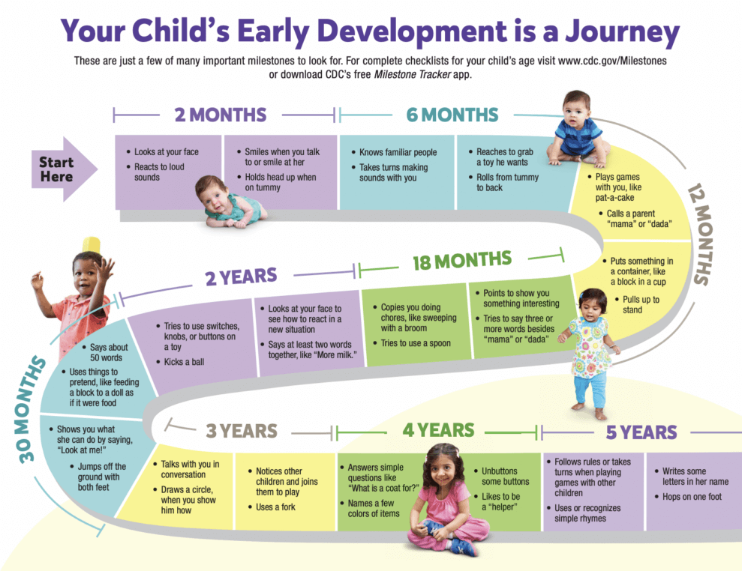

Slide 6
Task
Gropu A / Room 1 – 1. – 4. months
Group B / Room 2– 7 – 9. months
Group C / Room 3– 10. – 12. months
Group D / Room 4 – 1 – 2 years
Group E / Room 5 – 3 – 5. years
Group F / Room 6 – gestation period
Make the presetation
about milestones and „red flags” in the age…

Slide 7
Developmental disorder
Austism spectrum disorder
Learning disorders,
ADHD,
Fetal alcohol spectrum disorder
Language disorders,
Physical disorders,
Tourette Syndrome

Slide 8
Sourses:
Pediatria i pielęgniarstwo pediatryczne. Red. Zarzycka, Danuta; Emeryk, Andrzej . : PZWL Wydawnictwo Lekarskie, 2020
Human Growth and Development. Balasundaram P., Darshini I., StatPearls Publishing LLC, 03. 2023
https://www.registerednursing.org/nclex/developmental-stages-transitions/
https://www.cdc.gov/ncbddd/developmentaldisabilities/conditions.html
https://psychcentral.com/disorders/childhood-developmental-disorders
https://specialkidsclinic.com.sg/parent-centre/common-behavioural-and-developmental-disorders/

