Slide 1


Translated from Polish to English - www.onlinedoctranslator.com
COLOR INTESTINE CANCER

Slide 2
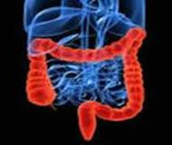
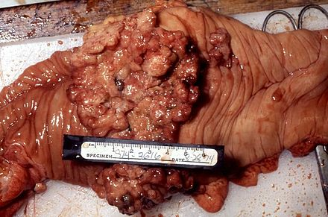
COLOR INTESTINE CANCER
Colorectal cancer is a malignant growth of the mucous membrane that can develop in any part of the 150 cm long large intestine and approximately 10 cm of the rectum.
In 90% of cases it develops from adenomas.
Lynch syndrome accounts for 5% of all colorectal cancer cases.
It rarely occurs before the age of 40.
It develops without causing any symptoms for a long time. It may take up to 10 years for the first symptoms to appear.
Notes:
2
Adenoma – a benign epithelial tumor.
Lynch syndrome - hereditary colorectal cancer, caused by a mutation in the genes responsible for repairing DNA gene damage.

Slide 3
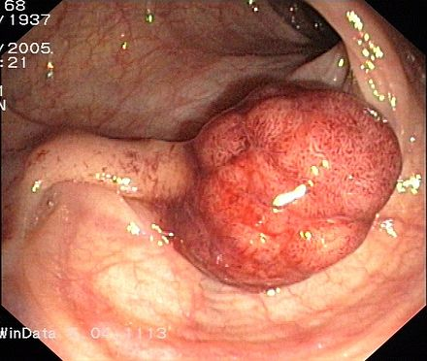
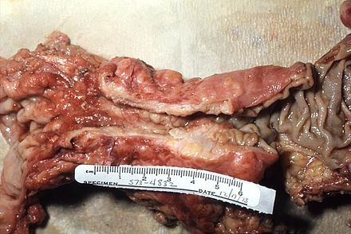
COLOR INTESTINE CANCER
The tumor may take the form of:
Soft polyposis
mass
Hard fibrous
mass
Large j. polyp
Endoscopic image
It sticks out into the light
colon/rectum
with a tendency to:
ulcers, infections
and bleeding
Surrounds the colon
causing her
narrowing
and closure
A tumor narrowing the intestinal lumen
Postoperative preparation
Notes:
3
Polyps - benign adenomas that form on the inner walls of the intestine.

Slide 4
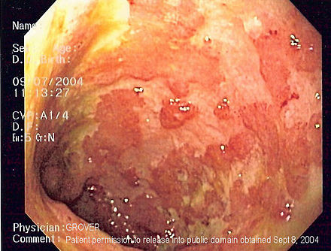
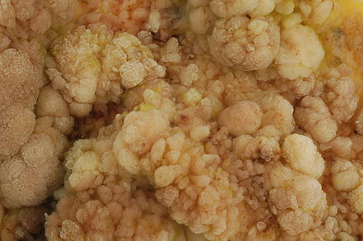
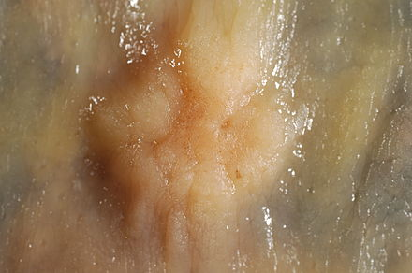
FACTORS AND DISEASES Predisposing to the development of colon cancer
Diseases
Factors
• nutrition
(Red meat,
animal fats,
↓fiber),
• genetic factors
overweight, obesity
excessive consumption
alcohol
• ulcerative
colitis
• some tumors
benign – adenomas
Ulcerative colitis
Adenoma
villous
Adenoma
sigmoid colon

Slide 5
CLINICAL PICTURE
CANCER OF THE RIGHT
PAIN HALF
CANCER OF THE LEFT
PAIN HALF
AND THE RECTUM
Occult bleeding
(increasing anemia)
Stomachache
Overt bleeding from the lower part
digestive section
Change in bowel movements (diarrhea
with a lot of mucus or constipation)
RECTAL CANCER
Often the lump is palpable
during a digital rectal examination
Hemorrhage or perforation - rare
Symptoms of obstruction may be the first manifestation of the disease

Slide 6
DIAGNOSIS
TESTS
AUXILIARY
TESTS
SCREENING
In burdened people
Colonoscopy
Tests
histological
Tests
laboratory
Tests
pictorial
Average
risk
illness
Increased
risk
illness
CRITERIA
RECOGNITIONS
DIAGNOSIS
DIFFERENTIAL
Hemorrhoids
Other cancers
(lymphoma)
Test
histological
Diverticular disease
colon
Infections and non-fouling
colitis
Notes:
6
Idiopathic – chronic inflammatory diseases of the large intestine.

Slide 7
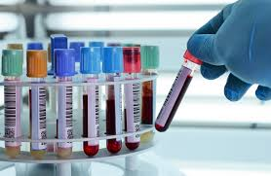
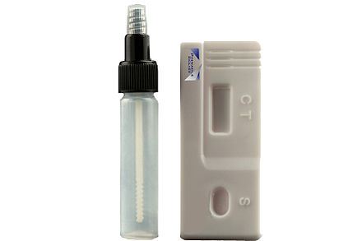
SUPPORTING RESEARCH Diagnosis
TESTS
LABORATORY
Anemia – common in cecum and ascending colon cancer.
Increased serum carcinoembryonic antigen (CEA) concentration.
Positive test result for the presence of occult blood in stool.
Method
Immunochromatographic
blood test
latent
Notes:
7
The immunochromatographic method is based on the detection of human hemoglobin.

Slide 8
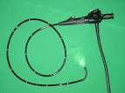
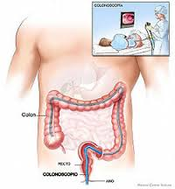
SUPPORTING RESEARCH Diagnosis
COLONOSCOPY
The most important study.
It allows you to: detect a tumor, take samples and look at the entire intestine to look for synchronous changes.
Endoscope
Colonoscopy
Notes:
8
Synchronous lesion – a second independent primary tumor focus.

Slide 9
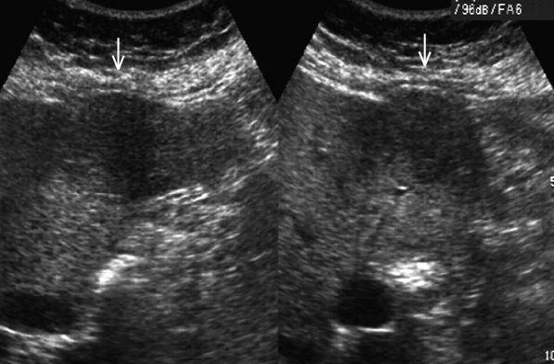
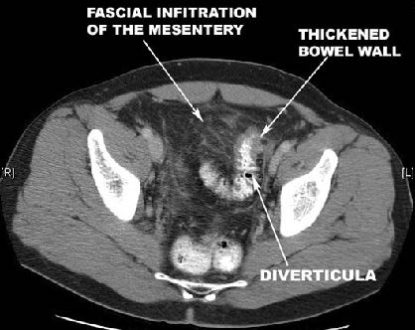
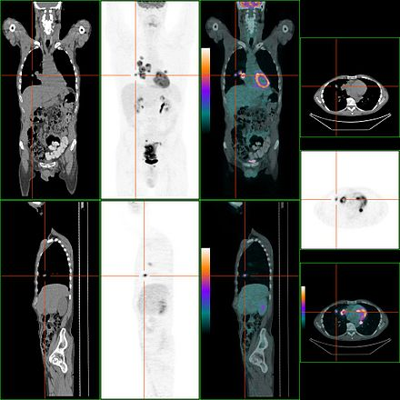
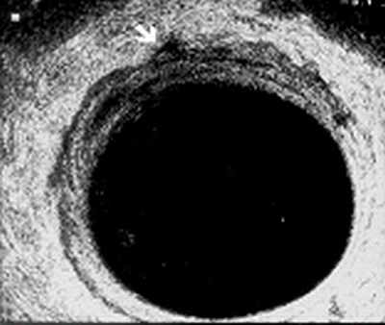
SUPPORTING RESEARCH Diagnosis
Colon cancer
descending
Ultrasound image
TESTS
IMPORTANT
Abdominal ultrasound and CT scandetection of metastases to the liver and lymph nodes.
Endosonography and MRI
determining the local stage of advancement of rectal cancer.
PET– detection of colorectal cancer recurrence
Large intestine - inflammation CT image
Lung metastasis
PET-CT
Endosonography
Rectal cancer
Notes:
9
PET – Position emission tomography. CT connection+fluorine isotope conjugated to glucose.The method is based on the detection of increased uptake of fluorine-labeled glucose. Pallows you to recognize places with an increased level of metabolism, such as cancer foci

Slide 10
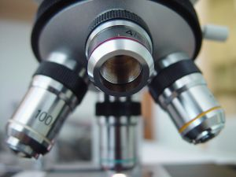
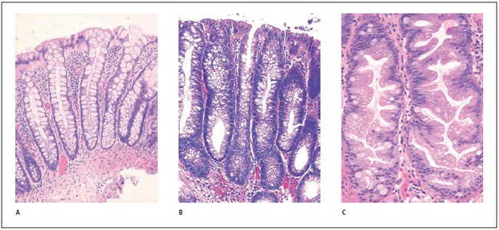
SUPPORTING RESEARCH Diagnosis
TEST
HISTOLOGICAL
Examination of a tissue fragment taken from a patient under a microscope
85% of cases – adenocarcinoma
It allows you to determine the type of tumor, its degree of malignancy and advancement.
Correct
mucous membrane
Polyp
hyperplastic
Adenoma
Notes:
10

Slide 11
STAGING OF RECTAL AND COLON CANCER
DEGREE | DUKES CLASSIFICATION/ ASTLER and COLERA | CLASSIFICATION TMN | DESCRIPTION | 5-YEAR SURVIVAL AFTER SURGERY
0 | - | Tis NO, MO | Cancer limited to the mucosa | 100%
AND | A/A and B1 | T1-T2 NO, MO | Tumor not extending muscle membrane | 85-100%
II | B/B2 and B3 | T3-T4, NO, MO | A tumor extending beyond the intestinal wall | 50-80%
III | C/C1 C2 C3 | T1-T4,N1-N2, MO | Metastases in lymph nodes | 30-60%
IV | D | T1-T4,NO-N2,M1 | General metastases | Up to a few %

Slide 12
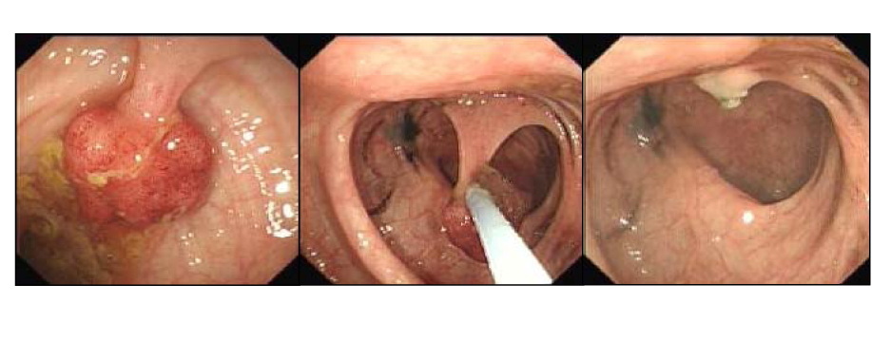
SCREENING TESTS Diagnosis
PURPOSE OF RESEARCH
Detecting cancer at an early stage.
Detection and removal of adenomatous polyps (considered precancerous).
Polypectomy in time
colonoscopy

Slide 13
SCREENING TESTS Diagnosis
IN BURNED PEOPLE
AVERAGE
RISK OF DISEASE
From the age of 50 in men and women - FOBT/FIT tests (detection of blood in stool) every 2 years.
Colonoscopy i
sigmoidoscopy every 10 years.
Notes:
13
FOBT/FIT tests detect the presence of blood in stool

Slide 14
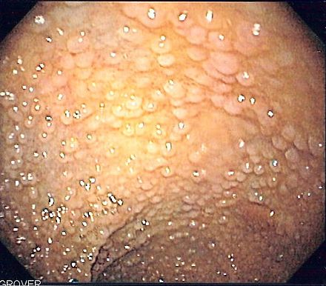
SCREENING TESTS Diagnosis
IN BURNED PEOPLE
INCREASED
RISK OF DISEASE
After polypectomy - colonoscopy frequency depending on the number and types of polyps.
Familial adenomatous polyposis colonoscopy every year from the age of 10-12.
Adenomas in the stomach and duodenum - gastroscopy every 6-12 months.
Family team
adenomatous polyposis
Notes:
14
Polypectomy – removal of polyps from the gastrointestinal tract.

Slide 15
TREATMENT
L. PRE-OPERATIVE
L. OPERATIONAL
Resection
classic/laparoscopic
Radiotherapy
Resection
endoscopic
Radiochemotherapy
L. SUPPLEMENTARY
L. ADVANCED
CANCER
Resection
Thermoablation
Cytostatic drugs
Chemotherapy
Chemotherapy
Radiochemotherapy
Laser therapy
Argon coagulation
Notes:
15
Systemic treatment – ​​systemic, non-surgical treatment.
Chemotherapy - administration of cytostatic substances - destroying cells.
Laparoscopy – examination of the peritoneum using an optical instrument introduced through the abdominal wall.
Endoscopy - introducing an endoscope probe into the body, i.e. optical fiber, image guide, instrument channel with tools for collecting material for examination and performing procedures.
Radiotherapy – i.e. using ionizing radiation, goal – irradiation of the tumor in order to destroy it, or in palliative radiotherapy – alleviation of pain. Cancer.

Slide 16
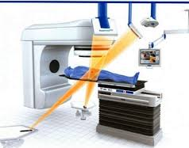
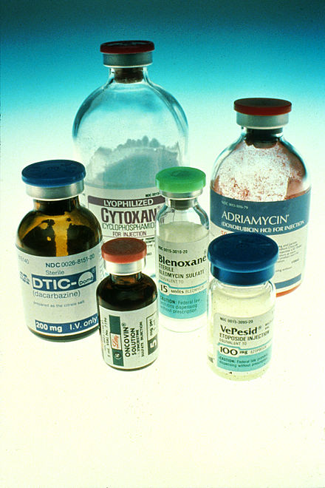
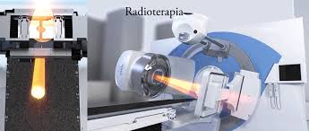
L. PRE-OPERATIVE
RADIOTHERAPY
RADIOCHEMIOTHERAPY
Rectal cancer
tumor clinically assessed as "mobile"
Rectal cancer
clinically advanced tumor as "immobile"
Notes:
16
Radiotherapy - treatment involving the destruction of cancer using ionizing radiation. Goal - reducing tumor mass and local recurrences.
The use of chemotherapy before surgery is intended to reduce the mass of the tumor, making surgery easier and increasing the chances of full recovery. After surgery, it is intended to improve the survival of patients by destroying any cancer cells circulating in the body

Slide 17

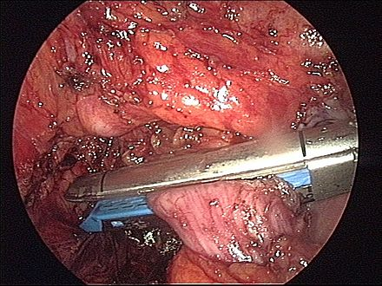
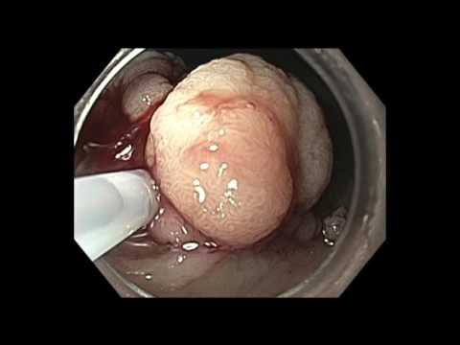
L. OPERATIONAL
RESECTION
CLASSIC/
LAPAROSCOPIC
RESECTION
ENDOSCOPIC
Rectal/colon cancer
tumor resection with
removal of lymph nodes
Rectal/colon cancer
resection of non-advanced, small tumor
well diversified

Slide 18
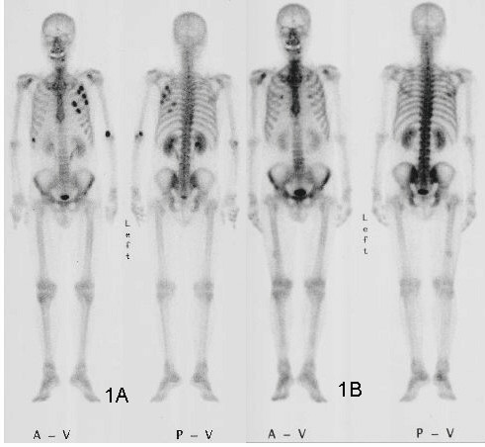
L. SUPPLEMENTARY
Scintigraphy
Metastases to the ribs
1A – before chemotherapy
1B – after chemotherapy
CHEMOTHERAPY
CHEMIORADIOTHERAPY
Rectal/colon cancer
in unfavorable cases
risk factors: perforation
intraoperative intestine, tumor
crossing the intestinal wall,
metastases in lymph nodes
When not carried out
radiotherapy before surgery
with unfavorable factors
risk
Notes:
18
Radiotherapy - the tumor bed with a 2-5 cm margin and the surrounding lymph nodes, including the presacral and internal iliac nodes, are irradiated.
The benefits of adding chemotherapy to radiotherapy result from the increased toxicity of the radiation used to cancer cells and the elimination of micrometastases.

Slide 19
MONITORING
Medical examination every 3-6 months. for 5 years.
CEA test every 3 months for 3 years.
Abdominal CT/USG is recommended every 6-12 months.
chest X-ray every year.
Colonoscopy 3-6 months. after surgery, then one year after surgery and 3 and 5 years after surgery.
Notes:
19
CEA – carcinoembryonic antigen.

