Slide 1
Gastrointestinal
Disease
Dominika Karpińska

Slide 2
Pyloric Stenosis
https://www.youtube.com/watch?v=XSS67KcbiWM&list=PLj9YgcGzjQqzQoIGSqM-D-z_gLhtdyO55&index=63&ab_channel=LevelUpRN
Pyloric stenosis is an uncommon condition in infants that blocks food from entering the small intestine.
Typically, a muscular valve between the stomach and small intestine holds food in the stomach until it is ready for the next stage in the digestive process. This valve is called the pylorus valve. In pyloric stenosis, the pylorus muscles thicken and become abnormally large, blocking food from reaching the small intestine.
Pyloric stenosis is a problem that affects babies between birth and 6 months of age
Pyloric stenosis must be repaired with an operation.

Slide 3
Pyloric Stenosis
Symptoms include:
Risk factors
Vomiting after feeding,
Weight loss
Ravenously hungry despite vomiting
Lack of energy
Fewer bowel movements
Constipation
Frequent, mucous stools
Sex. (more often in boys),
Race and ethnicity, (Pyloric stenosis is more common in white and Hispanic children)
Premature birth
Family history.
Early antibiotic use ( erythromycin )
Bottle-feeding ?

Slide 4
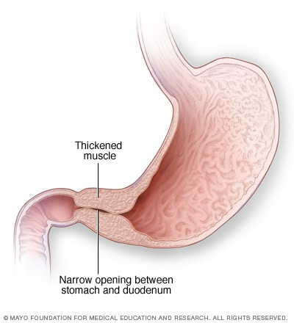
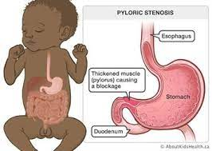

Slide 5
GERD - gastroesophageal reflux disease
chronic digestive disorder. It happens when stomach contents flow back up (reflux) into the esophagus,
CAUSE : GERD is often caused by something that affects the LES, the lower esophageal sphincter. The LES is a muscle at the bottom of the esophagus. The LES opens to let food into the stomach. It closes to keep food in the stomach. When the LES relaxes too often or for too long, stomach acid flows back into the esophagus. This causes vomiting or heartburn.
risk factors:
Down syndrome
Neuromuscular disorders such as muscular dystrophy and cerebral palsy

Slide 6
GERD - treatment
lifestyle changes
avoid eating just before they lie down or go to bed
change their eating habits or diet
sleep with their head elevated or sleep on their left side
Medicines
proton pump inhibitors (PPIs).
H2 blockers.
Antacids
Fundoplication is the most common surgery for GERD. In most cases, it leads to long-term improvement of GERD symptoms. Surgeons most often perform fundoplication as laparoscopic surgery, making small cuts in the abdomen and inserting special tools to perform the operation. Laparoscopic fundoplication leaves several small scars. During the procedure, surgeons sew the top of the stomach around the end of the esophagus, which adds pressure to the lower esophageal sphincter and helps reduce reflux.

Slide 7
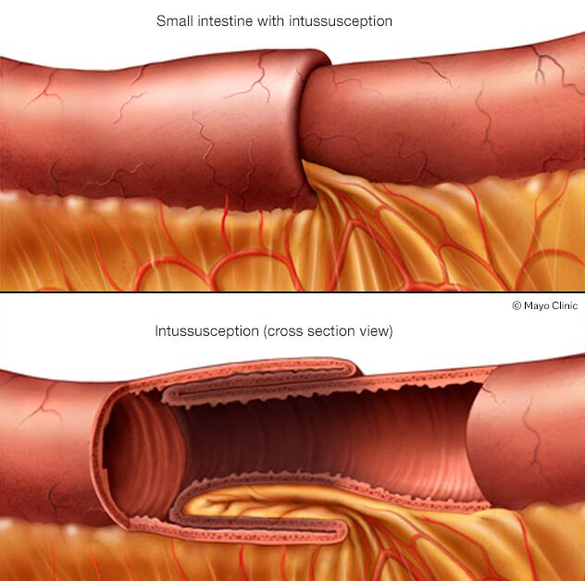
Intussusception
Intussusception is a serious condition in which part of the intestine slides into an adjacent part of the intestine. This telescoping action often blocks food or fluid from passing through. Intussusception also cuts off the blood supply to the part of the intestine that's affected. This can lead to infection, death of bowel tissue or a tear in the bowel, called perforation.

Slide 8
Intussusception
Symptoms
Risk factors
Severe pain,
Vomiting,
Weakness or lack of enery,
Stool mixes with blood and mucus „ currant jelly stool”,
Diarrhea
Age. Children — especially young children — are much more likely to develop intussusception than adults are. It's the most common cause of bowel obstruction in children between the ages of 6 months and 3 years.
Sex. Intussusception more often affects boys.
Irregular intestinal formation at birth.
Certain conditions. Some disorders can increase the risk of intussusception, including:
  Cystic fibrosis.
  Henoch-Schonlein purpura, also known as IgA vasculitis.
  Crohn's disease.
  Celiac disease.

Slide 9
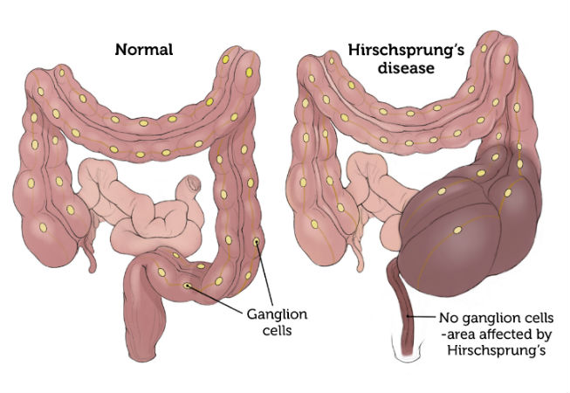
Hirschsprung's disease
Hirschsprung's disease (also called congenital aganglionic megacolon) occurs when some of baby’s intestinal nerve cells (ganglion cells) don’t develop properly, delaying the progression of stool through the intestines. The intestine becomes blocked with stool, and baby or child will be constipated (unable to have normal bowel movements).

Slide 10
Symptoms of Hirschsprung's disease
a newborn's failure to have a bowel movement within 48 hours after birth.
Other signs and symptoms in newborns may include:
Swollen belly
Vomiting, including vomiting a green or brown substance
Constipation or gas, which might make a newborn fussy
Diarrhea
Delayed passage of meconium — a newborn's first bowel movement

Slide 11
Treatment
Pull-through surgery
In this procedure, the lining of the diseased part of the colon is stripped away. Then, the normal section is pulled through the colon from the inside and attached to the anus. This is usually done using minimally invasive (laparoscopic) methods, operating through the anus.
Ostomy surgery (can be done in two steps)
First, the abnormal portion of the colon is removed and the top, healthy portion of the colon is connected to an opening the surgeon creates in the child's abdomen. Stool then leaves the body through the opening into a bag that attaches to the end of the intestine that protrudes through the hole in the abdomen (stoma). This allows time for the lower part of the colon to heal.
Once the colon has had time to heal, a second procedure is done to close the stoma and connect the healthy portion of the intestine to the rectum or anus.

Slide 12
https://www.youtube.com/watch?v=DJn4imxpi6U&list=PLj9YgcGzjQqzQoIGSqM-D-z_gLhtdyO55&index=63&ab_channel=LevelUpRN
https://www.youtube.com/watch?v=N1d1m3VOg80&list=PLj9YgcGzjQqzQoIGSqM-D-z_gLhtdyO55&index=69&ab_channel=LevelUpRN

Slide 13
Sourses:
https://www.mayoclinic.org/diseases-conditions/pyloric-stenosis/symptoms-causes/syc-20351416
https://www.nationwidechildrens.org/conditions/pyloric-stenosis
https://www.hopkinsmedicine.org/health/conditions-and-diseases/gerd-gastroesophageal-reflux-disease-in-children
https://www.niddk.nih.gov/health-information/digestive-diseases/acid-reflux-ger-gerd-children/treatment
https://www.mayoclinic.org/diseases-conditions/intussusception/symptoms-causes/syc-20351452
https://medlineplus.gov/genetics/condition/hirschsprung-disease/
https://www.niddk.nih.gov/health-information/digestive-diseases/hirschsprung-disease
https://www.mayoclinic.org/diseases-conditions/hirschsprungs-disease/symptoms-causes/syc-20351556
https://www.mayoclinic.org/diseases-conditions/hirschsprungs-disease/diagnosis-treatment/drc-20351561
https://www.childrenshospital.org/conditions/hirschsprungs-disease

