Slide 1
Resolving the nursing problems of a patient treated surgically for a hernia.

Slide 2
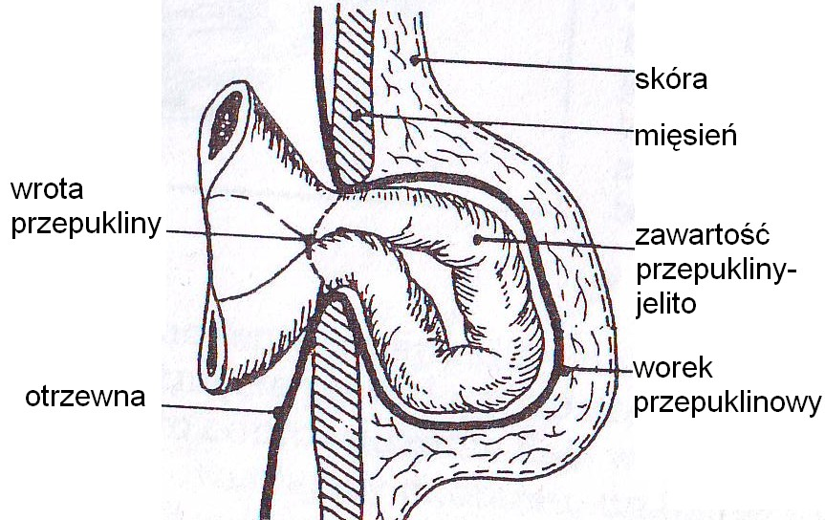
Hernia - the protrusion of tissues or organs beyond the anatomical boundaries of the cavity that confines them. This displacement takes place through fissures and openings that are congenital or acquired.

Slide 3
Types of hernia:
congenital
acquired,
internal,
external,
drainable,
irreducible,
incarcerated;

Slide 4
Congenital hernia - their presence is found in infants (at 1-2 years of age) usually in the inguinal or umbilical region, they arise as a result of developmental abnormalities in fetal life;
Acquired hernia - develops later in life, often formed under the influence of significantly increased intra-abdominal pressure with increased abdominal crowding;

Slide 5
External hernias - when part of the abdominal contents move with the peritoneal diverticulum outside the abdominal cavity (under the skin);
Internal hernias - when the contents of the hernia are displaced into adjacent body cavities, internally or into certain natural diverticula of the peritoneal cavity;

Slide 6
Drainable (free) hernias - when the hernia sac and its contents retract back into the abdominal cavity when lying down or under gentle pressure;
Symptoms from a drainable hernia include:
a pulling sensation in the abdominal cavity,
pain at the hernia site,
sometimes nausea, gastrointestinal discomfort,
a palpable 'lump' that usually becomes apparent when the abdominal wall is mobilised;

Slide 7
Irreducible hernias - when the hernia sac and its contents cannot be drained into the abdominal cavity.
The causes are:
adhesions between the hernia sac and its contents,
significant size of the hernia content, not commensurate with the
diameter of the hernia gate,
incarcerated hernia,

Slide 8
Incarcerated hernia– under the influence of intra-abdominal pressure, a larger than normal hernia content is forced into the hernia sac, thus preventing backflow into the abdominal cavity.
Too narrow hernia gates tighten the intestinal lumen.
Over time, the bowel becomes obstructed, the passage of intestinal contents is interrupted and the ischaemic bowel becomes necrotic.
Such a complication if left untreated can lead to diffuse peritonitis and death of the patient.

Slide 9
Local manifestations of incarcerated hernia:
vividly painful congestion,
reddening of the skin when the incarceration lasts a long time,
the hernia is hard and unrecoverable,

Slide 10
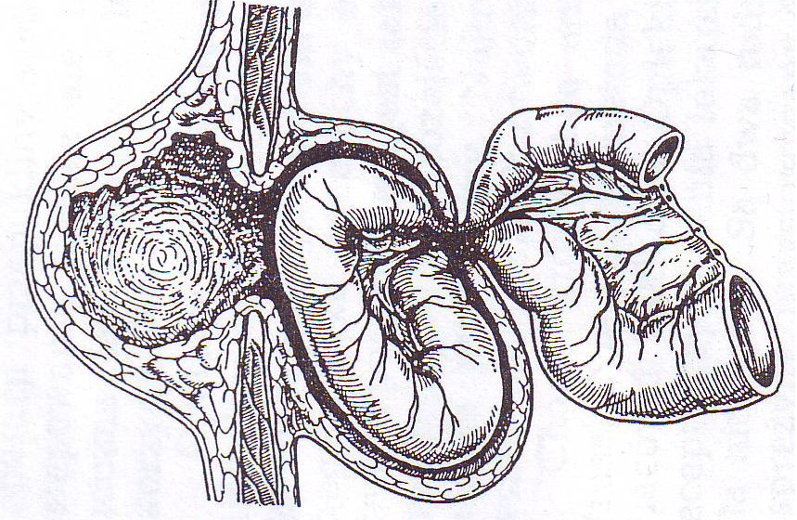
No hernia contents were drained into the abdominal cavity. But the hernia sac was pushed in, which continues to clamp the bowel, the so-called "en block" drainage.

Slide 11
General symptoms:
* typical of bowel obstruction:
vomiting
severe paroxysmal abdominal pain
abdominal bloating
increased heart rate
leukocytosis
a picture of mechanical bowel obstruction develops

Slide 12
Depending on the location, we distinguish between the following hernias:
inguinal,
femoral,
umbilical,
epigastric, otherwise known as a white line hernia,
in the postoperative scar.

Slide 13
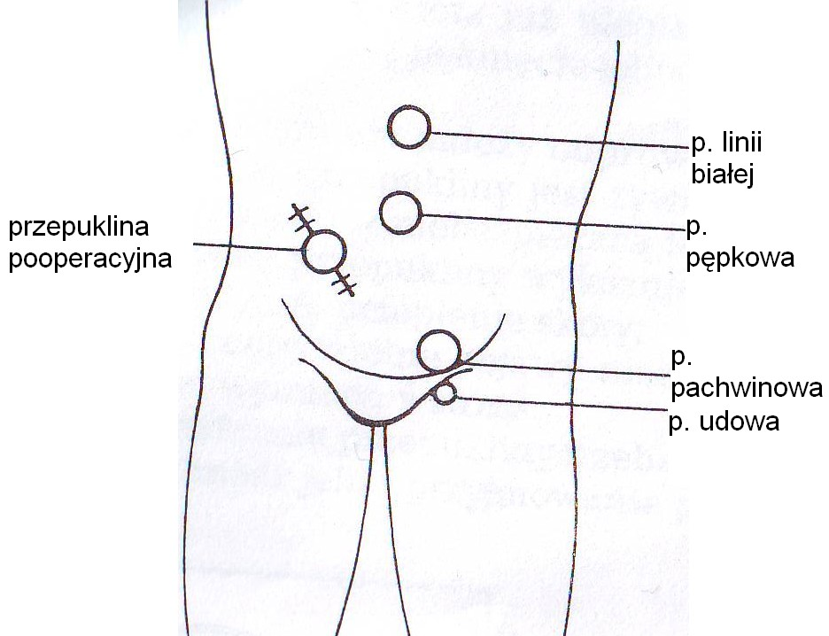

Slide 14



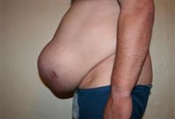

Slide 15
Post-operative hernia - occurs at the site of a scar following a surgical abdominal incision.
- The cause may be abnormal suturing of the shells or paralysis and laxity of one of the abdominal muscles.

Slide 16
The most common causes of muscle separation at the incision site are:
wound infection
haematoma in the wound,
poor blood supply to the wound,
coughing,
vomiting,
persistent abdominal bloating,
cachexia, which impairs the patient's ability to heal the wound.

Slide 17
Hernia formation is favoured by:
flaccidity and reduced tissue strength in old age,
obesity,
physical work,
chronic cough,
persistent constipation and urinary urgency,

Slide 18

Treatment:
Operative - the aim is to close the hernia gate.
Laparoscopic or traditional 'one day surgery' method,
Contraindications to surgery are:
severe systemic diseases (respiratory failure, circulatory failure),
refractory ascites.

Slide 19

The preparation of hernia patients with no systemic diseases for surgery does not require special management.
After uncomplicated surgery, the patient does not need to remain in a recumbent position for long.
Watch out for movements that cause tension on the wound, such as getting out of bed abruptly, pushing urinating and coughing.

Slide 20
Voltage-free methods.
In the second half of our century, the development of non-reactive synthetic materials made it possible to introduce a completely new type of hernia operation.
The defect in the fascia is filled with plastic mesh, closing the hernia gates without tension.
After some time, the mesh fuses with the surrounding tissues creating a strong barrier against recurrence.

Slide 21
These include polypropylene, marlex and acronium meshes, known as implants or prostheses.
A complication encountered among patients treated surgically with mesh is infection with Staphylococcus aureus or Gram-negative bacteria.

Slide 22

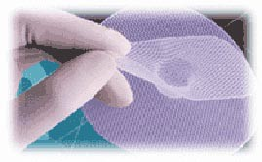
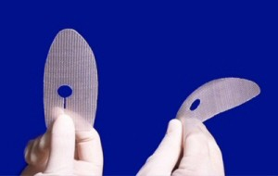

Slide 23
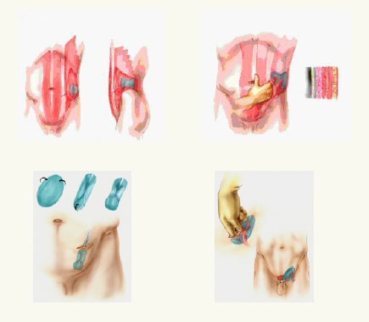
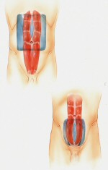

Slide 24
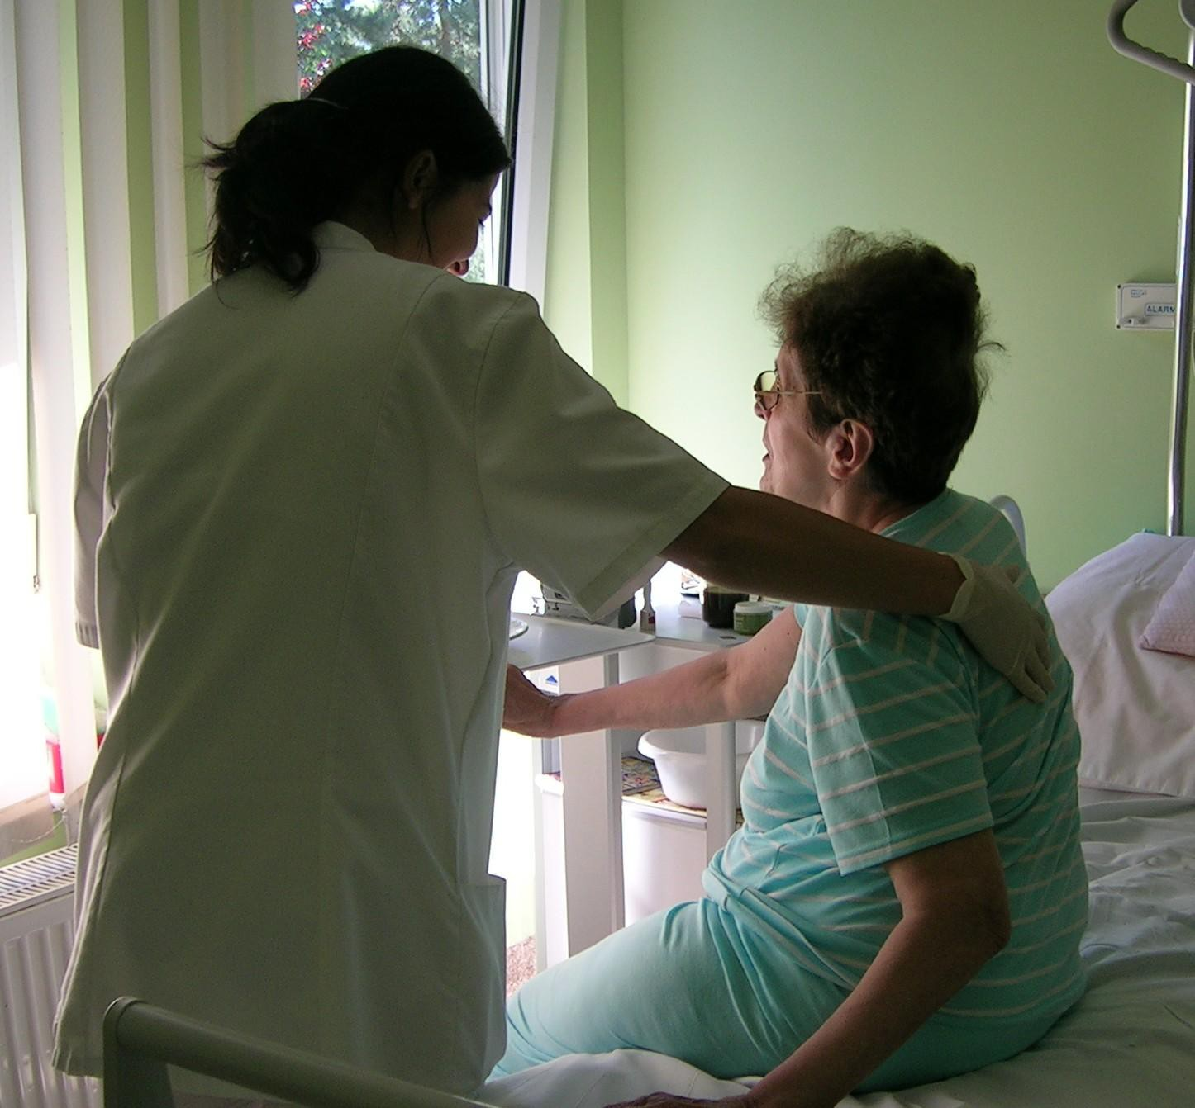
PROBLEMS OF A PATIENT UNDERGOING SURGICAL TREATMENT FOR A HERNIA.

Slide 25
I. Discomfort caused by hernia protrusion.
OBJECTIVE: to reduce discomfort until surgery is performed.
CARE PLAN :
Advise the patient to limit exercise - this reduces the increase in hernia symptoms.
Avoidance of heavy lifting by the patient, e.g. shopping - this does not put the hernia at risk.
Regulating bowel movements, preventing constipation (increase the amount of fibre in the food eaten) - constipation causes pain or enlarges the hernia.
Avoiding contact with a source of infection for the patient - coughing, sneezing aggravate hernia enlargement.
Suggesting to the non-elderly patient the wearing of a hernia belt (truss).

Slide 26
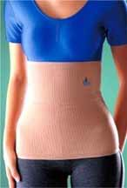
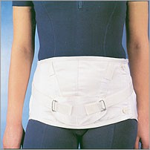
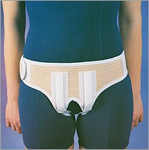
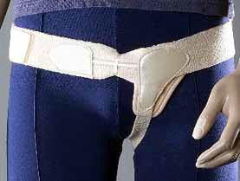

Slide 27
II. Anxiety about the decision to have surgery and the effects of treatment. OBJECTIVE: to reduce anxiety.
CARE PLAN :
Mentally preparing the patient for surgery.
Listening to the patient's concerns and requests.
Talking to the patient.
Enabling contact with the surgeon to clarify the patient's concerns.
Presenting positive patients after hernia surgery.
Enabling a discussion with the anaesthetist to rule out any contraindications to surgery.
To warn the patient of any discomfort that may occur after surgery.

Slide 28
III. Postoperative wound pain.
OBJECTIVE: to relieve pain.
CARE PLAN :
Listening to the patient's concerns and requests.
Talking to the patient.
Administering pain medication according to the medication order sheet. Observe response to medication.
Placing the patient in a position that reduces tension in the surgical wound (reducing abdominal muscle tension).

Slide 29
IV. Patient frailty resulting from surgery, limited self-care.
OBJECTIVE: to help meet basic biological needs, complications.
CARE PLAN :
Assist with bed position changes and encourage cooperation.
Assisting with the patient's toileting, which increases the patient's psychological comfort and provides a sense of security.
Conducting respiratory gymnastics, carrying out exercises active exercises.
Getting the patient up and running on the day of surgery.
Restoring full motor activity and independence by the day of the patient's discharge.

Slide 30
V. Risk of wound edge dehiscence in the patient.
OBJECTIVE: to reduce the risk of wound edges spreading.
CARE PLAN:
Observing the surgical wound and the course of the wound healing process, paying attention to the occurrence of wound inflammatory reaction.
Mobilising the patient to take care of personal hygiene by performing daily morning and evening toileting, keeping the bed clean and tidy.
Interacting with dressing changes, observing the principles of aseptics and antisepsis.

Slide 31
4. Wearing an elastic band or abdominal belts in very obese people (this protects against wound edges spreading and recurrence).
Explaining to the patient the type of diet proposed after consultation with the dietician and monitoring its use.
Assisting with follow-up examinations, e.g. ultrasound.

Slide 32
VI. Possibility of bloating 24-48 hours after surgery, due to slowed intestinal peristalsis.
OBJECTIVE: Prevention and elimination of flatulence when it occurs.
CARE PLAN:
Getting the patient up and running as early as the day of surgery with the assistance of a physical therapist with limited exercise.
Assistance with frequent bed position changes on the day of surgery and the following days after surgery if the patient is not independent.
Insertion of a dry rectal tube.
Massaging the abdomen with gentle clockwise movements.
Controlling bowel movements to prevent gas accumulation.

Slide 33
VII. Potential for hernia recurrence due to non-compliance.
OBJECTIVE: prevention of complications.
CARE PLAN:
Explaining the need to follow all recommendations after surgical treatment.
Explaining to the patient that for the next six months he/she should limit physical exertion, i.e. do not do jobs that involve a lot of physical exertion, do not carry heavy objects.
Taking care of hygienic rest.
Following an easily digestible diet, eating foods that are not bloating or constipating, controlling bowel movements.
Wearing an abdominal belt when walking, doing work.

Slide 34
Thank you for your attention!

