Slide 1
Infectious diseases
Dominika Karpińska

Slide 2
Basic informations
What is an infectious disease?
Caused by pathogenic microorganisms:
An infectious disease is an illness due to a pathogen or its toxic product, which arises through transmission from an infected person, an infected animal, or a contaminated inanimate object to a susceptible host.
bacteria,
viruses,
Parasites,
Fungi.

Slide 3
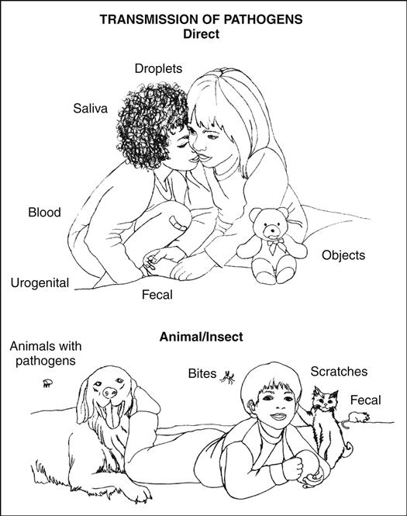
The principal modes of transmission of infectious agents:
direct,
indirect,
contact,
droplet,
airborne.
Chart: https://nursekey.com/the-child-with-an-infectious-disease/

Slide 4
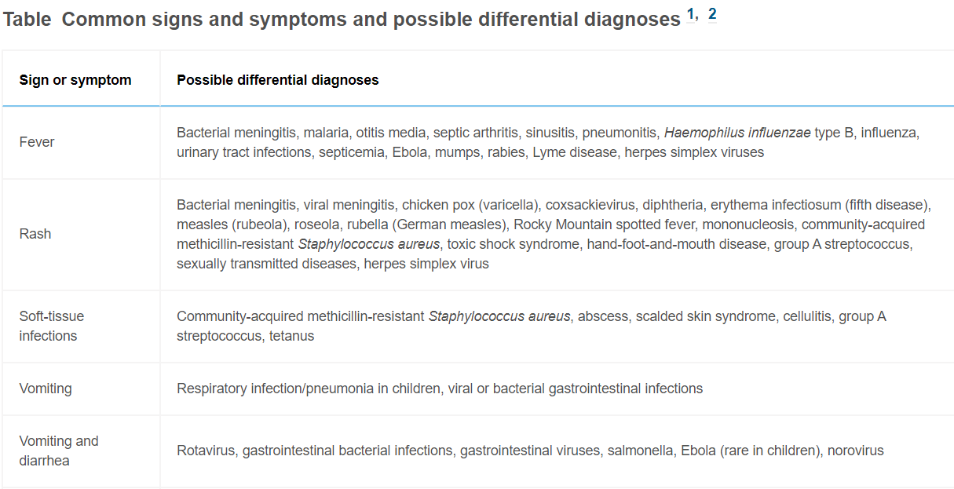
Table: https://www.jenonline.org/article/S0099-1767(14)00585-6/fulltext

Slide 5
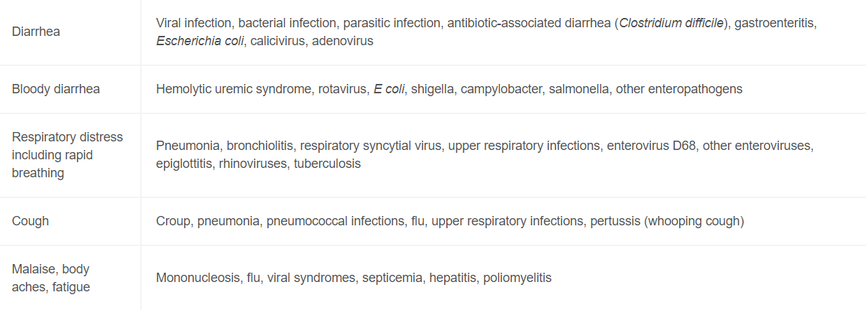
Table: https://www.jenonline.org/article/S0099-1767(14)00585-6/fulltext

Slide 6
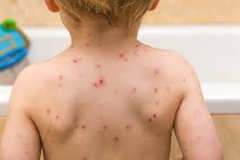
Varicella (chickenpox) and herpes zoster (shingles)
It is caused by varicella-zoster virus (VZV), which is a DNA virus that is a member of the herpesvirus group.
Primary infection with VZV causes varicella. Reactivation of latent infection causes herpes zoster.
Epidemiology : Humans are the only source of infection for this virus. Humans are infected when the virus comes in contact with the mucosa of the upper respiratory tract or the conjunctiva of a susceptible person. Person-to-person transmission occurs by the airborne route and from direct contact with patients with vesicular VZV lesions vesicles contain infectious virus that can be aerosolized.
Incubation Period : is 14 to 16 days after exposure to a varicella or a herpes zoster rash, with a range of 10 to 21 days. A mild prodrome of fever and malaise may occur 1 to 2 days before rash onset, particularly in adults. In children, the rash is often the first sign of disease.
Graphic: Google graphic

Slide 7
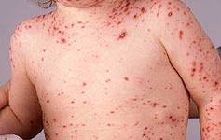
Symptoms
Graphic: Google graphic
Symptoms: The rash is generalized and pruritic. It progresses rapidly from macular to papular to vesicular lesions before crusting. Lesions are typically present in all stages of development at the same time. The rash usually appears first on the chest, back, and face, then spreads over the entire body. The lesions are usually most concentrated on the chest and back. Symptoms typically last 4 to 7 days.
In healthy children, varicella is generally mild, with an itchy rash, malaise, and temperature up to 102°F for 2 to 3 days.

Slide 8
Treatment
Varicella-Zoster Immune Globulin
For people exposed to varicella or herpes zoster who cannot receive varicella vaccine, varicella-zoster immune globulin can prevent varicella from developing or lessen the severity of the disease. Varicella-zoster immune globulin is recommended for people who cannot receive the vaccine and 1) who lack evidence of immunity to varicella, 2) whose exposure is likely to result in infection, and 3) are at high risk for severe varicella.
Acyclovir Treatment
The American Academy of Pediatrics (AAP) recommends that certain groups at increased risk for moderate to severe varicella be considered for oral acyclovir or valacyclovir treatment. These high risk groups include:
Healthy people older than 12 years of age
People with chronic cutaneous or pulmonary disorders
People receiving long-term salicylate therapy
People receiving short, intermittent, or aerosolized courses of corticosteroids
Some healthcare providers may elect to use oral acyclovir or valacyclovir for secondary cases within a household. For maximum benefit, oral acyclovir or valacyclovir therapy should be given within the first 24 hours after the varicella rash starts.

Slide 9
Complications
bacterial superinfection of skin lesions with or without bacterial sepsis, pneumonia, central nervous system involvement (acute cerebellar ataxia, encephalitis, stroke/vasculopathy), thrombocytopenia, and other rare complications, such as glomerulonephritis, arthritis, and hepatitis;
varicella tends to be more severe in infants, adolescents, and adults than in children.

Slide 10
Herpes simplex virus (HSV)
Types:
Type 1 (HSV-1) mostly spreads by oral contact and causes infections in or around the mouth (oral herpes or cold sores). It can also cause genital herpes. Most adults are infected with HSV-1.
Type 2 (HSV-2) spreads by sexual contact and causes genital herpes.

Slide 11
Herpes simplex virus (HSV) - transimission
HSV-1 I
contact with the virus in sores,
saliva,
surfaces in or around the mouth,
less commonly, HSV-1 can be transmitted to the genital area through oral-genital contact to cause genital herpes;
HSV-2
sex through contact with genital or anal surfaces, skin, sores or fluids of someone infected with the virus,
In rare circumstances, herpes (HSV-1 and HSV-2) can be transmitted from mother to child during delivery, causing neonatal herpes.

Slide 12
Herpes simplex virus (HSV) - symptoms
Most people with herpes have no symptoms or only mild symptoms
Symptoms may be different during the first episode (or ‘outbreak’) of infection than during a recurrent episode. If symptoms occur, they often begin with tingling, itching or burning near where the sores will appear.
Common oral herpes symptoms include blisters (cold sores) or open sores (ulcers) in or around the mouth or lips.
Common genital herpes symptoms include bumps, blisters, or open sores (ulcers) around the genitals or anus.
These sores and blisters are typically painful. Blisters may break open, ooze and then crust over.

Slide 13
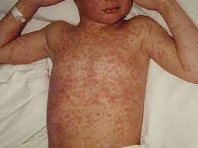
Measles
Causes of Measles
Measles is caused by the measles virus (MeV), a member of the Paramyxoviridae family.
The incubation period is on average 10 (8-12) days, and the period until the rash appears - on average 14 (7-18) days. The patient infects other people from the moment the symptoms appear until 3-4 days after the rash appears. The virus remains infectious in the air or on contaminated surfaces for up to 2 hours.

Slide 14
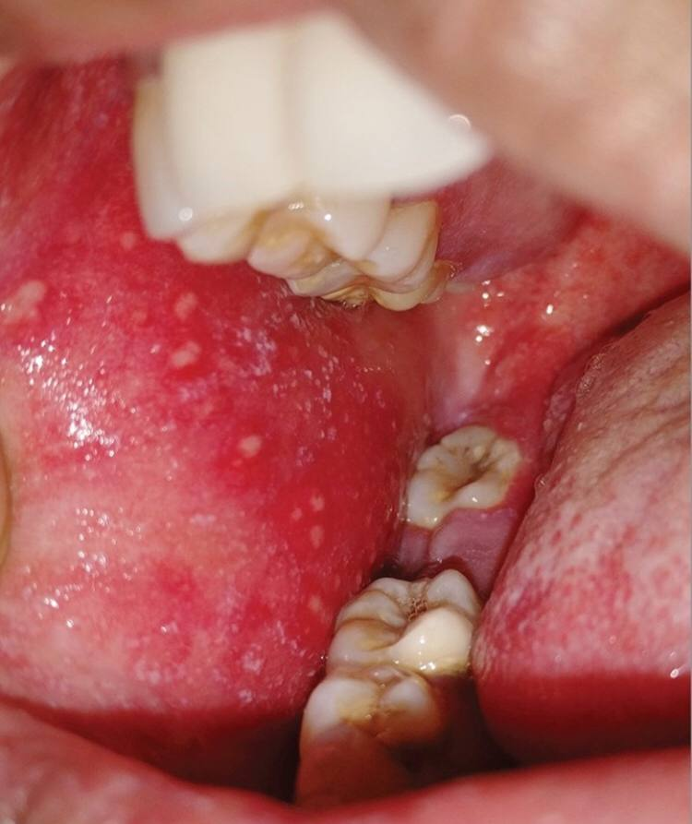
The clinical course of measles
is divided into catarrhal, rash and convalescent periods. The catarrhal period lasts 3-4 days and includes: high fever, dry, tiring cough, pharyngitis, runny nose, conjunctivitis with photophobia.
After 3–4 days of the catarrhal period, white spots with a red border (Koplik's spots) appear on the cheek mucosa.
The rash period begins approximately on the 14th day after infection, after the catarrhal period. It is accompanied by high fever. Spots and papules ranging from dark red to purple. During the period, the fever decreases and the rash turns brown.
Other symptoms occur less frequently and include: anorexia, diarrhea, and generalized lymphadenopathy.

Slide 15
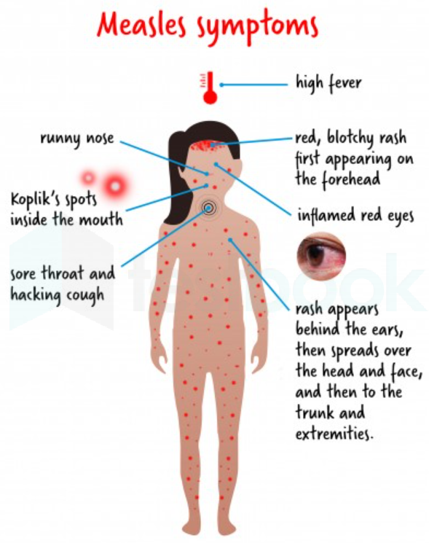

Slide 16
Treatment
is only symptomatic,
antipyretic drugs,
rest,
darkening the room,
proper hydration and nutrition,
in malnourished children, the doctor may recommend vitamin A supplementation.
in bacterial complications, antibiotic therapy is used;
Having measles leaves permanent immunity.

Slide 17
Complications
inflammation of the middle ear, lungs, brain and heart muscle,
convulsions,
blindness (retrobulbar optic neuritis),
secondary bacterial infections,
intensification of symptoms of latent tuberculosis,
very rarely, measles can be fatal.
Neurological complications are particularly dangerous, namely:
acute encephalitis,
subacute sclerosing encephalitis,

Slide 18
Prevention
The basic method of prevention is vaccination.
In case of illness, patients should be isolated for 4 days from the onset of the rash, and susceptible people (unvaccinated) who had contact with the sick person should be isolated for the entire incubation period. If measles complications occur, the patient does not infect anyone in contact with him and does not require isolation.

Slide 19
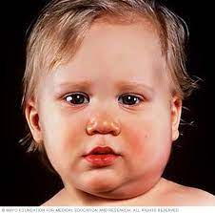
Mumps
swelling of one or more of the salivary glands,(most common the parotid glands), approximately one-third of infections do not cause clinically apparent salivary gland swelling and can be asymptomatic (subclinical) or manifest primarily as respiratory tract infection
Tramsmission: the source of the disease is a sick person.
The incubation period of the disease is 14–24 days. Infectiousness already before the onset of parotid glands within 2 weeks of the onset of the disease.

Slide 20
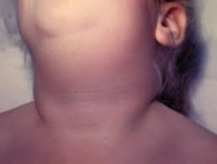
Symptoms
Typical symptoms:
high fever (lasting 3–4 days),
swelling in the parotid glands or other salivary glands,
ear pain,
problems with chewing and opening the mouth,
redness and swelling of the salivary duct openings in the mouth are visible,
Special clinical forms include:
meningitis (quite common in children, also in cases without salivary gland involvement) - manifested by high fever, headaches and muscle pain, nausea, vomiting, stiff neck and photophobia,
involvement of other glandular organs (inflammation of the pancreas, testicles - most often in teenagers and young men, mammary gland - most often manifested by pain and enlargement of the affected organ)

Slide 21
Complications
Orchitis is a commonly reported complication after puberty, although sterility rarely results.
Rare complications: arthritis, thyroiditis, mastitis, glomerulonephritis, myocarditis, endocardial fibroelastosis, thrombocytopenia, cerebellar ataxia, transverse myelitis, encephalitis, pancreatitis, oophoritis, and permanent hearing impairment,
Infection in adults is more likely to result in complications,
first trimester maternal mumps causes spontaneous abortion or intrauterine fetal death is uncertain, and this does not result in congenital malformation;

Slide 22
Glandular fever (infectious mononucleosis)
Cause:
Epstein-Barr Virus (EBV): The primary cause of glandular fever is the Epstein-Barr virus, a member of the herpesvirus family. It is highly contagious and is commonly spread through the exchange of saliva, making kissing a common mode of transmission. Additionally, it can be spread through other bodily fluids, such as blood and semen.
Symptoms:
fatigue,
fever,
sore Throat,
swollen Lymph Nodes,
enlarged Spleen and Liver,
Headache, muscle aches and joint pain;
Treatment: symptomatic treatment

Slide 23
Glandular fever
Complications:
Enlarged Spleen: Glandular fever can cause the spleen to enlarge, making it susceptible to rupture. Activities that increase the risk of trauma to the spleen, such as contact sports, should be avoided during recovery.
Jaundice: In some cases, the liver may be affected, leading to jaundice, a yellowing of the skin and eyes.
Secondary Infections: Due to the weakened immune system during the infection, there is an increased risk of secondary bacterial infections such as streptococcal pharyngitis.
Chronic Fatigue Syndrome (CFS): A small percentage of individuals may experience persistent fatigue and other symptoms resembling chronic fatigue syndrome after the acute phase of the illness.

Slide 24
Tuberculosis (TB)
Cause:
Bacterium: Tuberculosis is primarily caused by the bacterium Mycobacterium tuberculosis. It is an airborne disease, typically spread through the inhalation of respiratory droplets from an infected person. While TB commonly affects the lungs (pulmonary TB), it can also target other organs (extrapulmonary TB).
Symptoms:
Early or Latent TB:
- Asymptomatic: Many individuals with latent TB infection show no symptoms.
-Positive Skin Test or Blood Test: Latent TB can be detected through tests like the Mantoux tuberculin skin test (TST) or interferon-gamma release assays (IGRAs).
Active Pulmonary TB:
  Cough: Persistent cough lasting three weeks or longer.
  Hemoptysis: Coughing up blood or bloody sputum.
  Chest Pain: Pain or discomfort in the chest.
  Fatigue: Generalized weakness and fatigue.
  Weight Loss: Unintended weight loss.
Active Extrapulmonary TB:
  Symptoms Depend on the Affected Organ: Can include swelling, pain, or dysfunction related to the affected area (e.g., lymph nodes, bones, joints, meninges).

Slide 25
Treatment:
Antibiotics: Tuberculosis is treated with a combination of antibiotics over an extended period. Common medications include isoniazid, rifampin, ethambutol, and pyrazinamide.
Directly Observed Therapy (DOT): Ensuring that patients take their medications as prescribed is crucial for successful treatment. In some cases, healthcare providers directly observe patients taking their medication.
Complications:
Drug-Resistant TB:
  Multi-Drug Resistant TB (MDR-TB): Resistance to at least isoniazid and rifampin.
  Extensively Drug-Resistant TB (XDR-TB): Resistance to isoniazid and rifampin, plus resistance to fluoroquinolones and at least one second-line injectable drug.
Spread to Others:
  If not treated promptly and effectively, individuals with active TB can spread the disease to others.
Organ Damage:
  Long-term complications can arise from untreated or inadequately treated TB, including damage to the lungs, kidneys, bones, and other organs.
Miliary TB:
  The bacteria can spread through the bloodstream, causing widespread infection and affecting multiple organs.
Tuberculous Meningitis:
  TB can infect the membranes surrounding the brain and spinal cord, leading to meningitis.

Slide 26
Prevention:
Vaccination: The Bacille Calmette-Guérin (BCG) vaccine can help prevent severe forms of TB in children, but its efficacy varies.
Infection Control: Proper ventilation, isolation of individuals with active TB, and wearing masks can help prevent the spread of the disease.

Slide 27
Pertussis (Whooping Cough)
Cause:
Bacterium: Pertussis is caused by the bacterium Bordetella pertussis. It is highly contagious and spreads through respiratory droplets when an infected person coughs or sneezes. It primarily affects the respiratory system.
Symptoms:
Catarrhal Stage:
  Mild Respiratory Symptoms: Similar to the common cold, including runny nose, sneezing, and a mild cough.
  Low-Grade Fever: Slight elevation in body temperature.
Paroxysmal Stage:
  Severe Coughing Fits: Intense, uncontrollable coughing spells, often ending with a characteristic whooping sound as the person gasps for air.
  Post-Coughing Vomiting: Coughing fits may be so severe that they lead to vomiting.
  Exhaustion: The intensity of coughing fits can be physically exhausting.
Convalescent Stage:
  Gradual Improvement: Coughing fits become less frequent and less severe over several weeks.
  Residual Cough: A lingering cough may persist for several more weeks.
Treatment: Antibiotics, smptomatic treatment

Slide 28
Pertussis
Complications:
Secondary Infections: Individuals with pertussis are more susceptible to secondary bacterial infections, such as pneumonia or ear infections.
Breathing Difficulties,
Weight Loss and Dehydration,
Brain Dysfunction (Encephalopathy);
Vaccination: Vaccination is the most effective way to prevent pertussis. The DTaP vaccine (diphtheria, tetanus, and acellular pertussis) is routinely administered to infants and young children, while the Tdap vaccine (tetanus, diphtheria, and acellular pertussis) is recommended for adolescents and adults.

Slide 29
Influenza
Virus: Influenza is caused by influenza viruses, primarily types A and B. These viruses undergo frequent changes through genetic mutations, leading to seasonal outbreaks.
Symptoms:
Respiratory Symptoms:
  Sudden Onset: Symptoms often appear suddenly.
  Fever: High fever is common, especially in children.
  Cough: Dry or productive cough.
  Sore Throat: Irritation or pain in the throat.
  Runny or Stuffy Nose: Nasal congestion or discharge.
Systemic Symptoms:
  Body Aches: Severe muscle or body aches.
  Fatigue: Profound tiredness and weakness.
  Headache: Persistent or severe headaches.
  Chills: Cold sensations with or without shivering.
Gastrointestinal Symptoms:
  Nausea and Vomiting: Particularly in children.
  Diarrhea: Also more common in children.

Slide 30
Influenza
Treatment:
Antiviral Medications:
  Oseltamivir (Tamiflu), Zanamivir (Relenza), Peramivir: These antiviral drugs can reduce the severity and duration of flu symptoms when taken early in the course of the illness.
Symptomatic Relief:
  Pain Relievers: Acetaminophen or ibuprofen can help alleviate fever and body aches.
  Hydration: Drinking fluids helps prevent dehydration.
  Rest: Adequate rest is crucial for recovery.

Slide 31
Influenza
Complications:
Pneumonia:
  Bacterial or viral pneumonia can develop as a secondary infection, particularly in individuals with weakened immune systems or pre-existing health conditions.
Bronchitis:
  Inflammation of the bronchial tubes can occur, leading to persistent coughing.
Sinus and Ear Infections:
  Secondary bacterial infections affecting the sinuses or ears may occur.
Exacerbation of Chronic Conditions:
  Individuals with pre-existing conditions such as asthma or chronic obstructive pulmonary disease (COPD) may experience worsened symptoms.
Myocarditis and Encephalitis:
  While rare, influenza can lead to inflammation of the heart (myocarditis) or brain (encephalitis).

Slide 32
Influenza
Prevention:
Vaccination:
  Annual flu vaccination is the most effective way to prevent influenza and its complications.
Hygiene Practices:
  Regular handwashing, avoiding close contact with sick individuals, and practicing respiratory hygiene (covering mouth and nose when coughing or sneezing) can help prevent the spread of the virus.

Slide 33
Viral Hepatitis
Cause:
Viruses: Several viruses can cause hepatitis, including Hepatitis A, Hepatitis B, Hepatitis C, Hepatitis D, and Hepatitis E.
Transmission:
  Hepatitis A and E: Typically spread through contaminated food and water.
  Hepatitis B, C, and D: Transmitted through contact with infected blood and other body fluids, often through unprotected sexual contact, sharing of needles, or from mother to child during childbirth.
Symptoms:
Common Symptoms:
  Fatigue: Persistent tiredness and weakness.
  Abdominal Pain: Discomfort or pain in the upper right abdomen.
  Nausea and Vomiting: Feeling sick to the stomach and vomiting.
  Loss of Appetite: Reduced desire to eat.
Specific Symptoms by Type:
  Hepatitis A: May include jaundice (yellowing of the skin and eyes), dark urine, and pale-colored stools.
  Hepatitis B and C: Some individuals may be asymptomatic, while others may develop chronic liver disease.
  Hepatitis D: Typically occurs in conjunction with Hepatitis B and can lead to more severe disease.

Slide 34
Treatment:
Hepatitis A:
  Generally, no specific treatment. Supportive care includes rest, hydration, and managing symptoms.
Hepatitis B and C:
  Antiviral medications may be prescribed to control viral replication.
  Chronic cases may require long-term treatment to prevent complications.
Hepatitis D:
  There is no specific antiviral treatment for Hepatitis D. Management involves treating the underlying Hepatitis B infection.
Prevention:
Vaccination:
  Vaccines are available for Hepatitis A and B, providing effective prevention.
Safe Practices:
  Practicing safe sex, avoiding sharing of needles, and using precautions in healthcare settings can reduce the risk of transmission.
Safe Food and Water:
  Proper hygiene and consumption of safe food and water are crucial to preventing Hepatitis A and E.

Slide 35
Complications:
Chronic Hepatitis:
  Hepatitis B, C, and D can lead to chronic infections, increasing the risk of liver cirrhosis and liver cancer.
Liver Cirrhosis:
  Progressive scarring of the liver tissue, affecting liver function.
Liver Cancer (Hepatocellular Carcinoma):
  Long-term hepatitis infections, particularly Hepatitis B and C, can elevate the risk of liver cancer.
Acute Liver Failure:
  Severe cases may lead to acute liver failure, a life-threatening condition requiring urgent medical intervention.
Fulminant Hepatitis:
  Rapid and severe inflammation of the liver, resulting in a sudden onset of symptoms.

Slide 36
https://www.youtube.com/watch?v=n2nXY6Nuf9c&list=PLj9YgcGzjQqzQoIGSqM-D-z_gLhtdyO55&index=20&t=32s&ab_channel=LevelUpRN

Slide 37
Sourses
https://www.jenonline.org/article/S0099-1767(14)00585-6/fulltext
https://www.emro.who.int/health-topics/infectious-diseases/index.html
https://www.cdc.gov/chickenpox/hcp/index.html#features
https://www.who.int/en/news-room/fact-sheets/detail/herpes-simplex-virus
https://www.mp.pl/pacjent/pediatria/choroby/chorobyzakazne/74620,odra

