Slide 1
Airway assessment
Joanna Szczepanik
Iwona Żółtowska
Lidia Janicka

Slide 2
Patient interview
Examination of the respiratory system
Subjective examination. An important technique for subjective examination of a patient is observation augmented by an interview.
When looking at a patient, we first assess breathing, its intensity, nature and amount per minute.
Symptoms of abnormal breathing include:
- respiratory rate, in an adult less than 8 and greater than 24 per minute,
- Pulling the supraclavicular pits, intercostal and subcostal regions,
- Pale or bluish skin,
- Shallow or irregular breathing,
- open mouth,
- tilting the wings of the nose.
The evaluation of a patient with respiratory disease follows the guidelines relating to the collection of a general history

Slide 3
Main symptoms of respiratory diseases
The following 7 symptoms are of primary importance in the diagnosis of respiratory diseases:
Cough. Cough should be characterized: chronic, acute, time of day, effective (wet)/ineffective (dry). Cough should be related to aggravating factors: fast walking, contact with smoke, body position, medications.
Sputum. Describe its nature: volume, appearance and odor (mucous, mucopurulent, purulent, pus, rust, bloody, stinky, frothy).
Hemoptysis (expectoration of blood) should be distinguished from bloody vomiting. It is necessary to determine the amount of blood, the features of hemoptysis, the circumstances of occurrence and accompanying symptoms.

Slide 4
Main symptoms of respiratory diseases
Chest pain. Characterize the characteristics of pain, location and severity (on a scale of 1 to 10), timing and duration, factors that relieve and aggravate pain, accompanying symptoms (dyspnea, cough, other). - Shortness of breath (subjective feeling of "difficulty in breathing"). Specify the nature of dyspnea (exertional/resting, inspiratory/expiratory), duration, aggravating and relieving factors, accompanying symptoms.

Slide 5
Main symptoms of respiratory diseases
Swishes, murmurs, rales. Inspiratory wheezing and wheezing over both lungs can be an important symptom. An inspiratory wheeze should be defined as arising at the level of the trachea or larynx. Bilateral wheezing can be caused by lung cancer, a foreign body or bronchial inflammation. It is necessary to pay attention to duration, aggravating and reducing factors, accompanying symptoms.
Sinica. Sino-purple coloration of the skin. Central cyanosis caused by inadequate gas exchange in the lungs, causing a significant drop in PaO2 (best seen on the mucous membranes of the mouth). Peripheral cyanosis caused by increased peripheral oxygen consumption (peripheral cyanosis is confined to distal parts, such as fingers and toes). The type, location, duration, aggravating factors should be determined.

Slide 6
Physical examination of the respiratory system
The physical examination begins with observation of the patient. It is necessary to assess what the shape of the chest is, looking for asymmetries and deformities. When viewing the patient, the type of structure, symmetry, shape, mobility during breathing, breathing track, respiratory rate, depth and rhythm are assessed. Note how the wings of the nose behave during the patient's breathing. In a healthy person, during calm breathing, the nasal wings do not move. Moving of the nasal wings may occur during accelerated and deep breathing in states of nervousness, emotion or fever. After a thorough evaluation of the chest and breathing, proceed to the next stage of the examination, i.e. chest palpation.

Slide 7
Physical examination of the respiratory system
The examination is best performed in a sitting or supine position. Before the examination, the patient should cough to clear the bronchial tree. When groping the chest, note painful areas of abnormality regarding the skin, chest expansion and vocal tremor. Abnormal or delayed movements on one side of the chest may suggest lung or pleural disease on that side. Intercostal soreness appears over the inflamed pleura. Skin bruising occurs over broken ribs. Examination of chest expansion reveals decreased or delayed respiratory movements on one side. This can be caused by conditions such as chronic fibrosis of the lung or pleura on that side, pleural fluid, lobar pneumonia, pleural pain leading to stiffening of the side in question, or unilateral bronchoconstriction. Assessment of vocal tremor reveals that the chest tremor is weakened or abolished when the patient's voice is quiet or when the conduction of vibrations from the larynx to the chest surface is impaired. This occurs in cases of a very thick chest wall, bronchial stenosis, COPD, pleural fluid, pulmonary fibrosis, emphysema or tumor infiltrating the lung.

Slide 8
Study
Tapping is one of the most important techniques used during a physical examination. With the help of tapping, it is possible to determine whether the tissues in the area are filled with air, fluid or are cohesive. In a normal lung, the tapping sound is overt. In contrast, a muffled tapping sound occurs when there is fluid or solid tissue instead of air in the lung or the usually empty pleural cavity. For example: lobular pneumonia, in the course of which the alveoli are filled with fluid or blood cells, accumulation of serous fluid (effusion), blood (hematoma) pleural cavity), pus (pleural abscess),fibrous tissue or tumor. A generalized overt sound may be heard over overly air-filled lungs in the course of COPD or asthma, but it is not a reliable symptom. A unilateral overt tapping sound suggests a large pneumothorax or the presence of a large emphysematous cyst in the lung.

Slide 9
Study
Assess the mobility of the lower limits of the lungs (diaphragm mobility): First determine the level of suppression that occurs at the level of the diaphragm during calm breathing. Holding a finger of the left hand slightly above and parallel to the expected level of suppression, the lower and lower intercostals are tapped gradually until the overt auscultatory sound transitions to a suppressed auscultatory sound. If a pleural hematoma is present, the level of suppression is determined by tapping near the center of the hematoma and slightly to its side. If the muffling appears at a height higher than expected, this may indicate the presence of a pleural effusion or a highly positioned diaphragmatic dome, as in atelectasis or diaphragmatic paralysis.

Slide 10
Study
Auscultation This is the most important part of the examination to assess airflow through the airways. The loudness of respiratory murmurs and any abnormalities are assessed. Respiratory murmurs are usually louder in the upper anterior lung fields. Normal respiratory murmurs are: - alveolar murmur - inspiration > expiration, - bronchoalveolar murmur - inspiration = expiration.
Alveolar murmur It is heard over most of the lung surface in the form of a low-pitched sound. Similar to the sound of saying the letter "f" when the mouth is narrowed. The sounds are quiet, soft and last for the entire inhalation, after which a shorter expiratory murmur (1/3 of the initial expiratory phase) is immediately heard.
Bronchoalveolar murmur Inspiration phase = expiration phase. This is an indirect sound. It is correctly heard only over the large bronchi, i.e. in the 1st and 2nd intercostal spaces and in the space between the shoulder blades.

Slide 11
Study
Abnormal respiratory murmurs
Bronchial murmur It is heard in the form of a rough inspiratory murmur of a gust-like nature, followed by a pause and then a loud, rough expiratory murmur (throughout the expiratory phase). The murmur in the expiratory phase is louder and higher than the alveolar breathing murmur. The expiratory phase lasts longer than the inspiratory phase. A bronchial murmur normally occurs over the trachea and large bronchi; it is a pathological sign in the more peripheral parts of the lungs.
Bronchoalveolar murmur Lasts equally long during both the inspiratory and expiratory phases, sometimes there is a short pause between the two phases. Intensity of sound during expiration intermediate. It is heard in the peripheral parts of the lungs (outside the 1st and 2nd intercostal spaces in front and between the shoulder blades in back).

Slide 12
Study
Additional breathing sounds
Crackles (crepitations) These are single sounds occurring during inspiration. They are caused by the sudden opening of previously closed small airways. They are like "rubbing between the fingers of a hair". Crackles are detected in: pulmonary edema, pneumonia, bronchitis, bronchial dilatation, fibrosis. Crackles heard only at the peak of inspiration indicate pulmonary atelectasis.
Wheezes These are continuous sounds occurring during both inhalation and exhalation. They are caused by oscillation of airflow, as in wind instruments, due to narrowing of the airways, usually against a background of asthma or bronchitis. They are caused by turbulent airflow through a narrowed bronchial lumen. Constriction of the bronchi, such as by spasm, swelling of the mucous membrane, fluid, mucous or purulent secretions on the bronchial walls, or by swelling of the interstitial tissue of the bronchi (e.g., in left ventricular failure) or by infiltration in their walls, causes the organ pipe effect.

Slide 13
Study
Pleural friction It arises from the rubbing of fibrin-covered pleural laminae against each other (tuberculosis, uremia, rheumatic lesions, non-specific bacterial infections). With its sound, the murmur resembles the rubbing of 2 pieces of silk or the crunching of a kneaded knob of snow. The location usually coincides with the site of pleuritic pain. It is often combined with pain on deeper breathing. It is most clearly heard at the peak of inspiration.
Goat's beck (egophonia) We ask the patient to repeat "e"/"i". Clinical significance: the utterance is heard as "ej" if the lung area under examination is altered by inflammatory infiltration

Slide 14
Study
Clinical assessment of lung function ("walk test") A simple but informative method of assessing lung function is the "walk test." The patient walks a specified distance (e.g., 2.5 meters) at his or her own pace, the examiner measures the time the patient completed this activity. The walk is then repeated and the better time is recorded. During the test, respiratory rate, respiratory effort and breathing sounds are assessed. Older, able-bodied individuals who cover a distance of 2.5 meters in 5.6 seconds or longer are more likely to be later disabled than those who take 3.1 seconds or less. Early intervention can prevent later disability.

Slide 15
Study
Time to exhale intensively This test assesses the expiratory phase, which is prolonged in people with obstructive lung disease. The patient is asked to take a deep breath in and then let the air out of the lungs through the open mouth as quickly as possible. At this time, the diaphragm of the stethoscope is applied to the trachea and the time of audible exhalation is measured. The maneuver is performed 3 times, taking short breaks for the patient to rest, if possible. Patients over the age of 60 who have an audible exhalation time of 6-8 seconds are 2 times more likely to have COPD.

Slide 16
Study
Examination of broken ribs
Local pain and soreness in one or more ribs can be caused by a rib fracture. By applying pressure to the chest in its anteroposterior dimension, it is possible to differentiate whether the pain is due to a bone fracture or rather comes from the soft tissues. One hand is placed on the sternum, the other on the thoracic spine, and pressure is applied to the chest. We assess whether this causes pain. The severity of local pain suggests a rib fracture rather than a soft tissue injury.

Slide 17
Problems
Respiratory problems associated with respiratory failure
Oral care
Pain complaints occurring as a result of nursing and therapeutic activities undertaken
Bedsores
High fever
Risk of infection
Long-term immobilization threatening complications
Impaired patient oxygenation
Prolonged analgesia and sedation allowing the development of a delirious syndrome
Impaired exercise tolerance due to prolonged ventilation, immobilization and intensive therapy.
Dynamic change of vital parameters and status

Slide 18
Diseases
Intubation - indications
Airway obstruction.
Establishing the patient's airway during CPR.
Cardiac arrest.
Injuries to the neck, abdomen or chest that affect the airway.
Loss of consciousness or low level of consciousness.
The need for surgery to prevent independent breathing.
Respiratory failure or apnea.
Protection against aspiration of food content.

Slide 19
Symptoms
symptoms suggestive of respiratory diseases
- dyspnea
- wheezing
- poor exercise tolerance
- cough
- cyanosis
- clubbing fingers
- auscultatory changes over the lung fields

Slide 20
Structure of the airways
The main structures in the chest are the mediastinum and the two pleural cavities - the right and the left. The mediastinum contains the heart, aortic arch, superior vena cava, lower esophagus and trachea. The pleural cavities contain the right and left lung, respectively. The pleural cavities are covered by two serous membranes - the mural and the visceral. The mural pleura protects the chest wall and diaphragm, while the visceral pleura provides protection for the lungs. There is a small amount of fluid between the membranes, which reduces friction when the lungs move during inhalation and exhalation. The right lung consists of three lobes, and the left lung consists of two.
Most of the respiratory system is protected by bony structures consisting of 11 thoracic vertebrae, 12 pairs of ribs and the sternum. The ribs in the posterior part are connected to the thoracic vertebrae. In the front part, the first 7 pairs of ribs are connected to the sternum by rib cartilages. Rib pairs 8-10 are connected by rib cartilages to the rib lying above. Rib pairs 11 and 12 remain anteriorly unconnected to any bony structure.

Slide 21
Structure of the airways
The diaphragm and intercostal muscles are the primary muscles involved in inspiration. During inspiration, the diaphragm contracts, pushing the contents of the abdominal cavity downward. The intercostal muscles, on the other hand, help push the chest wall forward. These two mechanisms help reduce intrathoracic pressure, which results in negative pressure in the lungs. The difference in pressure in and out of the lungs allows the lungs to fill with air. During exhalation, the muscles relax, the pressure in the mediastinum increases, and air from the lungs escapes.

Slide 22
Structure of the airways
During inspiration, air is inhaled through the mouth or nose, passes through the pharynx, larynx, and reaches the trachea, which is a flexible tube about 10 cm long in an adult. The aforementioned structures form the upper respiratory tract, whose function is primarily to route air to the lower respiratory tract, to protect the lower respiratory tract from foreign elements entering it, and to warm, clean and moisten the inhaled air. The lower airways consist of the right and left main bronchi, lobular bronchi, segmental bronchi, terminal bronchi and alveoli. The trachea divides into the right and left main bronchi at about the height of the fourth or fifth thoracic vertebrae. The right bronchus is shorter, wider and more vertical than the left. The bronchi then divide into smaller and smaller bronchioles, which develop into alveolar ducts ending in numerous alveoli where gas exchange takes place.

Slide 23
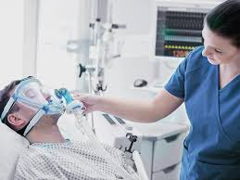
Anatomical causes of difficulties in maintaining airway patency and intubation
The difficulties that can occur during intubation are usually anatomical abnormalities:
short neck,
stiff neck,
receded mandible,
protruding large incisors,
trismus,
small mouth,
large tongue
genetic defect of the palate.

Slide 24
Medical reasons for tracheal intubation
Body weight - Excessive body weight and shortness of breath hinder physical activity, thereby reducing fitness. Obesity reduces quality of life, and patients experience progression of the severity of symptoms of the underlying disease. Dyspnea occurs on exertion, making it difficult to reduce body weight.
Risk factors: worsening COPD, risk of infection and exacerbation of the disease, pneumonia
Assessing the patient's level of difficulty in performing the procedure (risk factors include obesity, pregnancy, head and neck lesions and injuries, restricted mandibular mobility and oral lesions, edentulousness, abnormal occlusion, endocrine disorders, infections
Neck and head mobility
Mandibular mobility
Mandibular retraction

Slide 25
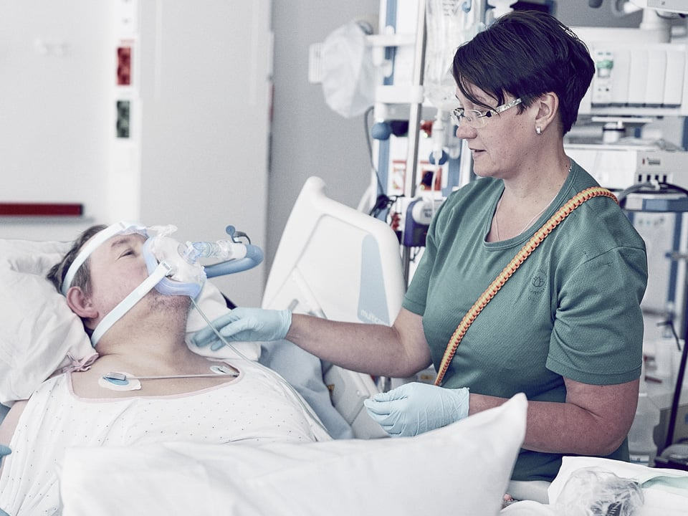
Complications after intubation
Among the most common negative patient feelings after extubation are sore throat, dryness of the mucous membrane and secretions in the airway causing hoarseness, coughing, difficulty swallowing. These are mild complications that usually pass within hours or days after removal of the endotracheal tube. In some cases, however, there are more serious injuries and conditions resulting from an improperly performed procedure or other causes. These include:
Mechanical injuries to the lips and gums, damage to the teeth, palate, larynx or trachea,
Swelling of the glottis, damage to the vocal cords,
Intubation of one main bronchus leading to emphysema and atelectasis,
Esophageal intubation and choking of food contents,
respiratory infections,
Hypoxia or cardiac arrest during intubation.

Slide 26
References
https://swiatzdrowia.pl/artykuly/intubacja-dotchawicza-w-jaki-sposob-sie-odbywa-i-czy-jest-bezpieczna/
https://www.mp.pl/pacjent/badania_zabiegi/150486,badania-czynnosciowe-ukladu-oddechowego
https://www.izbapiel.katowice.pl/attachments/article/5739/Wentylowanie%20mechaniczne%20I.pdf
https://pzp.umw.edu.pl/pdf/2020/10/3/205.pdf
https://www.ptpaio.pl/dokumenty/38.pdf
https://www.izbapiel.katowice.pl/attachments/article/5739/Badanie%20fizykalne.pdf (accessed 01.04.2024)

