Slide 1
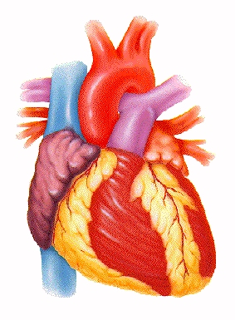
Introduction to the Human Cardiovascular System

Slide 2
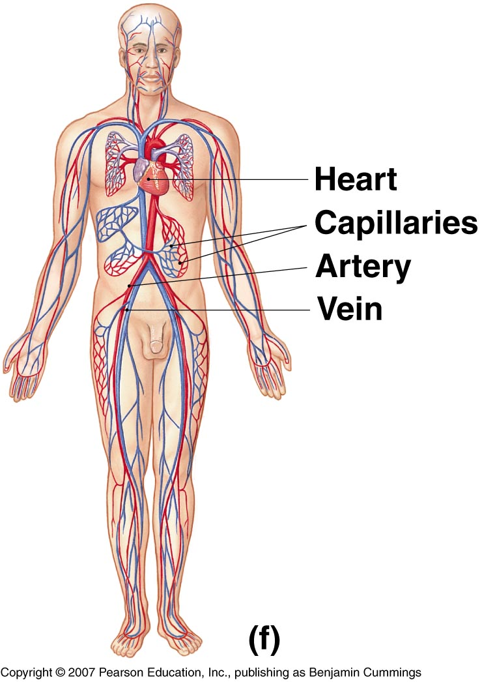
INTRODUCTION
The cardiovascular system is transport system of body
It comprises blood, heart and blood vessels.
The system supplies nutrients to and remove waste products from various tissue of body.
The conveying media is liquid in form of blood which flows in close tubular system.
Figure 1-2(f)

Slide 3
FUNCTION OF CARDIOVASCULAR SYSTEM
Transport nutrients, hormones
Remove waste products
Gaseous exchange
Immunity
Blood vessels transport blood
Carries oxygen and carbon dioxide
Also carries nutrients and wastes
Heart pumps blood through blood vessels

Slide 4
COMPONENTS OF CARDIOVASCULAR SYSTEM
BLOOD
HEART
BLOOD VESSELS

Slide 5
BLOOD
The Blood: Blood cells & Plasma
Blood cells
1- Erythrocytes - Red Blood Cells
2- Leucocytes
3- Thrombocytes
Plasma is fluid portion

Slide 6
HEART
Chapter 18, Cardiovascular System
6
Heart is a four chambered, hollow muscular organ approximately the size of your fist
Location:
Superior surface of diaphragm
Left of the midline
Anterior to the vertebral column, posterior to the sternum

Slide 7
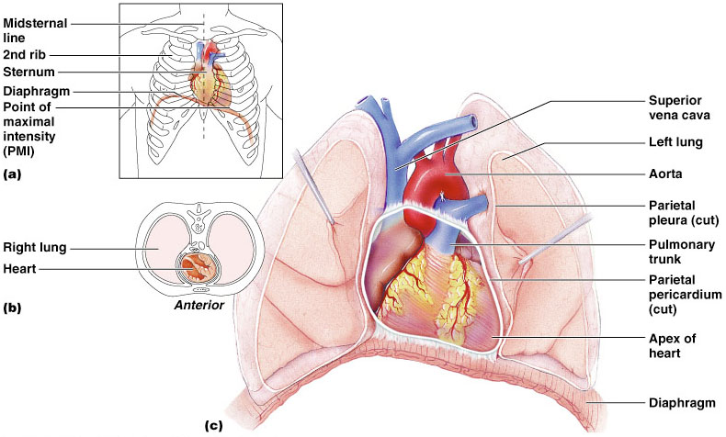
HEART
Chapter 18, Cardiovascular System
Figure 18.1
7

Slide 8
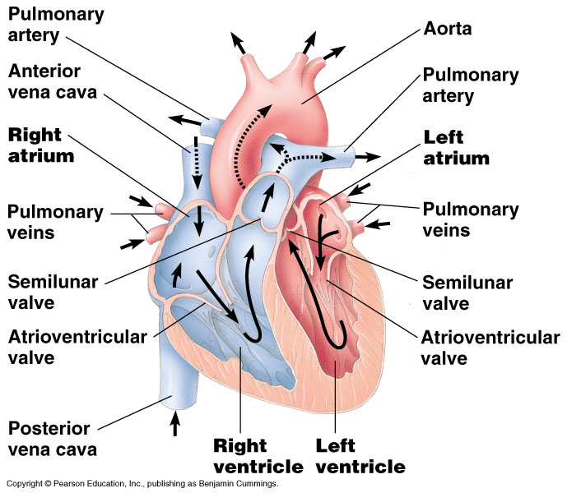

Slide 9
FUNCTIONS OF THE HEART
Generating blood pressure
Routing blood
Heart separates pulmonary and systemic
circulations
Ensuring one-way blood flow
Heart valves ensure one-way flow
Regulating blood supply
Changes in contraction rate and force match
blood delivery to changing metabolic needs

Slide 10
BLOOD VESSELS
Blood Vessels -A closed network of tubes
These includes:
Arteries
Capillaries
Veins

Slide 11
BLOOD VESSELS
-Arteries(Distributing channel)
Thick walled tubes
Elastic Fibers
Circular Smooth Muscle
Capillaries (microscopic vessels)
One cell thick
Serves the Respiratory System
Veins (draining channel)

Slide 12
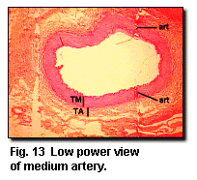
BLOOD VESSELS
General structure
1.Tunica intima
2.Tunica media
3.Tunica adventitia

Slide 13
CLASSIFICATION OF BLOOD VESSELS
Conducting Vessels
Distributing Vessels
Resistance Vessels
Exchange Vessels
Capacitance / Reservoir Vessels

Slide 14
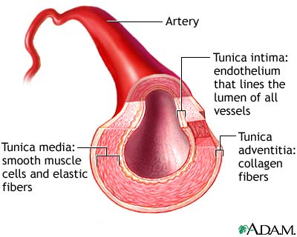
ARTERIES
Blood vessels that carry blood away from the heart are called arteries.
They are the thickest blood vessels and they carry blood high in oxygen known as oxygenated blood (oxygen rich blood).

Slide 15
ARTERIES
Accompanied by vein and nerves
Lumen is small
No valves
Repeated branching

Slide 16
CLASSIFICATION OF ARTEIES
Elastic- e.g. (Aorta & its Major branches)
Muscular -e.g.(Renal, Testicular, Radial, Tibial etc.)
Arterioles (<0.1 mm)-
Terminal arterioles
Meta-arterioles
Thoroughfare
channel/ preferred

Slide 17
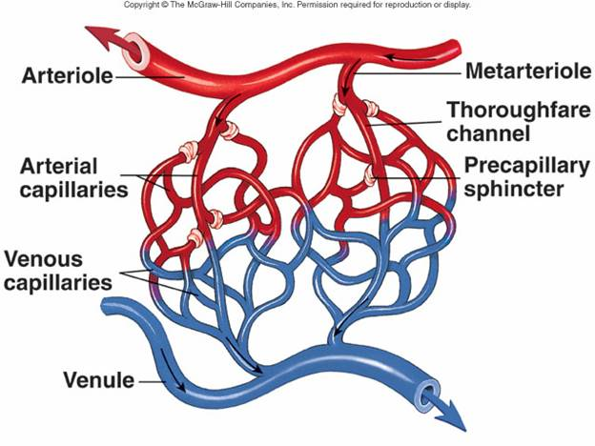
CAPILLARIES (5-8 micron)
The smallest blood vessels are capillaries and they connect the arteries and veins.
This is where the exchange of nutrients and gases occurs.

Slide 18
BODY CONTAINS TWO KINDS OF CAPILLARIES
CONTINUOUS-SKIN, LUNG, SMMOTH MUSCLE, CONNECTIVE TISSUES
FENESTRATED- PANCREAS,ENDOCRINE GLANDS, SMALL INTESTINE,CHOROID PLEXUS,CILLIARY PROCESS etc.

Slide 19
SINUSOIDS
SINUSOIDS- Large irregular vascular space (30-40 micron) eg.Liver, Spleen, Bone marrow, suprarenal, Parathyroid etc.

Slide 20
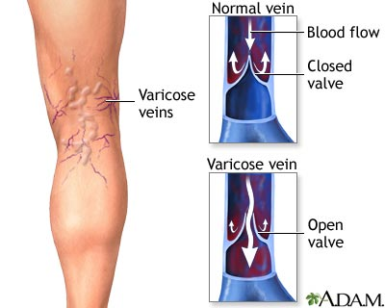
VEINS
Blood vessels that carry blood back to the heart are called veins.
They have one-way valves which prevent blood from flowing backwards.
They carry blood that is high in carbon dioxide known as deoxygenated blood (oxygen poor blood).

Slide 21
VEINS
Thin Walled
Large irregular lumen
Have valves
Dead space around
Types:
Large
Medium
Small

Slide 22
VEINS
Veins without valves:
SVC & IVC
Hepatic, Renal
Uterine, Ovarian not Testicular
Facial
Pulmonary
Umbilical
Emissary
Portal Veins <2mm

Slide 23
VEINS
Veins without Muscular tissue:
Dural venous sinuses
Pial Veins
Retinal
Veins of erectile tissue of sex organs
Veins of spongy bones

Slide 24
VEINS
Factors responsible for venous return:
Muscle contraction
Negative intrathoracic pressure
Pulsation of arteries
Gravity
Valves

Slide 25
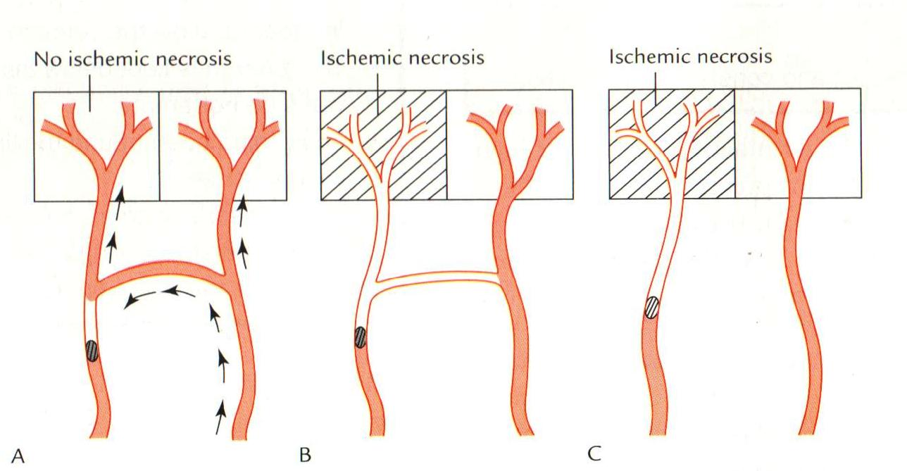
ANASTOMOSIS
Communication between vessels
ARTERIAL:
Actual( end to end & convergent)-Palmar, plantar, Circle of Willis, Labial Intestinal arcade, etc.
Potential-Coronary, around joints etc.

Slide 26
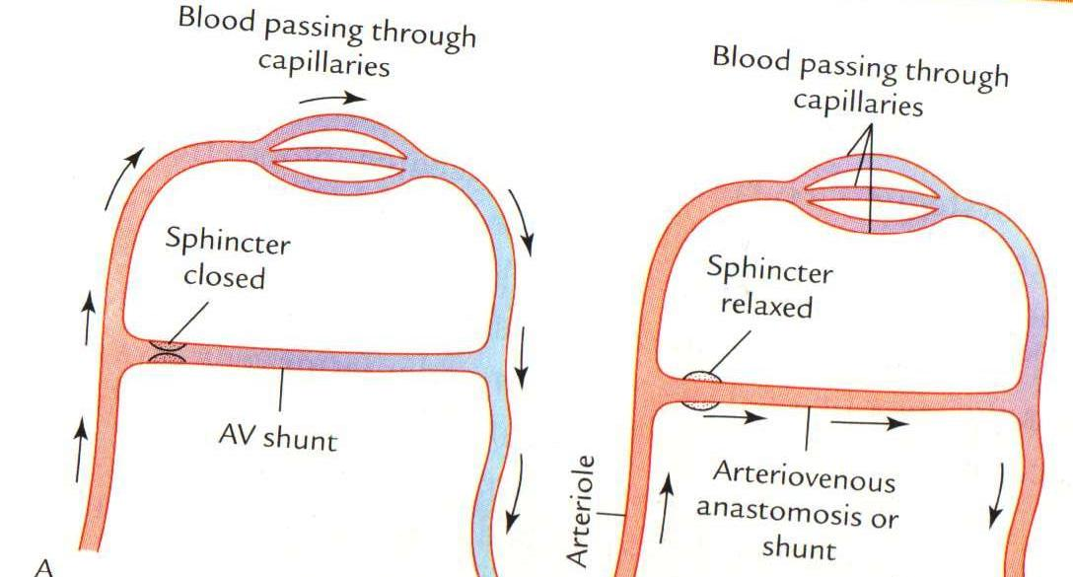
ANASTOMOSIS
ARTERIOVENOUS ANASTOMOSIS:
Skin of nose
Lips
External Ear
Mucus membrane of GI & nose
Erectile tissue of sex organ
Thyroid
Tongue

Slide 27
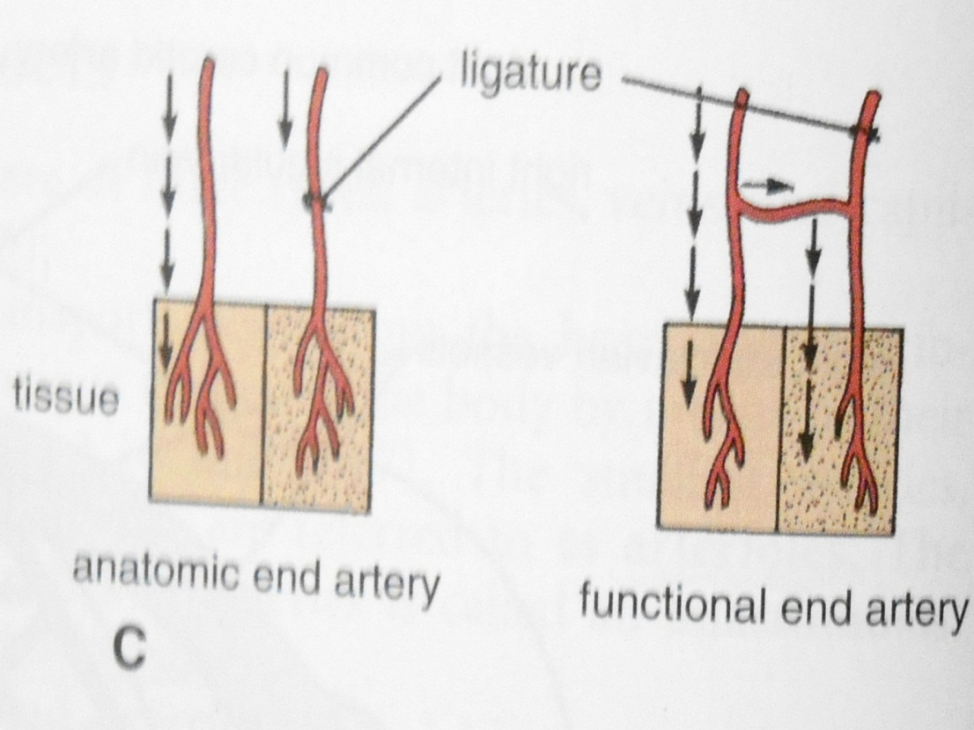
END ARTERIES
END ARTERIES:
Central artery of retina
Arteries of spleen, liver, kidneys, metaphyses of long bones
Central branches of cerebral cortex

Slide 28
CIRCULATION
Coronary circulation – the circulation of blood within the heart.
Pulmonary circulation – the flow of blood between the heart and lungs.
Systemic circulation – the flow of blood between the heart and the cells of the body.
Fetal Circulation

Slide 29
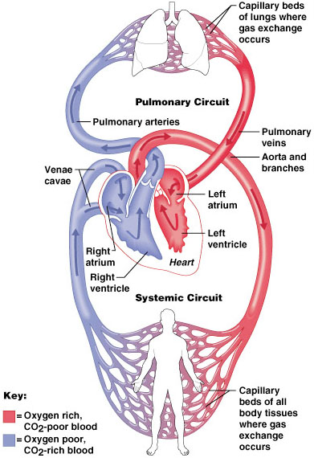
SYSTEMIC AND PULMONARY CIRCULATION
Pulmonary circulation
The flow of blood between the heart and lungs.
Systemic circulation The flow of blood between the heart and the cells of the body.
Chapter 18, Cardiovascular System
Figure 18.5
29

Slide 30
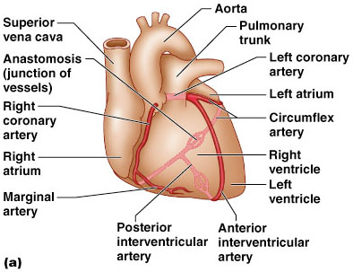
CORONARY CIRCULATION: ARTERIAL SUPPLY
Chapter 18, Cardiovascular System
30
Figure 18.7a

Slide 31
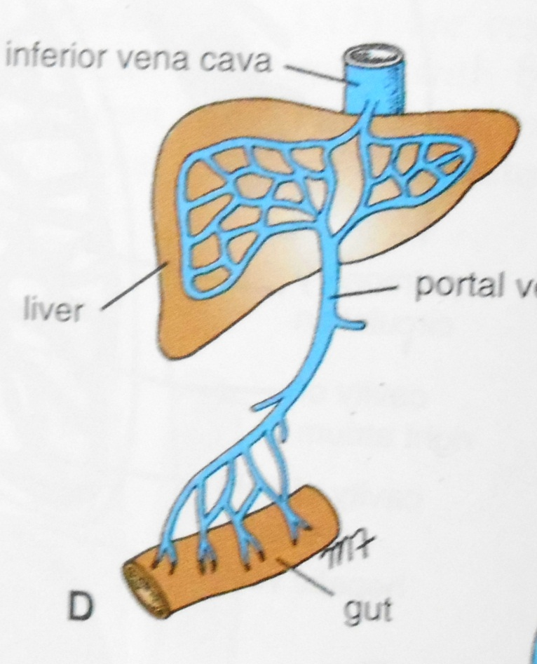
PORTAL CIRCULATION
Portal circulation - the flow of blood between tow set of capillaries before draining in systemic veins.

Slide 32
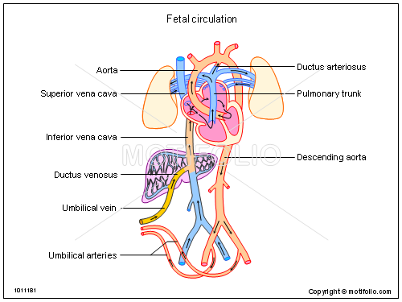
FETAL CIRCULATION

Slide 33
UMBILICAL ARTERY
DESCENDING AORTA
(Through Ductus Arteriosus)
PULMONARY TRUNK
RIGHT VENTRICLE
ASCENDING AORTA
UMBILICAL VEIN
PORTAL VEIN
(Through Ductus Venosus)
INFERIOR VENA CAVA
RIFHT ATRIUM
(Through Foramen Ovale)
LEFT ATRIUM
PLACENTA

Slide 34
APPLIED
Diseases and Disorders
BLOOD PRESSURE
HAEMORRHAGE/STROKE
ARTERIOSCLEROSIS
ANEURYSM
CORONARY ARTERY DISEASE (CAD)
HEART ATTACK
CONGESTIVE HEART FAILURE (CHF)
ANEMIA, HEMOPHILIA, AND LEUKEMIA

Slide 35

APPLIED
Problems with the cardiovascular system are common, but they don’t just affect older people.
Many heart problems affect children and teenagers.

Slide 36
QUESTIONS
1-All of the following are the example of elastic arteries except:
Aorta
Common carotid artery
Subclavian artery
Radial artery

Slide 37
QUESTIONS
2-All of the following are the example of end arteries except:
Central branches of cerebral arteries
Central artery of retina
Facial artery
Splenic artery

Slide 38
QUESTIONS
3-Arteriovenous anastomosis are found at all of the following sites except:
Skin of lips
Erectile tissue of penis
Thyroid gland
Liver

Slide 39
QUESTIONS
4-All of the following are the example of portal circulation except:
Hepatic circulation
Renal circulation
Circulation of hypophysis cerebri
Pulmonary circulation

Slide 40
QUESTIONS
5-All of the following are features of veins except:
Thin walls
Thin tunica media
Thin tunica adventia
Wide lumen

Slide 41
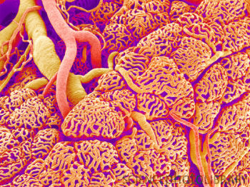
Vessels

Slide 42
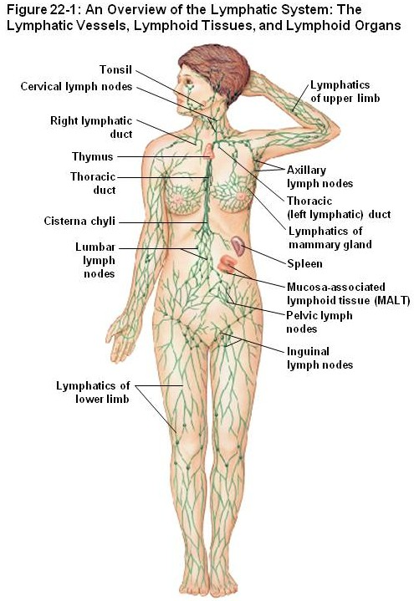
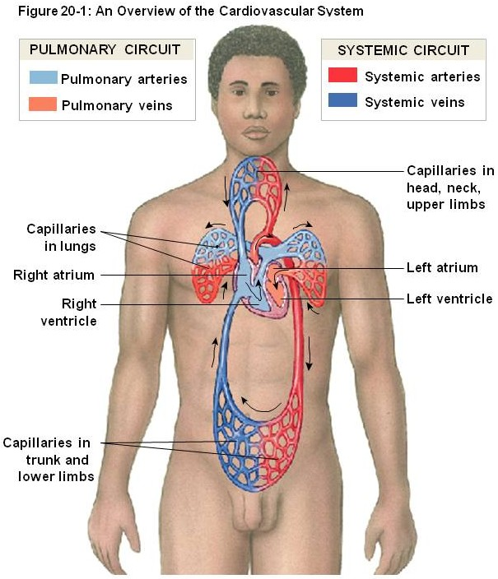
Blood and lymphatic vessels
Vessels in the body transport fluids, either blood or lymphatic fluid, which allows for distribution of nutrients, waste products, hormones, etc. throughout the body. There are two components of the vascular system:
Cardiovascular system – transports blood, and includes the heart, arteries, capillaries, and veins
Lymphatic system – which returns tissue fluid (lymph) from the tissues back to the cardiovascular system

Slide 43
Blood and lymphatic vessels
Both of these systems are essentially a set of tubes, with different characteristics. The contents of these tubes, namely blood and lymph, will be covered elsewhere. Here, we focus on the tubes themselves. However, at this time, we will focus on basic characteristics of arteries, capillaries, veins, and lymphatic channels. More details regarding the histology of the cardiovascular system will be presented in the Cardiovascular and Pulmonary Block.

Slide 44
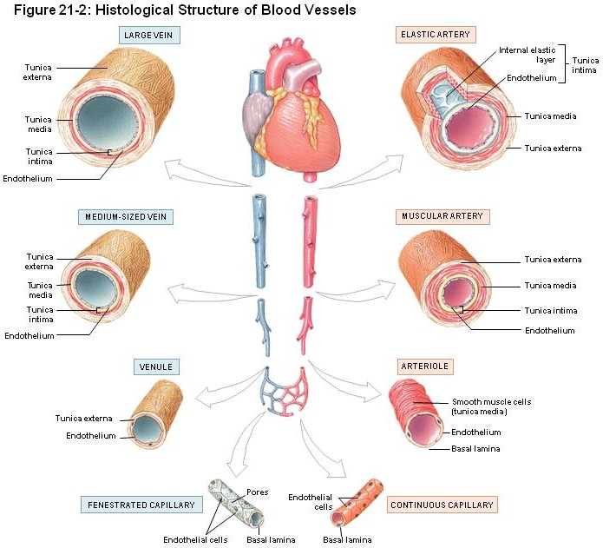
Blood and lymphatic vessels
As mentioned, the details of the different types of arteries and veins will be presented elsewhere. Here, note that vessels have three basic components (from inside to outside):
Tunica intima – a simple squamous epithelium, called the endothelium, with underlying loose connective tissue
Tunica media – a thicker layer with smooth muscle and elastic fibers
Tunica externa (adventitia) – dense connective tissue

Slide 45
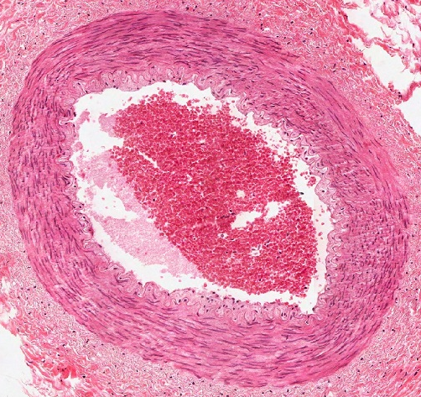
Blood and lymphatic vessels
In this cross section of a blood vessel, the blood in the lumen is indicated. The double-arrow indicates the extent of the tunica media; you should recognize the smooth muscle tissue that is predominant in this region. The smooth muscle cells are circularly arranged; in other words, the cells lie perpendicular to the long axis of the vessels.
The thin portion of the wall “inside” the tunica media is the tunica intima, while the dense irregular connective tissue surrounding the tunica media is the adventitia.
blood

Slide 46

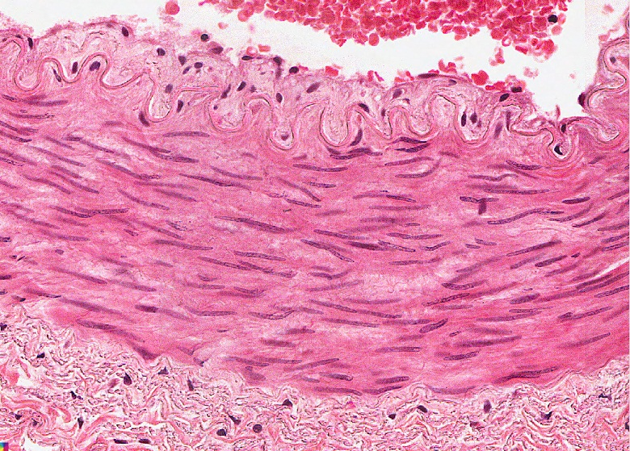
Blood and lymphatic vessels
In the higher-powered image, it is easier to see the tunica intima (green double-arrow), tunica media (black double-arrow) and adventitia (blue double arrow). Arrows indicate nuclei of endothelial cells that form the inner lining of vessels.
blood
The border between the intima and media (yellow dotted line) is indeed wavy here; we’ll address this in detail later.

Slide 47
Blood and lymphatic vessels
In this overview, we will focus on a few key differentiating features of vessels:
The major histological difference between arteries and veins lies in the thickness and muscularity of the tunica media; arteries have a thicker, more muscular tunica media
Capillaries are composed simply of endothelial cells, without a tunica media or adventitia
Lymphatic vessels have an even less-developed tunica media, and the smallest lymphatic vessels have valves

Slide 48
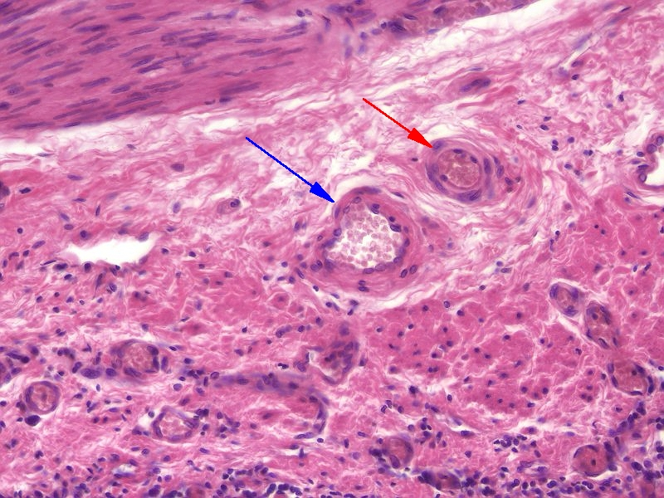
Blood and lymphatic vessels
Histologically, differentiating between arteries/arterioles (red arrow) and veins/venules (blue arrow) is best done by comparing vessels of approximately the same size. Arteries have a thicker smooth muscle layer in their wall; therefore, their wall is relatively thicker compared to the size of the vessel itself, with a narrower lumen. In addition, arteries tend to be rounder. Both will typically contain blood cells in their lumen, though during tissue preparation they can be washed away (see vessel toward the left) and become trapped in inappropriate locations.
Arterioles are smaller arteries; venules are smaller veins.

Slide 49
Blood and lymphatic vessels
Higher-powered view of the same vessels…
All blood vessels are lined by a simple squamous epithelium, referred to as an endothelium. Endothelial cells have flattened nuclei (black arrows). The “fatter” nuclei in the wall of the vessel (green arrow), particularly in the artery, belong to smooth muscle cells.

Slide 50
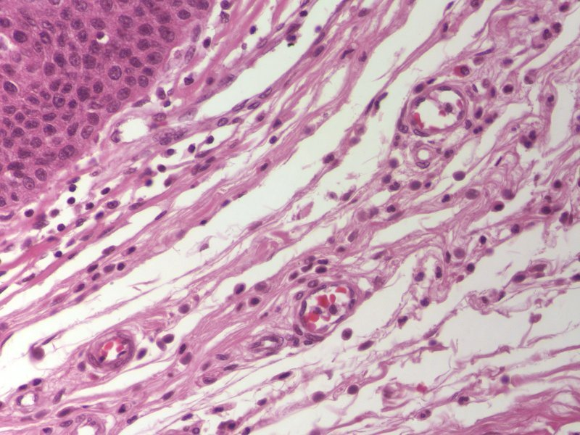
Blood and lymphatic vessels
Capillaries are very thin-walled, small vessels; they consist mostly of the endothelial cells. Because of this, they are difficult to find and identify definitively. Possible candidates for capillaries are indicated by the arrows, though the left is likely a small venule, and the right a small arteriole.

Slide 51
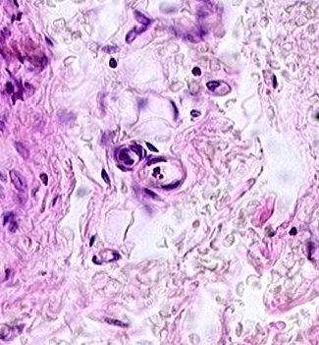
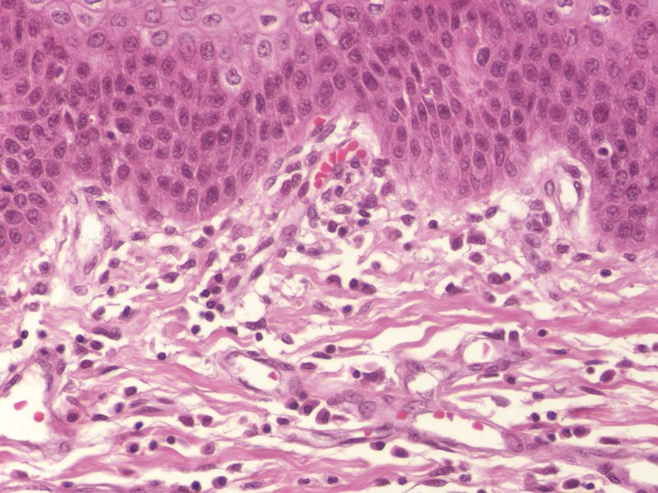
Blood and lymphatic vessels
A couple more examples of capillaries. In the left image, note the simple squamous endothelial cells that make up the wall, and a diameter that is approximately the size of a red blood cell (possible RBC in upper capillary). To the right is a longitudinal section through a capillary (green arrows).

Slide 52
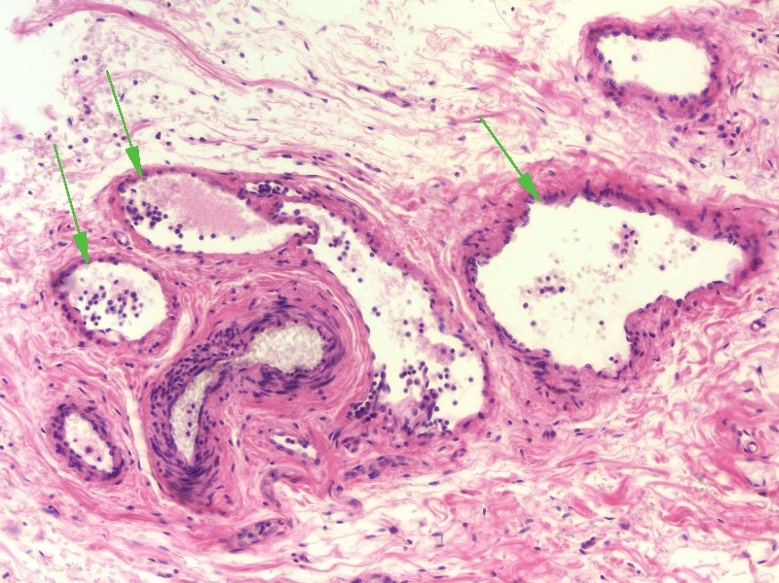
Blood and lymphatic vessels
Lymphatic vessels (green arrows) typically have even thinner walls than veins, although these examples show relatively thick walls. However, small lymphatic vessels in tissues have numerous valves. In addition, they are typically devoid of red blood cells, and are filled with a “colloid” from precipitated lymph fluid as well as white blood cells.
Yes, veins have valves too, but not in the smallest veins in the wall of an organ like we are looking at now.
artery

Slide 53
Blood and lymphatic vessels
Enlarged portion of previous image. If you look VERY closely in the artery, you might see that the pink disks are red blood cells, whereas the pink in the lymph vessels isn’t cellular.
In addition, note the much greater proportion of white blood cells in the lymphatic vessels (green arrows) compared to the artery.
artery

Slide 54
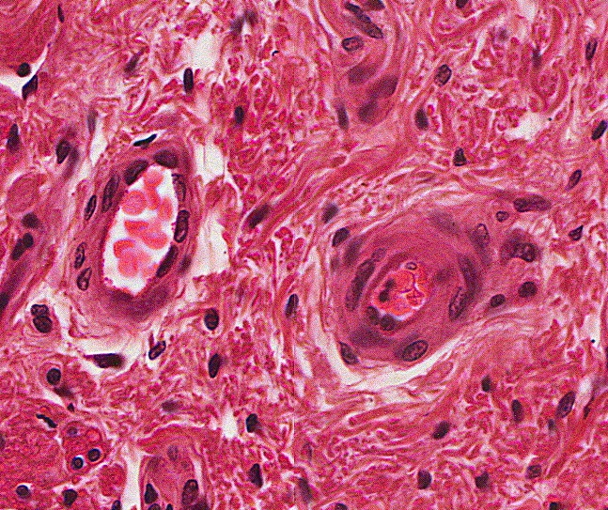
Final quiz
Self-check: Identify the outlined structures. (advance slide for answer)
Artery / areteriole

Slide 55
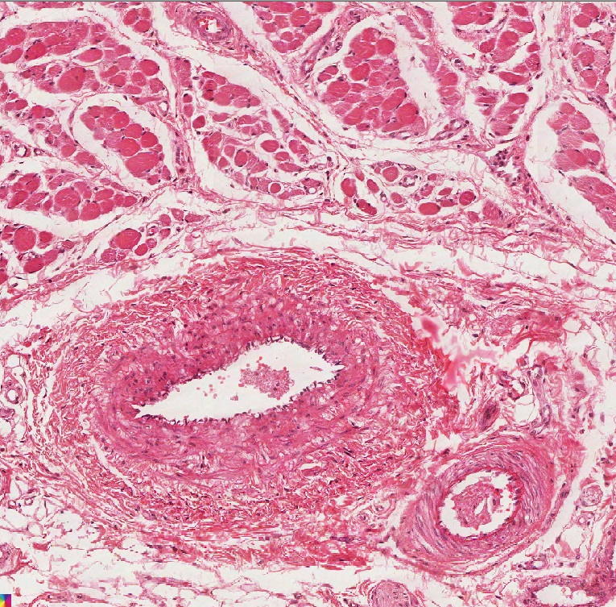
Final quiz
Self-check: Identify the outlined structure (advance slide for answer)
vein

Slide 56
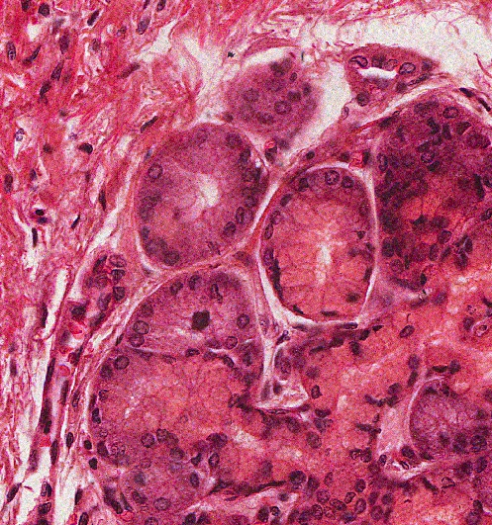
Final quiz
Self-check: Identify the outlined structure (advance slide for answer)
Serous gland

Slide 57
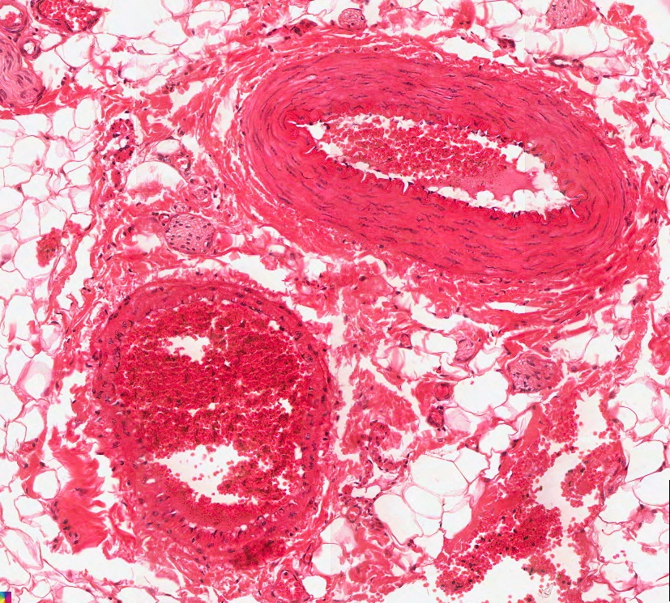
Final quiz
Self-check: Identify the outlined structure (advance slide for answer)
vein

Slide 58
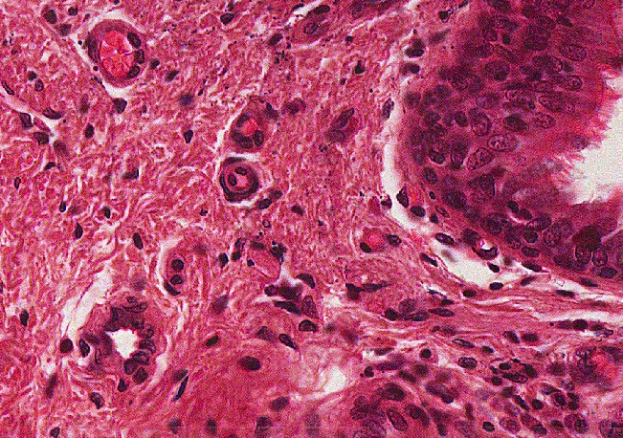
Final quiz
Self-check: Identify the structure indicated by the arrows(advance slide for answer)
arteriole

Slide 59
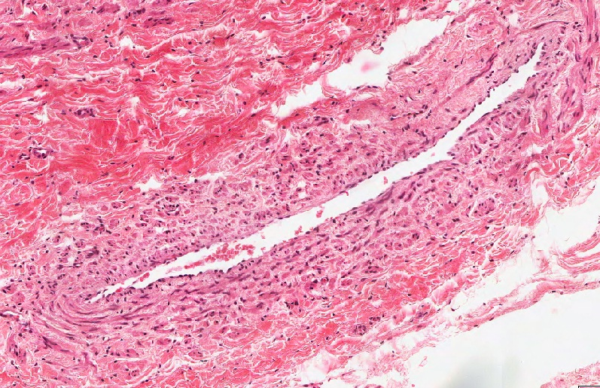
Final quiz
Self-check: Identify the outlined structure. (advance slide for answer)
vein

Slide 60
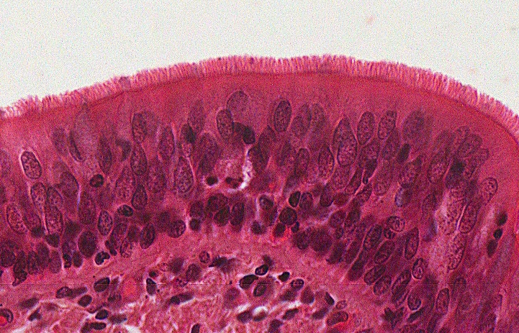
Final quiz
Self-check: Identify the predominant tissue on this slide. (advance slide for answer)
Pseudostratified ciliated columnar epithelium (with goblet cells)
That sure is one good-looking epithelium; the cilia are fine.

Slide 61
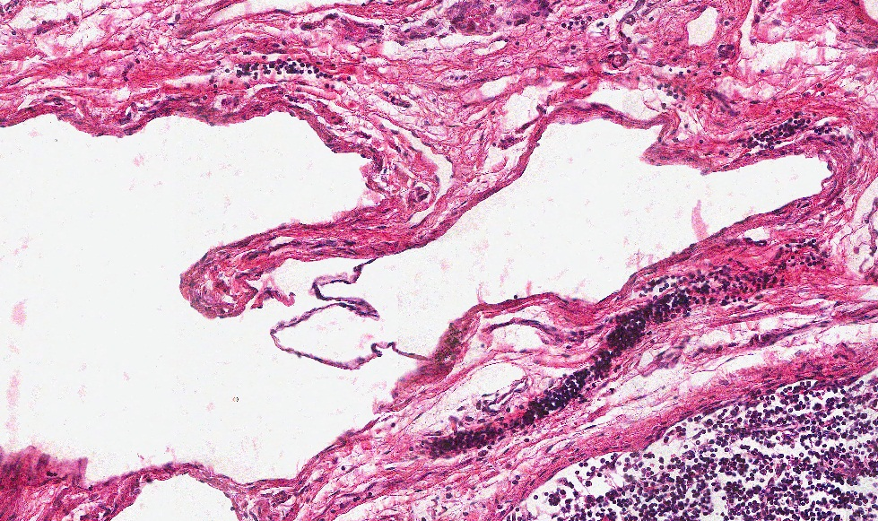
Final quiz
Self-check: Identify the outlined structure (advance slide for answer)
Lymphatic vessel

Slide 62
Final quiz
Self-check: Identify the structure indicated by the arrows (advance slide for answer)
Capillary

Slide 63
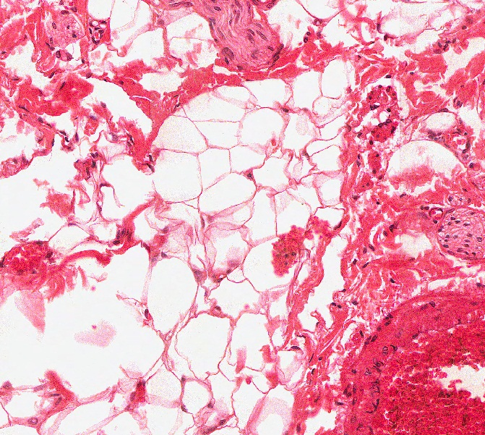
Final quiz
Self-check: Identify the predominant tissue in the outlined region (advance slide for answer)
Unilocular adipose

Slide 64
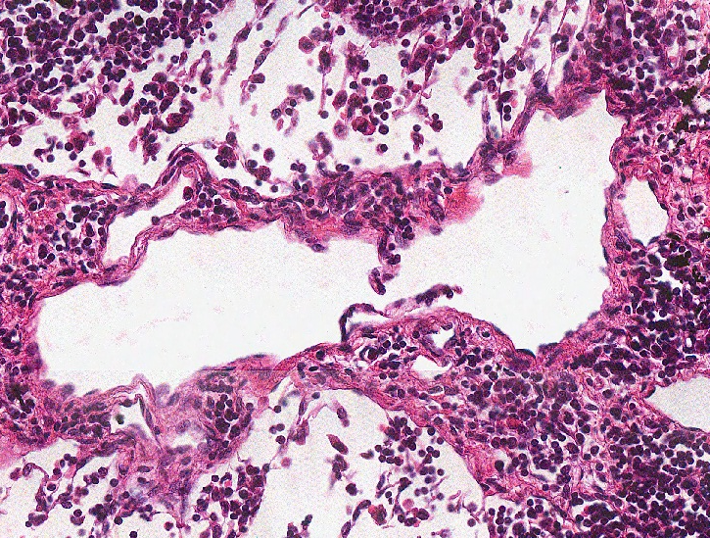
Final quiz
Self-check: Identify the outlined structure (advance slide for answer)
Lymphatic vessel

Slide 65
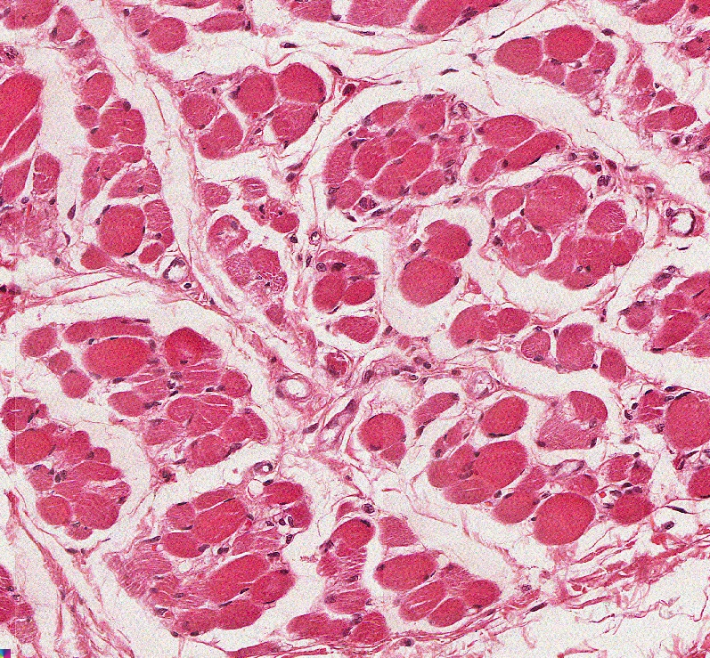
Final quiz
Self-check: Identify the predominant tissue on this slide (advance slide for answer)
Skeletal muscle

Slide 66
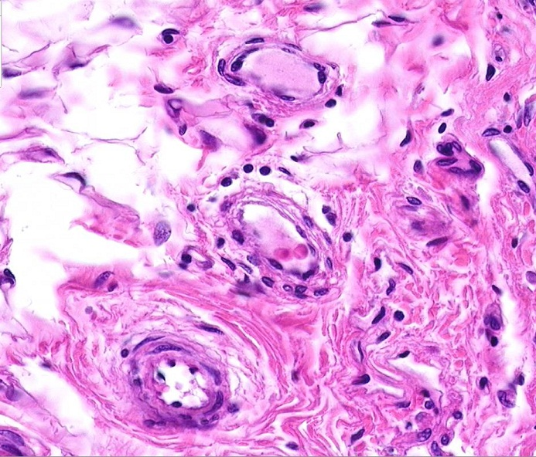
Final quiz
Self-check: Identify the outlined structures. (advance slide for answer)
lymphatic vessel
Vein/venule
Artery/arteriole

Slide 67
Final quiz
Self-check: Identify the outlined structures. (advance slide for answer)
vein / venule

Slide 68
Final quiz
Self-check: Identify the outlined structure (advance slide for answer)
artery

Slide 69
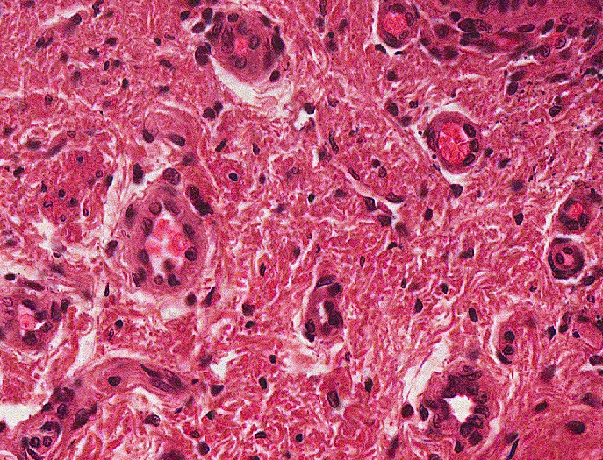
Final quiz
Self-check: Identify the structure indicated by the arrows(advance slide for answer)
venule

Slide 70
Final quiz
Self-check: Identify the outlined structure (advance slide for answer)
Artery

Slide 71
Final quiz
Self-check: Identify the outlined structure (advance slide for answer)
mucous gland (with serous demilune)

Slide 72
ACUTE CIRCULATORY FAILURE AND CARDIOGENIC SHOCK

Slide 73
DEFINITION
Shock occurs when the rate of arterial blood flow is in adequate to meet tissue metabolic needs, this results is regional hypoxia, and lactic acidosis, then eventual end organ damage and death.

Slide 74
Essentials of diagnosis
Hypotension, tachycardia, oliguria, altered mental status, cool clammy skin.
Peripheral hypoperfusion

Slide 75
CLASSIFICATION OF SHOCK
Hypovolemic : decreased intravascular volume (blood loss, dehydration, burn)
Cardiogenic: inability of heart to maintain tissue perfusion due to decreased cardiac output with adequate intravascular volume(acute MI, CMP, acute valvuler lesions, arrhythmias, myocardial contusion)

Slide 76
Obstructive : acute decrease in cardiac output (tamponade, pneumothorax, pulmonary embolism)
Distributive :reduction in systemic vascular resistance causing inadequate cardiac output in spite of normal intravascular volume (septic shock, anaphylactic shock, neurogenic shock)

Slide 77
SYMPTOMS AND SIGNS
Hypotension, weak or thready peripheral pulses, cold or mottled extremities.
Splanchnic vasoconstriction may lead to oliguria, bowel ischemia, and hepatic dysfunction.
Mentation may be normal or altered (restlessness, agitation, confusion, lethargy, or coma).

Slide 78
Hypovolemic shock
Low JVP
Narrow pulse pressure from reduced stroke volume

Slide 79
Cardiogenic shock
Elevated JVP
Global hypoperfusion with oliguria, altered mental status, cool extremities.
Pulmonary edema if there is left sided heart failure

Slide 80
Obstructive shock
Central venous pressure (CVP) may be elevated.
Signs of causative disease.

Slide 81
Distributive shock
Hyperdynamic heart sounds.
Worm extremities
Wide pulse pressure
(Due to large stroke volume)
Causes for distributive shock
Septic shock : evidence of infection and organ hypoperfusion ( lactic acidosis, oliguria, altered mental status) despite adequate volume resuscitation

Slide 82
2. Anaphylactic shock
Evidence of allergen exposure ( injected, ingested, contact, inhaled).
3. Neurogenic shock
Evidence of CNS injury and hypotension despite volume resuscitation.
4. Acute adrenal insufficiency
Hypocortisolism

Slide 83
LABORATORY TESTS
Complete blood count
Serum electrolytes
Glucose
Cardiac enzymes and b nitrouretric peptides (BNP)
Lactate
Coagulation parameters
Type and cross match
Arterial blood gas determination
Blood cultures

Slide 84
IMAGING STUDIES
CXR
Echo
transthoracic TTE
and transesophageal echoTEE

Slide 85
DIAGNOSTIC PROCEDURES
ECG
Arterial line placement (for bp and arterial oxygen monitoring )
Foley catheter for uop monitoring
Pulmonary artery catheter can distinguish cardiogenic from septic and monitor effect of volume resuscitation or pressure medication
CVP line and measurement can suggest volume status

Slide 86
Cardiac index is often low in cardiogenic shock and high in septic shock
SVR is often low in septic and neurogenic shock and high in cardiogenic and hypovolemic shock.

Slide 87
MANAGEMENT OF SHOCK

Slide 88
General measures
Prompt diagnosis
Basic life support with assessment of circulation , airway and breathing.
Airway intubation and mechanical ventilation (ventilatory failure should be anticipated in patient with shock and severe metabolic acidosis).
Intravenous access and fluid resuscitation with cardiac monitoring

Slide 89
Cardiac monitoring to detect myocardial ischemia or malignant arrhythmias, and treated with standard ACLS (advanced cardiac life support) protocols .
Check glucose level and treat hypoglycemia immediately with 50% dextrose IV
Place arterial line.
Place folly catheter to monitor UOP

Slide 90
Central venous pressure
Placement of central venous catheter(CVC)
for infusion of fluid and medication.
for hemodynamic pressure measurement CVP
CVP less than 5 mmhg suggest hypovolemia,
more than18 mmhg suggest fluid overload,
cardiac failure, tamponade or pulmonary
hypertension.
for central venous oxygen saturation

Slide 91
Pulmonary artery catheters (PACs)
measurement of pulmonary artery pressure.
left sided filling pressure or pulmonary capillary wedge pressure (PCWP)
measure cardiac opt and mixed venous o2 s

Slide 92
Aim of treatment
to maintain
* CVP 8-12 mmhg
* mean arterial bp 65 mmhg or more
* cardiac index of 2-4 L/min/m²
* ScvO₂ greater than 70%

Slide 93
Volume replacement
Hemorrhagic shock : rapid infusion of blood component
Hypovolemic shock: rapid boluses of isotonic crystalloid (0.9 % saline or ringer lactate) in 1 L increments
Cardiogenic shock : smaller fluid challenges in the absence of fluid overload with 250 ml increments
Septic shock : requires large volume of fluid for resuscitation, usually more than 2 L

Slide 94
MEDICATIONES

Slide 95
1. Vasoactive therapy (vasopressors and inotropics)
only administered after adequate fluid resuscitation
if hypotension with high cardiac output use vasopressor, if low cardiac opt with high filling pressures use inotrops
Norepinephrine (alpha and beta agonist)
initial dose 1-2 mcg/min IV infusion, maintenance 2-4 mcg/min, up to 10-30 mcg/min
mainly used for vasodilatory shock, but can be used in all causes

Slide 96
Epinephrine (alpha and beta agonist )
used in severe shock and acute resuscitaion, it is vasopressor of choice in anaphylactic shock
Dose initially 1 mcg/min iv infusion, then titrate to 1-10 mcg/min.
Dopamine action according to dose
- low dose (2-5 mcg/kg/min) dopamenergic
effect increasing GFR and urine out put
- medium dose 5-10 mcg/kg/min, has beta1
adrenergic effect, increasing HR &contractility,
and increase uop
- high dose more than 10 mcg/kg/min has alpha
effect lead to peripheral vasoconstriction
max 50mcg/kg/min

Slide 97
Phenylephrine first line hyperdynamic septic shock
Dobutamine (predominantly beta agonist)
increase contractility and decrease afterload
used for patient with low cardiac output and
high PCWP, but without hypotension
initial dose is 0.1-0.5mcg/kg/min IV infusion
usual dose is 2-20 mcg/kg/min

Slide 98
Amrinone or milrinone (phosphodiesterase inhibitors) can be substituted for dobutamine.
Vasopressin (ADH) for distributive or vasodilatory shock, also in sepsis if 2 drugs needed

Slide 99
2. Corticosteroids
For shock secondary to adrenal insufficiency
3. Antibiotics
empiric broad spectrum antibiotics for septic shock after obtaining appropriate cultures.
4. Correction of acidosis by sodium bicarbonate

Slide 100
SURGERY AND OTHER TREATMENT MODALITIES

Slide 101
For cardiac failure
Transcutaneous or transvenous pacing
Placement of intra- arterial balloon bumps.
Revascularization by percutaneous
angioplasty (PCI),or coronary artery bypass
surgery (CABG)

Slide 102
Pericardiocentesis . chest tube. Catheter – directed thrombolytic therapy for obstructive shock
Urgent hemodialysis or hemofiltration for acute kidney injury

Slide 103
Hemodynamic Disorders

Slide 104
Fluid Distribution
~60% of lean body weight is water
~2/3 is intracellular
~1/3 is extracellular (mostly interstitial)
~5% of total body water is in blood plasma

Slide 105
Edema
Edema is defined as increased fluid in interstitial tissue space.
Hydrothorax is edema in the thoracic cavity. Hydropericardium is edema in the pericardial cavity, and hydroperitoneum is edema in the peritoneum.

Slide 106
Mechanisms and Causes
Increased hydrostatic pressure
Can be localized as in limbs eg. Deep vein thrombosis DVT
Can be generalized as in heart failure.
Decreased osmotic pressure
Common causes: liver cirrhosis, nephritic syndrome and malnutrition

Slide 107
Lymphatic obstruction
As in elephantiasis or obstruction by malignancy or following surgery and radiation therapy.
Sodium retention
As in excessive salt intake in renal insufficiency, or increased rennin-angiotensin-aldosterone system.
Inflammation

Slide 108
Common sites of edema
Subcutaneous edema: occurs in heart failure in the dependent part of the body eg. Legs and sacral area (dependent edema, or pitting edema)
Pulmonary edema: is accumulation of fluid in the alveolar space. It occurs in heart failure (Left side failure). It can occur with renal failure or pulmonary infection.
Brain edema:
Localized: in abscess or around tumors
Generalized: in encephalitis, hypertensive crisis

Slide 109
Hyperemia and Congestion
It is local increase in the volume of blood in tissues. Hyperemia is an active process eg. Increase blood to skeletal muscle during exercise , while congestion is passive eg. Heart failure.
Congestion is commonly associated with edema.

Slide 110
Common sites of congestion
Pulmonary congestion
Liver congestion

Slide 111
Circulatory shock
Shock is a clinical condition of reduced blood flow to organs and tissues.
Shock may be classified into three main categories based upon the cause of the shock. These categories of shock are:
- distributive shock
- cardiogenic shock
- hypovolemic shock.

Slide 112
Types of shock
Type of Shock | Clinical Examples | Principal Mechanisms
Cardiogenic | Heart failure Myocardial infarction Cardiomyopathy Cardiac tamponade Pneumothorax | Shock that occurs when the heart is unable to maintain normal cardiac output
Distributive shock | Can be - Neurogenic shock - Septic shock - Anaphylactic shock | Shock that occurs as a result of marked vasodilation and loss of vascular tone

Slide 113
Type of Shock | Clinical Examples | Principal Mechanisms
Hypovolemic | - Hemorrhage Fluid loss, e,g., vomiting, diarrhea , burns, or trauma - Shifting of fluids from the vasculature to the interstitial spaces (ascites) | Inadequate blood or plasma volume

Slide 114
Distributive shock
- Neurogenic shock
Caused by a defect in sympathetic input to the blood vessels
May be caused by brain injury, central nervous system depressant drugs or spinal cord injury

Slide 115
- Septic shock
Occurs most frequently with systemic infection by bacteria
May be triggered by an immune response to bacterial endotoxins
Widespread vasodilation occurs in response to the release of inflammatory mediators (examples: histamine, cytokines) and bacterial toxins

Slide 116
- Anaphylactic shock
Triggered by an allergic reaction to antigens such as drugs, food, insect venom, etc.
Develops suddenly and manifests with marked vasodilation, bronchospasm and hypotension
May be rapidly fatal

Slide 117
Physiologic responses to shock
Decreased blood pressure is detected by baroreceptors (pressure sensors) in the aortic arch and carotid arteries. Activated baroreceptors stimulate a centrally mediated increase in heart rate and cardiac output.
The catecholamines epinephrine and norepinephrine are also released by the adrenal medulla to increase peripheral resistance, heart rate and cardiac output.

Slide 118
Reduced renal blood flow will also lead to activation of the renin–angiotensin system with subsequent vasoconstriction and fluid retention.
Up to a certain point, these compensatory mechanisms are able to maintain blood pressure and cardiac output; however, as shock progresses these compensatory mechanisms are no longer able to maintain adequate blood pressure and as a result tissue and organ perfusion will suffer.

Slide 119
Stages of shock
Mild or compensated shock
Blood volume loss less than 25% of total volume
Slight reductions in blood pressure
Moderate or progressive shock
Blood volume loss on the order of 25 to 35% of total
Failure of compensatory mechanisms to adequately maintain cardiac output

Slide 120
Severe or irreversible shock
Loss of blood volume that may approach 50%
Shock irreversible at this point
Death from circulatory collapse

Slide 121
Complications of shock
Adult respiratory distress syndrome (shock lung) – potentially fatal respiratory failure that accompanies severe shock. The exact cause is uncertain but the condition may involve ischemic injury to lung tissues.
Acute renal failure due to reduced renal perfusion.

Slide 122
Disseminated intravascular coagulation
Formation of multiple small blood clots that may be related to sluggish blood flow or abnormal clotting activity.
- Multiple organ failure, cerebral hypoxia, death.

Slide 123
Rationale for therapy
The underlying cause of the shock must be corrected if possible. Plasma volume must also be restored through the administration of fluids, plasma or blood. Drugs that affect vascular tone or cardiac output may also be of value.

Slide 124
Treatment of shock
Administration of intravenous fluids; possible incorporation of plasma expanders such as dextran and albumin
Maintenance of airways, mechanical ventilation
Administration of packed red cells for hemorrhagic shock

Slide 125
Vasoactive drugs such as dopamine that causes vasoconstriction to skin and muscle while increasing blood flow to vital organs
Vasodilator drugs such as nitroprusside that may be useful for relieving workload on the heart in cases of cardiogenic shock

Slide 126
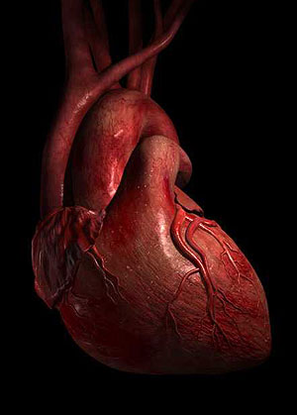
Hemodynamic Monitoring

Slide 127


Slide 128
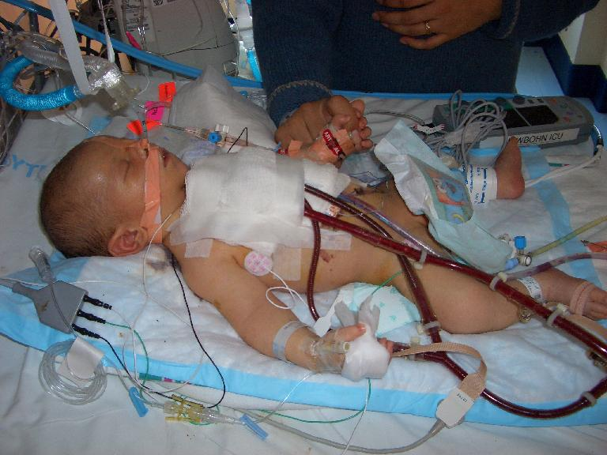

Slide 129
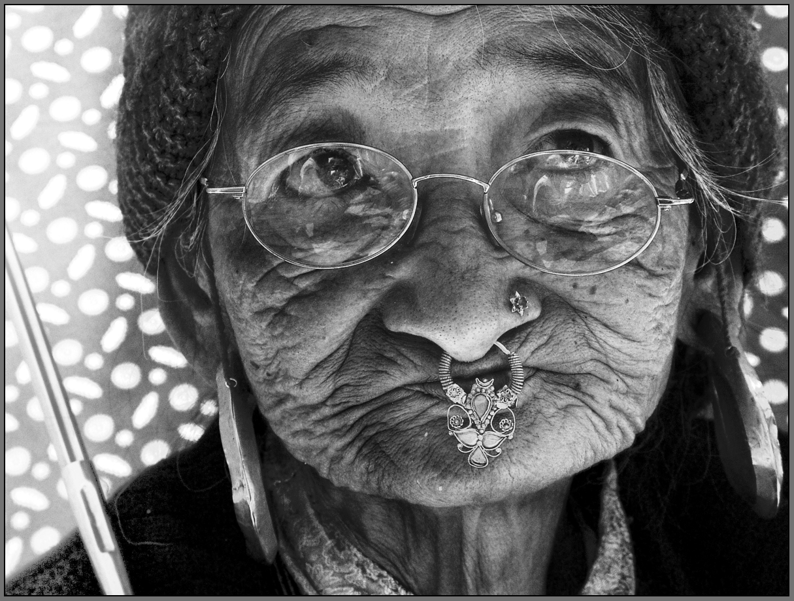
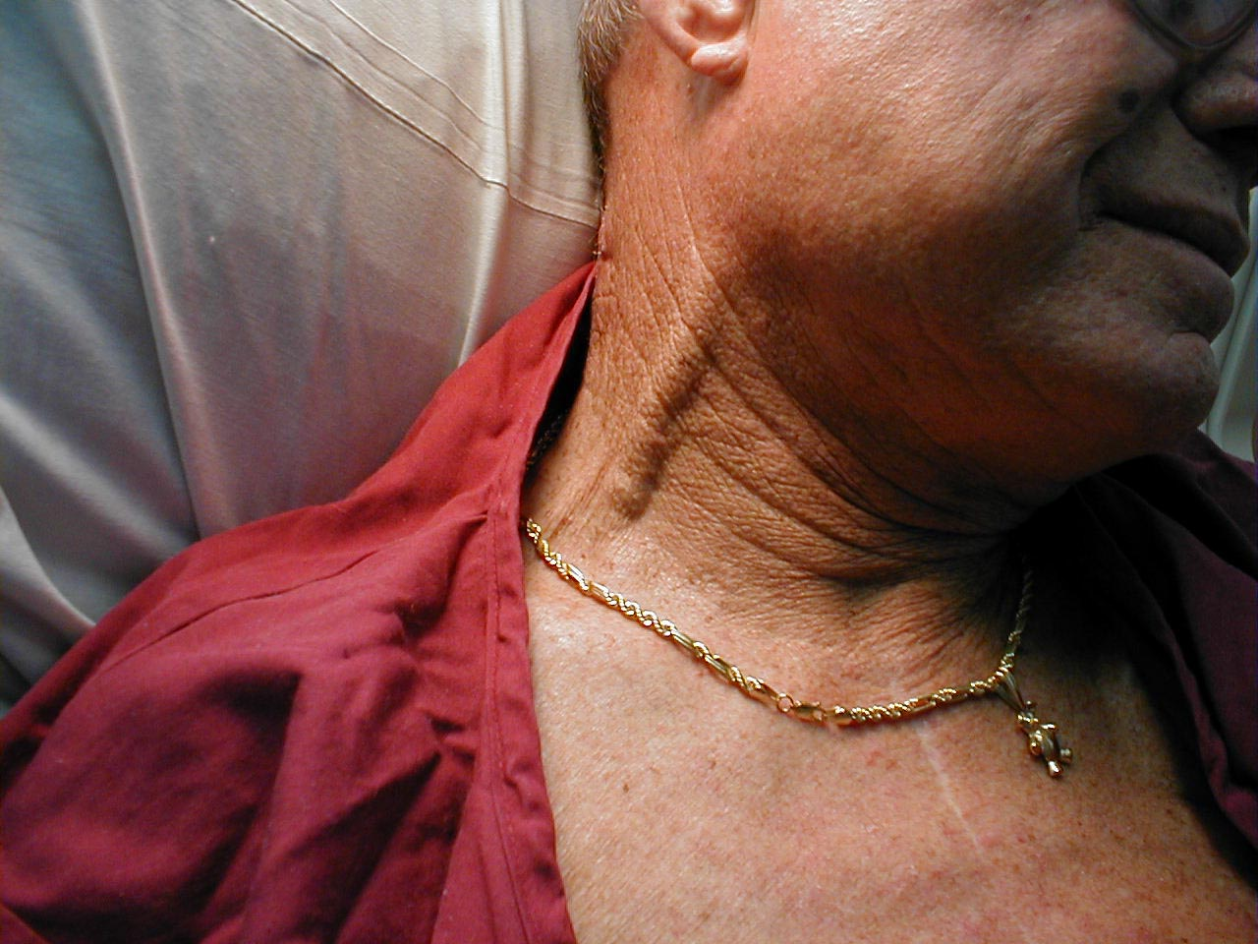
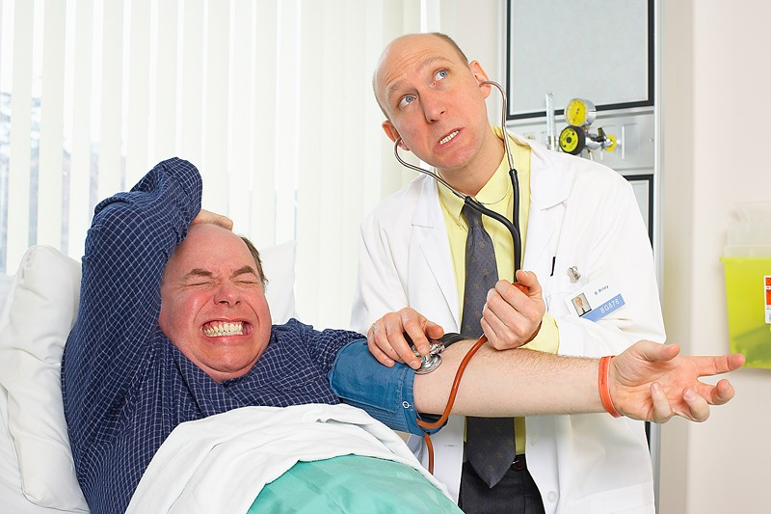
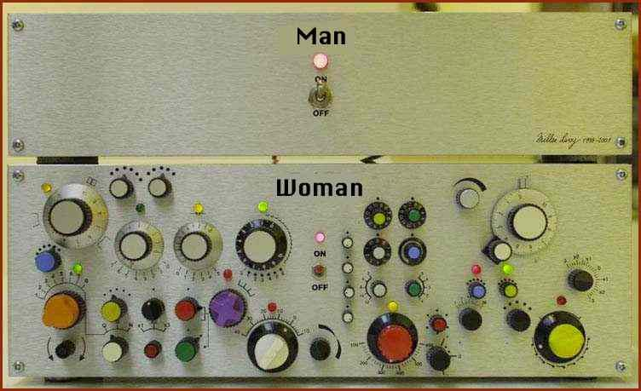
Bedside Assessment
Most difficult and yet vitally important
Cardiac performance and ventricular preload
Traditional clinical signs not reliable in ICU
Blood pressure
Jugular venous distention
Skin perfusion
Skin tugor

Slide 130
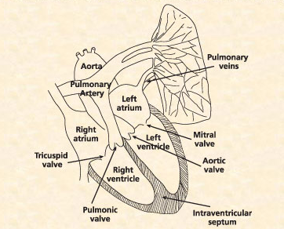
Anatomy of the Heart

Slide 131
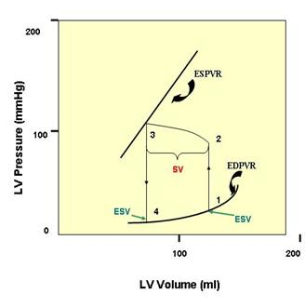
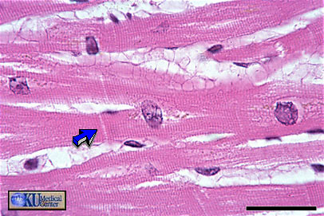
Frank-Starling principle
Cardiac contraction relates directly to muscle fiber length at end-diastole
Presystolic fiber stretch, or preload, is proportionate to end-diastolic volume
Left ventricle end-diastolic volume (pre-load) major factor determining cardiac output

Slide 132
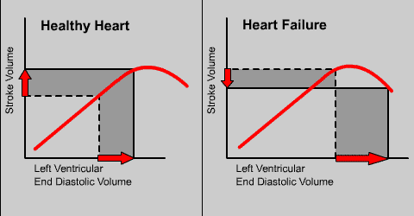

Slide 133
SVV/PPV – Volume demand predicted
Volume Responsiveness = CO increase by preload increase
SV
∆ SV₂
SVV > 10%
PPV > 13%
SVV 0-10% PPV 0-13%
∆ SV₁
∆ EDV₁
∆ EDV₂
EDV
Frank-Starling curve

Slide 134
Preload – direct correlation of preload and CO
CI (l/min/m²)
7.5
5.0
Inotropic drugs
2.5
Preload increased / Volume recruitment
200
400
600
800
1000
1200
1400
GEDI (ml/m²)
Frank-Starling curve
Volume substitution increases cardiac output to the maximum
After preload optimization further increase is only possible by an increase of the contractility by inotropic drugs
Notes:
Die Animation dieser Folie bitte in die vorherige einbauen; zusätzlich sollte auch auf der Vorlast-Achse der Schnittpunkt animiert werden.

Slide 135
Cardiac Factors
Ohm’s Law :
Blood pressure = Cardiac Output x systemic vascular resistance
Cardiac Output
Stroke Volume
Preload
Afterload
Myocardial contractility
Heart Rate

Slide 136
Oxygen delivery
DO2 = Hb x Sat x CO x 1,34
O2 Delivery
Hemoglobin
1,34
Cardiac output
Saturation

Slide 137
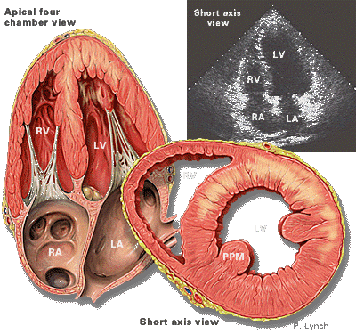
Preload:
Preload is the muscle length prior to contractility.
It is dependent of ventricular filling (end diastolic volume.)
The most important determining factor for preload is venous return.

Slide 138


Afterload:
(Total peripheral resistance or systemic vascular resistance)
It is the tension (arterial pressure) against which the ventricle must contract.
If arterial pressure increases, afterload also increases.
Afterload for the left ventricle is determined by aortic pressure,
Afterload for the right ventricle is determined by pulmonary artery pressure.

Slide 139

Contractility:
Contractility is the intrinsic ability of cardiac muscle to develop force for a given muscle length. It is also referred to as inotropism

Slide 140
Core hemodinamic variables
Assesses
Pump performance
Blood flow
Right heart filling P
Left heart filling P
Tissue oxygenation
Variable
Stroke volume
Cardiac index
CVP
PAWP
SvO2

Slide 141
Measured Hemodynamic Variables
Variable | Unit | Normal Range
Systolic Blood Pressure (SBP) Diastolic Blood Pressure (DBP) Pulmonary Artery SP (PASP) Pulmonary Artery DP (PADP) Right Ventricle SP (RVSP) Right Ventricle end-DP (RVEDP) Central Venous Pressure (CVP) Pulmonary Artery Occlusion P (PAOP) Cardiac Output (CO) | mmHg mmHg mmHg mmHg mmHg mmHg mmHg mmHg l/min | 100-140 60-90 15-30 4-12 15-30 2-8 2-8 8-12 4-8

Slide 142
Stroke Volume
Amount of blood pumped with each heart beat
Normal: 50-100 ml/ beat
SVI: 25-45 ml/beat/m2
SV= (CO x 1000) / HR

Slide 143
Decreased:
Inadequate blood volume
Bleeding
Impaired ventricular contractility
Ischemia, infarction, MCD….
Increased SVR/PVR
Cardiac valve dysfunction
Increased
Decreased SVR

Slide 144
Cardiac output/index
Amount of blood pumped in one minute
Normal CO: 4-8 L/min
Normal CI: 2.5-4L/min/m2
Abnormal values should be evaluated with SV/I and Sv02

Slide 145
CVP/Right heart filling pressure
Reflects right heart diastolic function
Normal CVP: 2-8 mm Hg
Assess with SV/SVI
>6mm Hg –RV failure if SV is low
<2 – hypovolemia if SV is low

Slide 146
PAWP
End diastolic LV pressure
Normal: 8-12 mm Hg
Assess with SV/SVI
>18 – LV impairment if SV is low
<8 – Hypovolemia if SV is low

Slide 147
SvO2
Reflects balance between O2 delivery and demand.
Normal 0.6 - 0.8

Slide 148

Parameter physiology
Global oxygenation ScvO₂
Oxygen delivery
Oxygen consumption
Cardiac output
Arterial oxygen content
Stroke volume
Heart rate
Oxygenation
SaO₂
Haemoglobine
Hb
Preload
GEDI; SVV; PPV
Afterload
SVRI; MAP
Contractility
GEF; CFI; dPmx
Pulmonary Oedema
ELWI; PVPI
Volume
Vasopressors
Inotropics
Blood transfusion

Slide 149


Slide 150
A 24-year-old man is brought to the emergency department following a car accident. He is unconscious and has an obvious fractured right femur, as well as a taunt abdomen. His BP is 92/58 and pulse 110. Prior to going to CT, radiology, and then surgery, the anesthesiologist requests that a PA catheter be inserted. This is done, and the following values are obtained: SvO2 = 0.54 CI = 2.5 L/min/M2 SI = 18 mL / beat/M2 PAOP = 3 mm Hg

Slide 151
A 64 year old female is brought into the hospital by ambulance after resuscitation from a witnessed arrest. After stabilization in the ER she is transferred to the ICU. No history is available. Her examination is remarkable for some crackles in her lungs posteriorly and a trace of pretibial edema. Because of persistent hypotension and concern about fluid administration, a PA catheter is inserted and the following values are obtained. SvO2 = 0.46 CI = 2.1 L/min/M2 SI = 22 mL / beat/M2 PAOP = 19 mm Hg
Left ventricular failure
Fluid overload
Sepsis
Aspiration pneumonia

Slide 152
You have been following a 73 year old man with COPD and a history of a 4 vessel CABG 10 years ago. He had called you three days ago because of fever, increased dyspnea and cough. You had prescribed an oral antibiotic. His family brought him into the hospital because of increasing dyspnea. You admit him to the ICU. Because of some evidence of hypoperfusion without an obvious explanation, you place a PA catheter and find the following values. SvO2 = 0.52 CI = 2.7 L/min/M2 SI = 19 mL/beat/M2 PAOP = 21 mm Hg CVP = 14 mm Hg
Sepsis
Left ventricular failure
Combined right and left ventricular failure
Hypovolemia

Slide 153
You are called to provide an ICU consult on a 46 year old with chronic renal failure on dialysis. He had dialysis today but has had persistent hypotension since returning. He is afebrile but his WBC’s have risen to 14,000/mm3. In order to sort out some diagnostic possibilities, you insert a PA catheter and obtain the following values. SvO2 = 0.38 CI = 1.9 L/min/M2 SI = 21 mL/beat/M2 PAOP = 2 mm Hg CVP = 3 mm Hg
Sepsis
Fluid overload
Hypovolemia
LV failure

Slide 154
You are asked to see a 48-year-old woman who is now 36 hours posthysterectomy and bilateral oophorectomy. She has been febrile since surgery. Her WBC count has gone from 12,000 to 16,000/cu mm. She has continued to have some blood from some drains placed during surgery. Her urine is cloudy, and you send a UA. However, because of hypotension that has not been responsive to aggressive fluid replacement, you place a PA catheter and obtain the following results: SvO2 = 0.83 CI = 5.6 L/min/M2 SI = 54 mL/beat/M2 PAOP = 7 mm Hg CVP = 4 mm Hg
Fluid overload
Sepsis
Hypovolemia
Combined Right and left ventricular failure

Slide 155
Therapeutic Interventions
B-Blockers
Ca-Blockers
High
Heart Rate
Atropine
Pace-maker
 Low
Diuretics
Venodilators
High
Preload
Fluids
 Low
Arterial Dilators
Ca-Blockers
ACE-inhibitors
High
Afterload
Vasopressors
 Low
Contractility
Inotropic
agents
 Low

Slide 156
Circulatory SHOCK
MAP = CO * TPR
CO = SV * HR
SV = EDV - ESV

Slide 157
Definition
Inadequate perfusion (oxygen supply) of tissues, resulting in:
Organ dysfunction
Cellular and organ damage
And if not quickly corrected…
Death

Slide 158
Causes of Shock – a quick list:
Heart Attack
Anaphylaxis
Loss of Circulating Blood Volume (bleeding , burns, dehydration)
Venous Dilation (allergy, pain, drugs, heat stroke, infection)
High or Low Body Temperature

Slide 159
Signs of Shock
Pulse: Rapid, weak, thready
Tachycardia
Why?
Compensation for decreased MAP sensed by ___________
Baroreceptors

Slide 160
Signs of Shock
Respirations
Shallow, irregular, labored
May be tachypnea (increased respiratory rate.) Why?
Compensation for hypoxia sensed by:
Chemoreceptors

Slide 161
Signs of Shock: MAP
Blood Pressure
Low, Falling
Hypotension is a late finding: why?
Compensatory mechanisms work at first to maintain MAP

Slide 162
Signs of Shock
Due to hypoperfusion:
Decreased “mentation” - confused, sluggish, anxious
Skin cold, mottled

Slide 163

Emergency Treatment
Evaluate vital signs
BP, Respiration Rate, Pulse Oximeter, Temp.
Control bleeding
Prevent loss of body heat

Slide 164
Causes of Shock: Classification (the real list)
Low Output Circulatory Failure
Hypovolemic shock (too little volume)
Cardiogenic shock (pump failure)
Obstructive shock
Distributive shock: Venous pooling
High Output Circulatory Failure
Distributive Shock: Sepsis, toxic shock, anaphylaxis:

Slide 165
Hypovolemic Shock
CO reduced due to loss of intravascular VOLUME
Reduced venous return
Causes
Most often, blood loss (hemorrhage)
Dehydration
Burns
Fluid lost into peritoneal cavity w/ pancreatitis
MAP = CO * TPR
Notes:
Low output circulatory failure, affects CO (by decreasing EDV due to decreased venous return.)

Slide 166
Hypovolemic Shock
CO reduced due to loss of intravascular VOLUME
Reduced venous return
Causes
Most often, blood loss (hemorrhage)
Dehydration
Burns
Fluid lost into peritoneal cavity w/ pancreatitis
MAP = CO * TPR
Notes:
Low output circulatory failure, affects CO (by decreasing EDV due to decreased venous return.)

Slide 167
Cardiogenic Shock
Myocardial Infarction (most frequent cause)
Acute Valvular Dysfunction – e.g. papillary muscle rupture post-MI
Arrhythmia – e.g., heart block, ventricular tachycardia
MAP = CO * TPR
Notes:
CO severely reduced due to heart dysfunction (“pump failure”)

Slide 168
Cardiogenic Shock
Myocardial Infarction (most frequent cause)
Acute Valvular Dysfunction – e.g. papillary muscle rupture post-MI
Arrhythmia – e.g., heart block, ventricular tachycardia
MAP = CO * TPR
Notes:
CO severely reduced due to heart dysfunction (“pump failure”)

Slide 169
Obstructive Shock
CO reduced by vascular obstruction:
Obstruction of Venous return (vena cava syndrome – usually neoplasms)
Compression of the heart (pericardial tamponade*)
Outflow from heart (Massive pulmonary embolism, aortic dissection)

Slide 170

Pericardial Tamponade
Life threatening condition caused by fluid (blood, effusion fluid) under pressure around the heart.
Decreases CO by decreasing filling
Causes include pericarditis and MI

Slide 171


Slide 172
Distributive Shock
Maldistribution of flow
Two Categories:
Low Output - Venous pooling due to loss of venous tone
High Output Circulatory Failure

Slide 173
Venous Pooling
A Low Output Circulatory Failure
Often due to spinal shock or drug overdose
Behaves like hypovolemic shock
CO severely reduced because blood is pooled in peripheral veins, rather than returned to heart

Slide 174
Distributive Shock: High Output
CO is normal or elevated; distribution inappropriate
Shock is due to loss of vascular resistance
Examples:
Sepsis, Toxic Shock:
Bacterial endotoxin triggers vasodilation
Anaphylaxis
MAP = CO * TPR

Slide 175
Distributive Shock: High Output
CO is normal or elevated; distribution inappropriate
Shock is due to loss of vascular resistance
Examples:
Sepsis, Toxic Shock:
Bacterial endotoxin triggers vasodilation
Anaphylaxis
MAP = CO * TPR

Slide 176

Anaphylaxis

Slide 177





Anaphylactic Shock
Histamine triggers vasodilation, increased capillary permeability
Can lead to low-output distributive shock

Slide 178
Physiological Response to Shock
MAP = CO * TPR
The pressure drop is compensated for by regulatory mechanisms
This = “Nonprogressive” / “Compensated” Shock

Slide 179


Slide 180
Additional Compensatory Mechanisms
Renin-Angiotensin Mechanism
AII : vasoconstrictor
Aldosterone: Water conservation
ADH: Water retention and thirst

Slide 181
Progressive Shock
Compensatory mechanisms inadequate to compensate for loss of blood volume
Cardiac circulation compromised → decreased heart function → decreased flow
Positive feedback cycle: Shock worsens → less compensation → shock worsens…
Clotting in small vessels
Vessels dilate and permeability increases

Slide 182
Irreversible Shock
Cardiac and other tissue irreversibly damaged
Characterized by:
Decreasing cardiac function
Progressive blood vessel dilation
Progressive increase in vessel permeability

Slide 183
Hemodynamic Monitoring

Slide 184
What is Hemodynamic Monitoring?
It is measuring the pressures in the heart

Slide 185
Hemodynamic Monitoring
Baseline data obtained (low cardiac output)
General appearance
Level of consciousness
Skin color/temperature
Vital signs
Peripheral pulses
Urine output

Slide 186
Hemodynamic Monitoring
Baseline data correlated with data obtained from technology (e.g., ECG; arterial, CVP, PA, and PAWP pressures
**Single hemodynamic values are rarely significant. Look at trends!!

Slide 187
Purpose of Hemodynamic Monitoring
Evaluate cardiovascular system
Pressure, flow, resistance
Establish baseline values and evaluate trends
Determine presence and degree of dysfunction
Implement and guide interventions early to prevent problems

Slide 188
Hemodynamic Monitoring Components
Heart Rate
Blood Pressure and MAP
CVP
Pulmonary Artery Pressures
Systemic Vascular Pressure (SVR)
Pulmonary Vascular Pressure (PVR)
Cardiac Output/ Cardiac Index
Stroke Volume

Slide 189


Slide 190

Comparing Hemodynamics to IV pump
Fluid =preload
Pump= CO or contractility (needs electricity)
Tubing =afterload

Slide 191


Slide 192


Slide 193


Slide 194


Slide 195
Types of Invasive Pressure Monitoring
Continuous arterial pressure monitoring
Acute hypertension/hypotension
Respiratory failure
Shock
Neurologic shock
Coronary interventional procedures
Continuous infusion of vasoactive drugs
Frequent ABG sampling

Slide 196


Components of an Arterial Pressure Monitoring System
Fig. 66-3

Slide 197
Arterial Pressure Monitoring
High- and low-pressure alarms based on patient’s status
Risks
Hemorrhage, infection, thrombus formation, neurovascular impairment, loss of limb (Assess 5 P’s)

Slide 198

Arterial Pressure Tracing
Fig. 66-6

Slide 201


Dicrotic notch signifies the closure of the aortic valve.

Slide 202
Pulmonary Artery Pressure Monitoring
Guides management of patients with complicated cardiac, pulmonary, and intravascular volume problems
PA diastolic (PAD) pressure and PAWP: Indicators of cardiac function and fluid volume status
Monitoring PA pressures allows for therapeutic manipulation of preload

Slide 203
Manipulating the PA pressures affects the preload
True
False

Slide 204
Pulmonary Artery Pressure Monitoring
PA flow-directed catheter
Distal lumen port in PA
Samples mixed venous blood
Thermistor lumen port near distal tip
Monitors core temperature
Thermodilution method measuring CO

Slide 205
Pulmonary Artery Pressure Monitoring
Proximal -Right atrium port
Measurement of CVP
Injection of fluid for CO measurement
Blood sampling
Administer medications

Slide 206
The proximal port or right atrial port is used to:
Measure the CVP
Administer meds
Measure the wedge pressure
Draw blood

Slide 207


Pulmonary Artery Catheter
Fig. 66-7

Slide 208


Slide 209


Slide 210


Slide 211


Slide 212

PA Waveforms during Insertion
Fig. 66-9

Slide 213


Slide 214


Slide 215
Hemodynamics: Normal value
Mean Arterial Pressure (MAP) 70 -90 mm Hg
Cardiac Index (CI)- 2.2-4.0 L/min/m2
Cardiac Output (CO)- 4-8 L/min
Central Venous Pressure (CVP) (also known as Right Atrial Pressure (RA)) 2-8 mmHg
Pulmonary Artery Pressure (PA)
Systolic 20-30 mmHg (PAS) Diastolic 4-12 mmHg (PAD) Mean 15-25 mmHg
Pulmonary Capillary Wedge Pressure (PWCP)
6-12 mmHg
Systemic Vascular Resistance(SVR) 800-1200

Slide 216

Cardiac Output
http://www.lidco.com/docs/Brochure.pdf

Slide 217

Measuring Cardiac Output
Intermittent bolus thermodilution method
Continuous cardiac output method

Slide 218
Measuring Cardiac Output
SVR, SVRI, SV, and SVI can calculated when CO is measured
↑ SVR
Vasoconstriction from shock
Hypertension
↑ Release or administration of epinephrine or other vasoactive inotropes
Left ventricular failure

Slide 219

Best indicator of tissue perfusion. Needs to be at least 60 to perfuse organs

Slide 220
If a patient’s B/P is 140/80 the MAP would be:
120
80
100
60

Slide 221


Slide 222
Complications with PA Catheters
Infection and sepsis
Asepsis for insertion and maintenance of catheter and tubing mandatory
Change flush bag, pressure tubing, transducer, and stopcock every 96 hours
Air embolus (e.g., disconnection)

Slide 223
Complications with PA Catheters
Ventricular dysrhythmias
During PA catheter insertion or removal
If tip migrates back from PA to right ventricle
PA catheter cannot be wedged
May need repositioning

Slide 224
Which would be complications in a patient with a PA catheter?
Arrhythmias
Infection
Air embolism
Bleeding

Slide 225
Complications with PA Catheters
Pulmonary infarction or PA rupture
Balloon rupture (e.g., overinflation)
Prolonged inflation
Spontaneous wedging
Thrombus/embolus formation

Slide 226
Continuous or intermittent, noninvasive method of obtaining CO and assessing thoracic fluid status
Continuous or intermittent, noninvasive method Continuous or intermittent, noninvasive method of obtaining CO and assessing thoracic fluid status
of obtaining CO and assessing thoracic fluid status

Slide 227
Noninvasive Hemodynamic Monitoring
Major indications
Early signs and symptoms of pulmonary or cardiac dysfunction
Differentiation of cardiac or pulmonary cause of shortness of breath
Evaluation of etiology and management of hypotension

Slide 228
Noninvasive Hemodynamic Monitoring
Major indications (cont’d)
Monitoring after discontinuing a PA catheter or justification for insertion of a PA catheter
Evaluation of pharmacotherapy
Diagnosis of rejection following cardiac transplantation
hemodynamic cases

