Slide 1

Clinical case analysis
PATHOLOGY – part 3

Slide 2
1. Present complaint
Notes:
Barrett

Slide 3
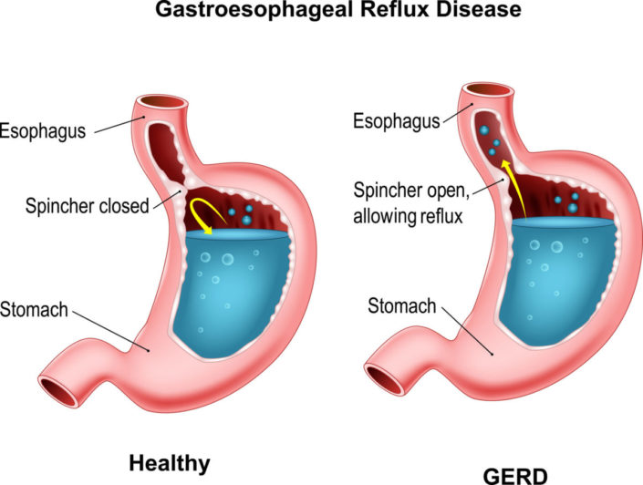
1. History of present illness

Slide 4
1. Physical examination

Slide 5
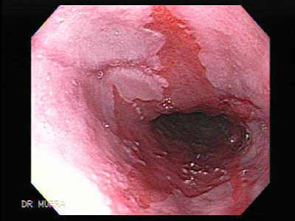
1. Endoscopy

Slide 6
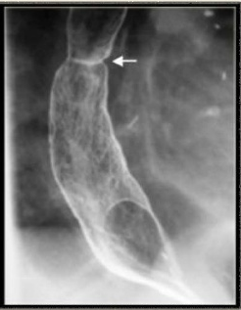
1. imaging

Slide 7
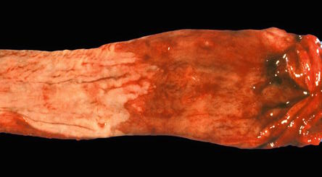
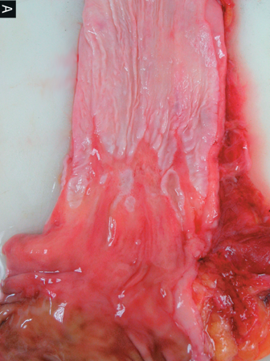
1. pathology

Slide 8
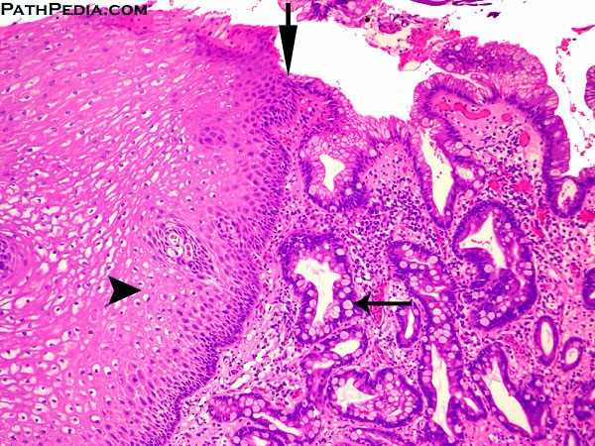
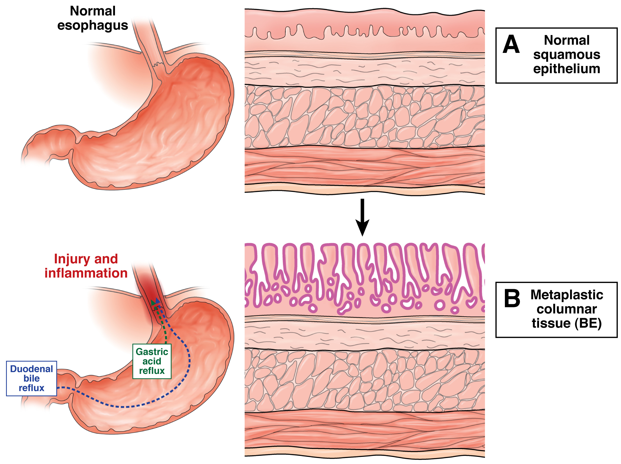
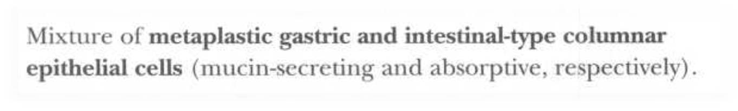
1. pathology

Slide 9
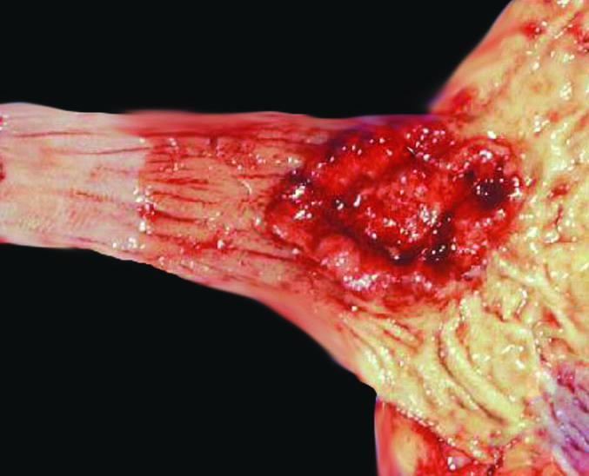
1. treatment

Slide 10
1. barrett’s esophagus
Metaplasia of the distal esophageal squamous epithelium to a columnar epithelium in response to prolonged injury
Long-standing esophageal reflux leads to inflammation and ulceration of squamous mucosa
Healing occurs through reepithelialization by pluripotent cells, which in the setting of low pH differentiates into the more resistant gastric (both cardiac and fundic)type or the specialized columnar (intestinal) type

Slide 11
1. barrett’s esophagus
Only the columnar type is of clinical importance
The most serious complication is development of adenocarcinoma
Additional complications may include stricture formation and ulceration

Slide 12
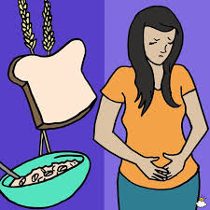
2. Present complaint
Notes:
Celiac disease

Slide 13
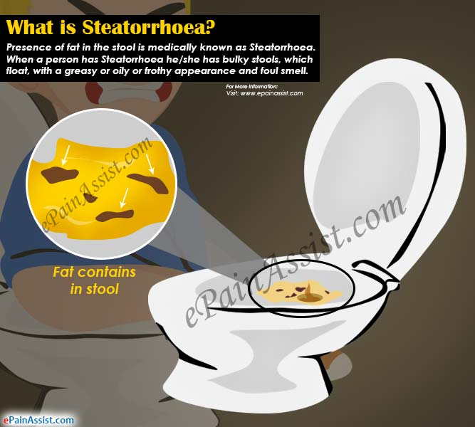
2. History of present illness

Slide 14
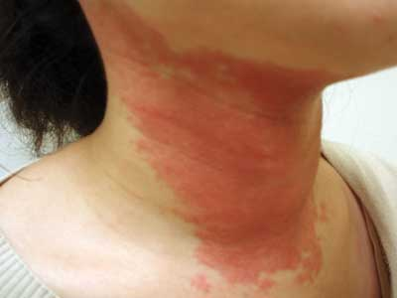
2. Physical examination

Slide 15

2. labs

Slide 16
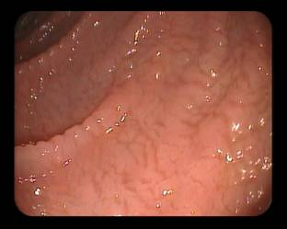
2. imaging

Slide 17
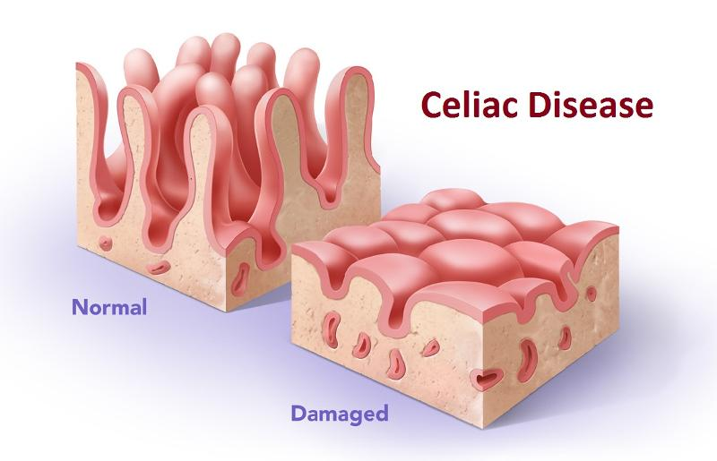
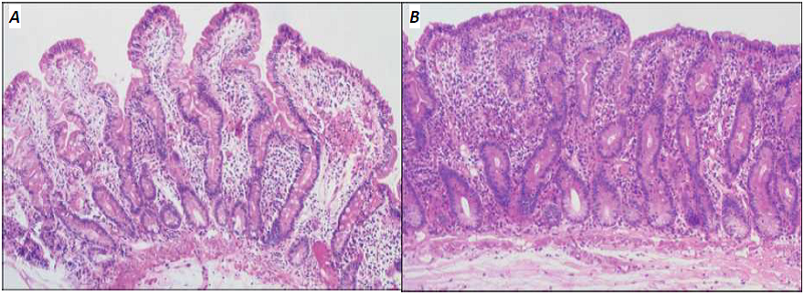
2. pathology

Slide 18

2. treatment

Slide 19
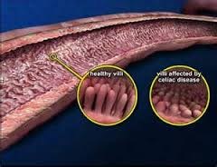
2. Celiac disease
Diease of the small intestine
Due to gluten (gliadin) hypersensitivity
Characterized by varying degrees of nutrient malabsorption
It is also known as nontropical sprue, celiac sprue, or gluten-sensitive enteropathy

Slide 20
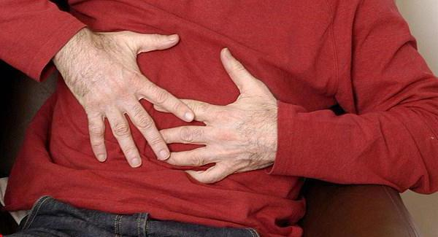
3. Present complaint
Notes:
Atrophic gastritis

Slide 21
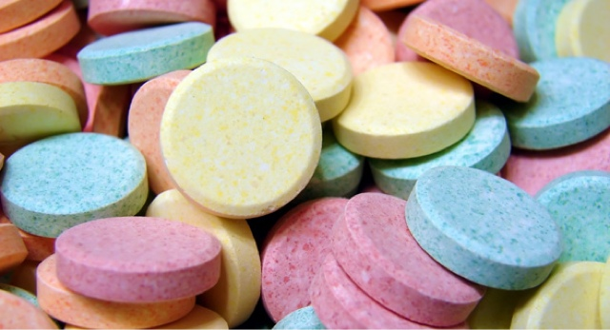
3. History of present illness

Slide 22
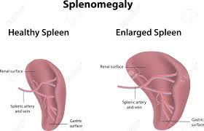
3. Physical examination

Slide 23
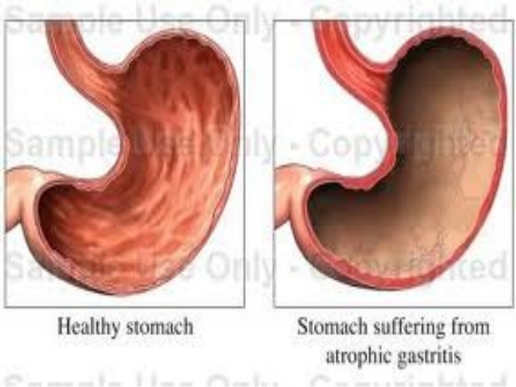
3. labs

Slide 24
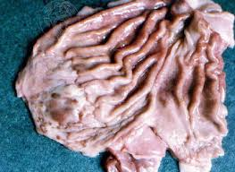
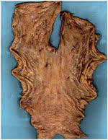

Slide 25
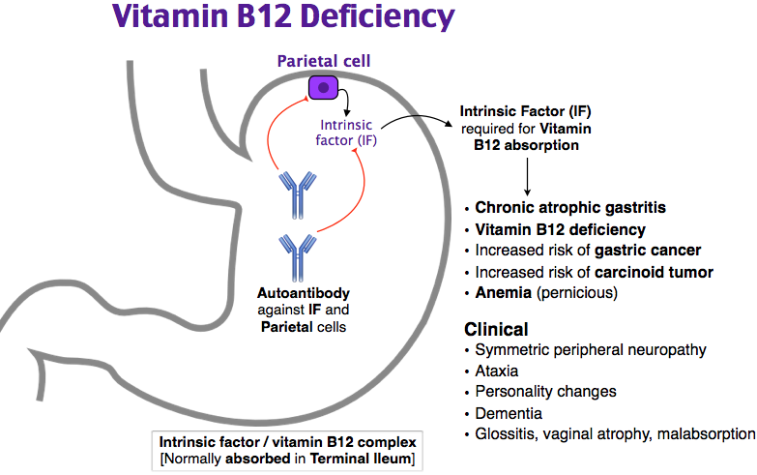
3. treatment

Slide 26
3. Chronic atrophic gastritis
Pernicious anemia is characterized by chronic atrophic gastritis with achlorhydria and antibodies to parietal cells and intrinsic factor
The conditio is more common among older patients (mean age of 60)
These patients are predisposed to other disorders, such as vitiligo, hypoparathyroidism, adrenal insufficiency, and thyroid disease

Slide 27
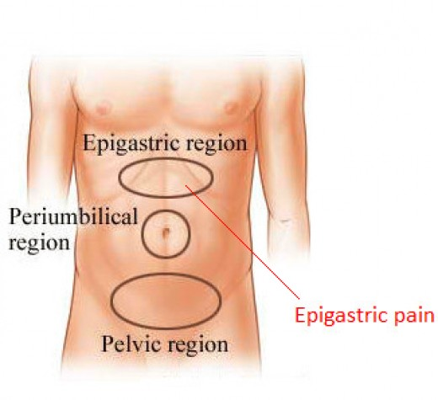
4. Present complaint
Notes:
Chronic pancreatitis

Slide 28
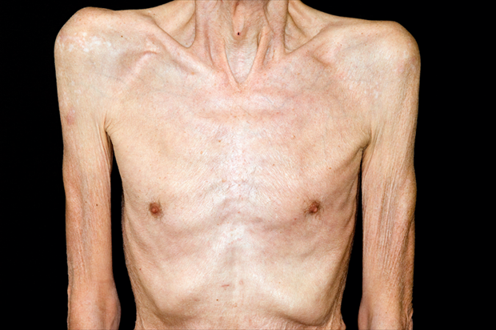
4. History of present illness

Slide 29
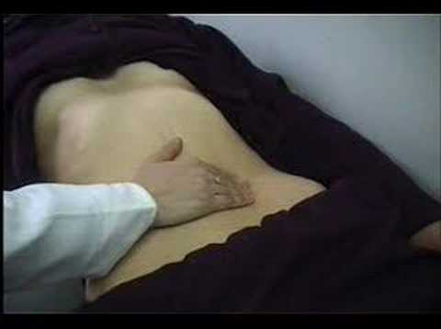
4. Physical examination

Slide 30
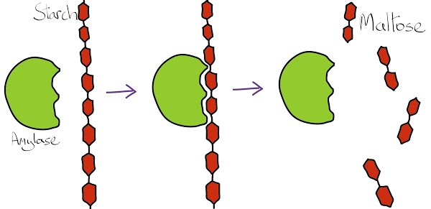
4. labs

Slide 31
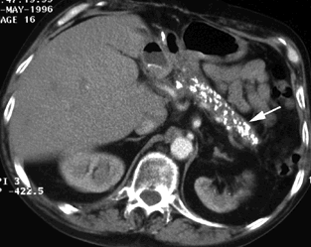
4. imaging

Slide 32
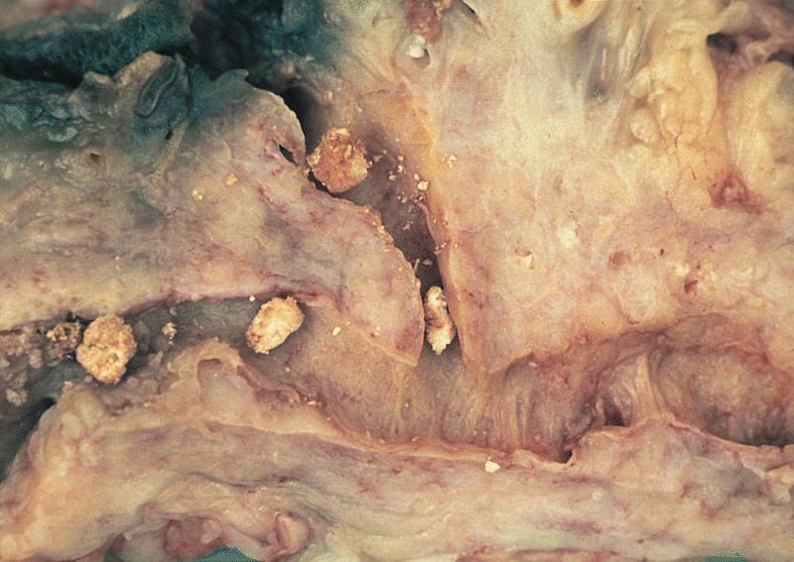
4. pathology

Slide 33

4. treatment

Slide 34
4. Chronic pancreatitis
Persistent inflammatory disease of the pancreas that is irreversible and causes pain and permanent impairment of exocrine function
Alcohol abuse is the most common cause in adult, cystic fibrosis in children

Slide 35
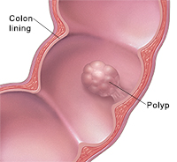
5. Present complaint
Notes:
Colon polyps

Slide 36
5. History of present illness

Slide 37
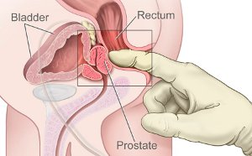
5. Physical examination

Slide 38
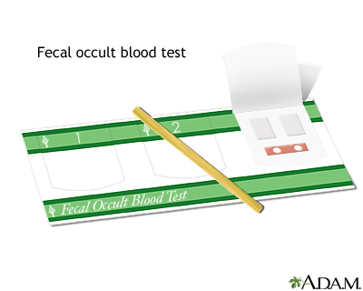
5. labs

Slide 39
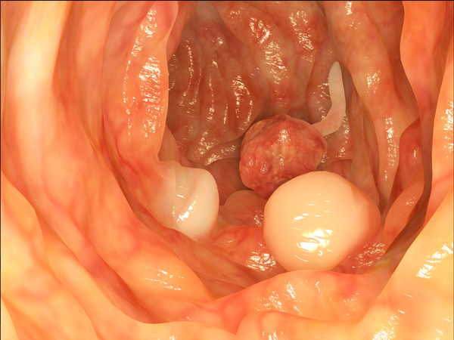
5. endoscopy

Slide 40
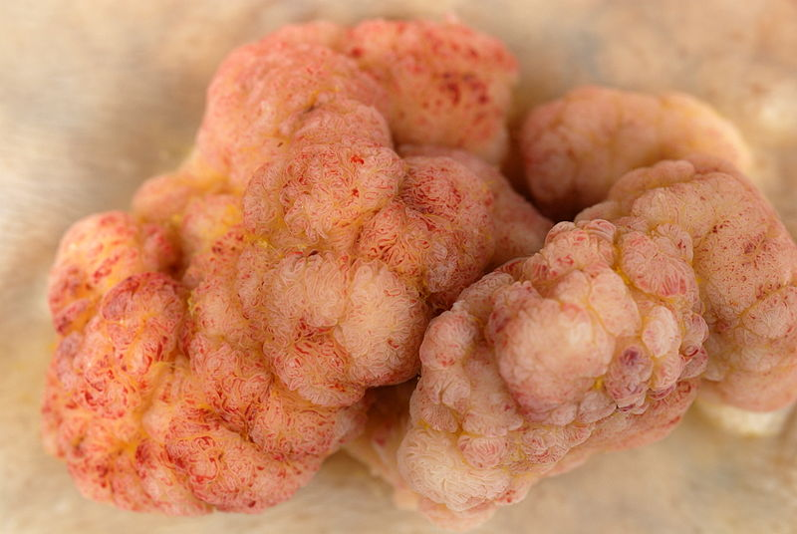
5. pathology

Slide 41
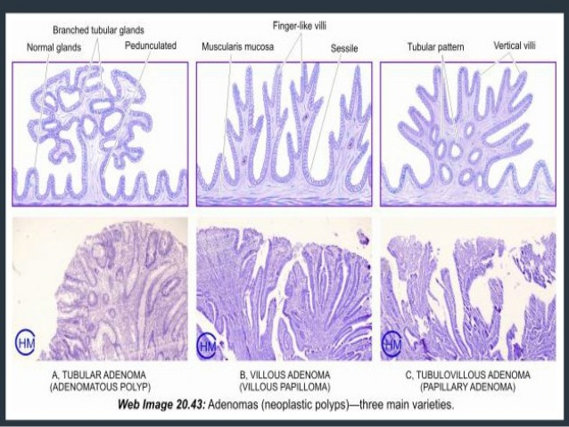

Slide 42
5. treatment

Slide 43
5. Colonic polyps
The oncogene associated with adenomatous polyposis coli is the tumor suppressor gene located on chromosome 5
The most common variety is adenomatous
The risk of malignant transformation increases with size, villous morphology, and the familial form of the disease (which has a 100% probability of becoming malignant)

Slide 44
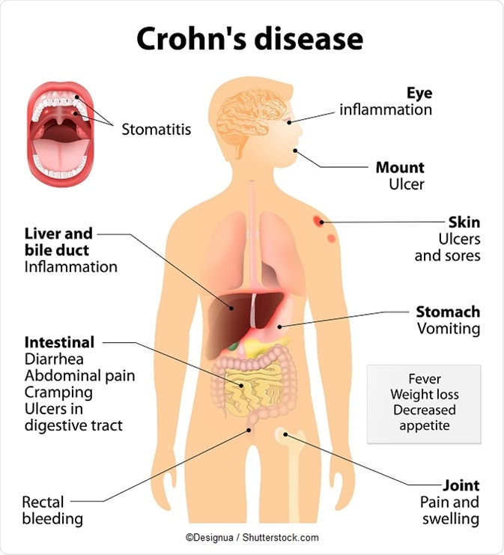
6. Present complaint
Notes:
Crohn

Slide 45

6. History of present illness

Slide 46
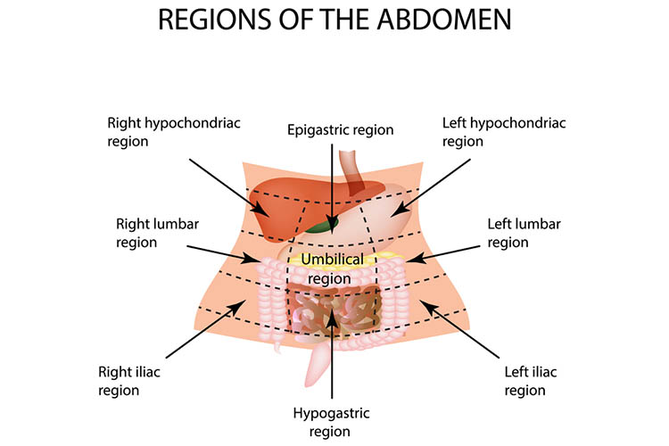
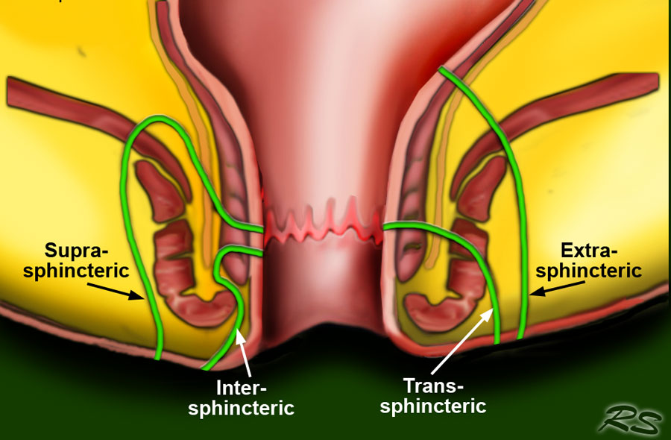
6. Physical examination

Slide 47
6. labs
The stool guaiac test or guaiac fecal occult blood test (gFOBT) is one of several methods that detects the presence of fecal occult blood (blood invisible in the feces). The test involves placing a faecal sample on guaiac paper (containing a phenolic compound, alpha-guaiaconic acid, extracted from the wood resin of Guaiacum trees) and applying hydrogen peroxide which, in the presence of blood, yields a blue reaction product within seconds.

Slide 48
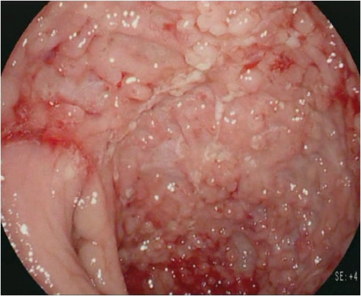
6. imaging

Slide 49
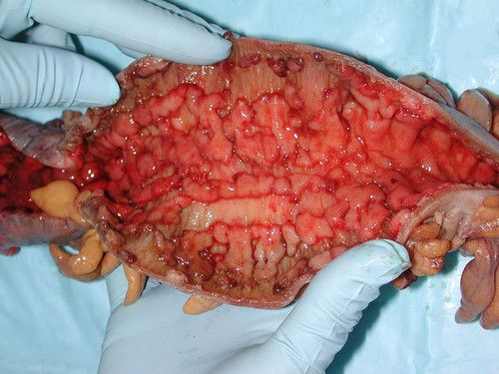
6. Gross pathology

Slide 50
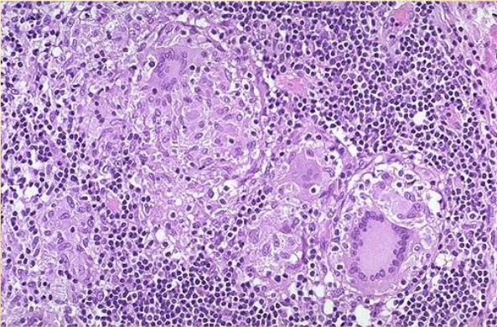
6. Micro pathology

Slide 51
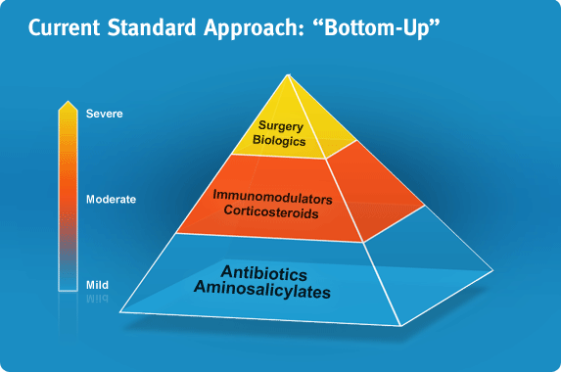
6. treatment

Slide 52
6. crohn’s disease
Complications include adhesions, ulcers, strictures, fissures, and fistulas
Extraintestinal manifestations may include arthritis, ankylosing spondylitis, sclerosing cholangitis, and uveitis
Patients have a 5 to 6-fold increased risk of developing colon cancer; however, this risk is much lower than that associated with ulcerative colitis

Slide 53
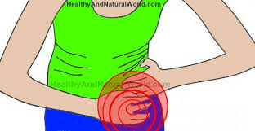
7. Present complaint
Notes:
Diverticulitis

Slide 54
7. History of present illness

Slide 55
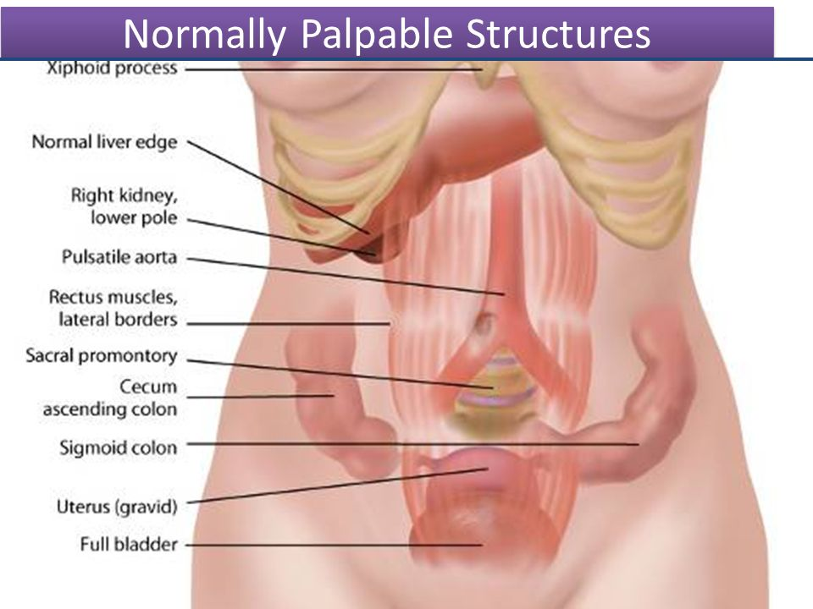
7. Physical examination

Slide 56
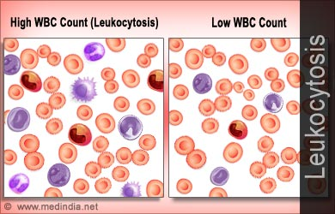
7. labs

Slide 57
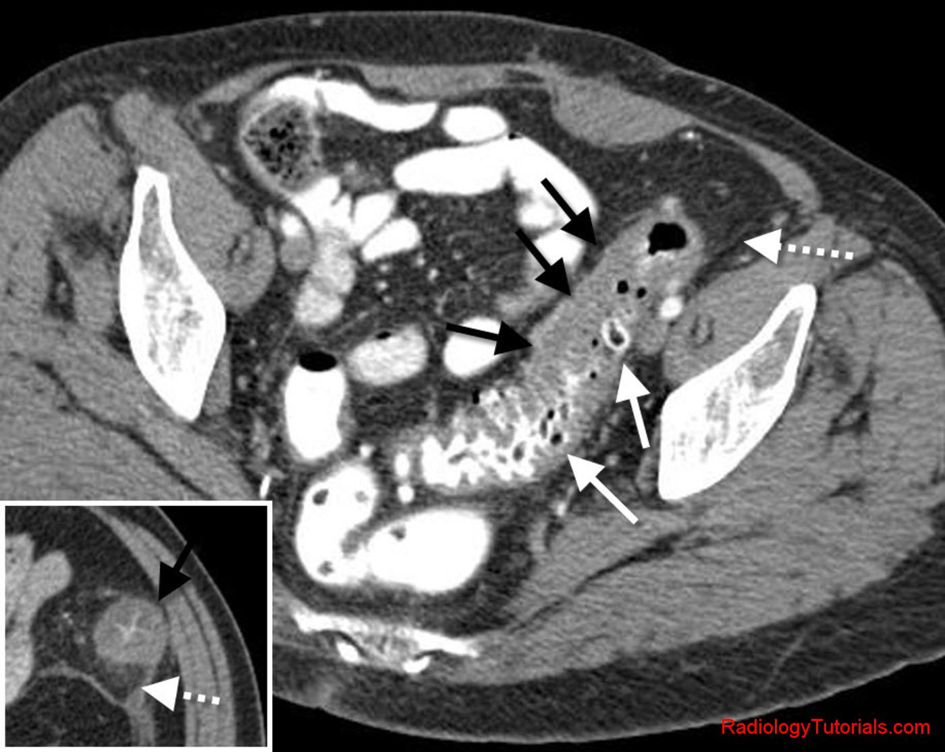
7. imaging

Slide 58
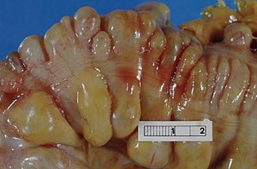
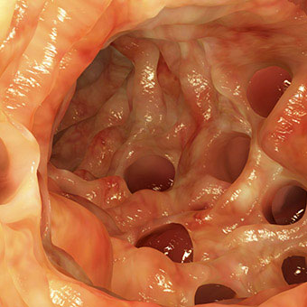
7. Gross pathology

Slide 59
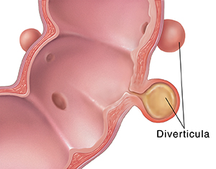
7. Micro pathology

Slide 60
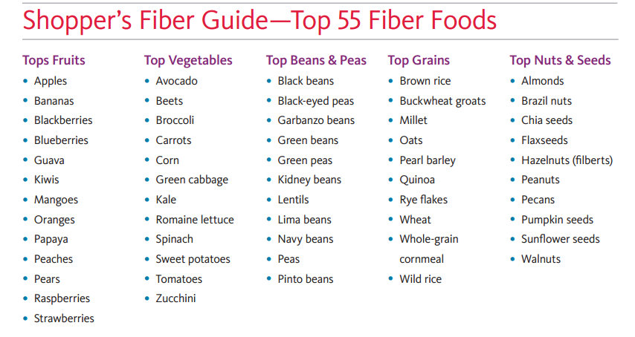
7. treatment

Slide 61
7. diverticulitis
Condition of the colon in which the mucosa and submucosa herniate through the muscular layers of the colon to form outpouching that may become obstructed with feces
The pathogenesis involves increased intraluminal pressure and focal weakness of the wall of the colon (near areas of vessel and nerve penetration alongside the teniae coli)
Outpouchings may become rapidly inflamed, resulting in abscess formation, development of fistulas to adjoining organs, colonic obstruction, perforation, and sepsis
Most commonly seen in sigmoid colon

Slide 62

8. Present complaint
Notes:
Espohageal variceal bleeding

Slide 63

8. History of present illness

Slide 64

8. Physical examination

Slide 65

8. labs

Slide 66


8. endoscopy

Slide 67

8. Gross pathology

Slide 68

8. treatment

Slide 69
8. Esophageal variceal bleeding
Esophageal varices are often silent until they rupturę
Associated with a significant mortality rate
Cirrhosis of the liver is the most common cause, but other causes of portal hypertension may also be involved

Slide 70

9. Present complaint
Notes:
GERD

Slide 71
9. History of present illness

Slide 72

9. imaging

Slide 73
9. Micro pathology

Slide 74

9. treatment

Slide 75
9. gerd
The pathophysiology of gastroesophageal reflux disease involves a sustained decrease in lower esophageal sphincter tone (caused by muscle weakness, scleroderma-like diseases, pregnancy, smoking, alcohol, or surgery), which allow reflux to occur
The extent of damage depends on the amount of refluxed material per episode, the frequency of episodes, the clearance rate by gravity and peristalsis, and the rate of neutralization of acid by salivary secretion
Chronic untreated gerd can lead to stricture formation or columnar metaplasia of distal esophagus epithelium (barrett’s esophagus), which predisposes to esophageal adenocarcinoma

Slide 76

10. Present complaint
Notes:
Hemochromatosis

Slide 77
10. History of present illness

Slide 78

10. Physical examination

Slide 79

10. Labs & imaging

Slide 80

10. pathology

Slide 81

10. treatment

Slide 82
10. hemochromatosis
In idiopathic hemochromatosis, iron accumulates until the total body iron content reaches 50g
Normally, the amount of iron accumulated inversely affects the gi mucosal absorption of both heme and non-heme iron
In hemochromatosis there is a breakdown in the normal control of iron absorption from the gi tract
As iron overload progresses, iron that is oridinarily stored in the cells of the reticuloendothelial system is deposited in the liver, joints, gonads, pancreas, heart, and skin

Slide 83

11. Present complaint
Notes:
Cirrhosis

Slide 84
11. History of present illness

Slide 85

11. Physical examination

Slide 86

11. labs

Slide 87


11. imaging

Slide 88

11. pathology

Slide 89

11. treatment

Slide 90
11. Liver cirrhosis
Most commonly causes by alcohol
Less commonly it is caused by biliary diseases, hepatitis b and c, Wilson;s disease, and hemochromatosis
End-stage liver disease leads to liver failure, nutritional deficiencies, GI bleeding, and toxic ammonemia
There is also an increased risk of hepatocellular carcinoma

Slide 91

12. Present complaint
Notes:
Hepatic encephalopathy

Slide 92
12. History of present complaint

Slide 93
12. Physical examination

Slide 94

12. labs

Slide 95

12. imaging

Slide 96

12. treatment

Slide 97
12. Hepatic encephalopathy
The cause is multifactorial and includes:
elevated concentration of blood ammonia,
short-chain fatty-acids,
false neurotransmitters,
decreased nranched-chain amino acids,
and circulating substance that has properties similar to that of benzodiazepine agonist that potentiate action of GABA

Slide 98

13. Present complaint
Notes:
Alcoholic hepatitis

Slide 99
13. History of present complaint

Slide 100

13. Physical examination

Slide 101
13. labs

Slide 102

13. imaging

Slide 103

13. pathology

Slide 104

13. treatment

Slide 105
13. Alcoholic hepatitis
Liver diseases produced by excessive consumption of alcohol include fatty liver, alcoholic hepatitis, and cirrhosis
Fatty change, and to an extent, alcoholic hepatitis may reverse fully with abstinence
10-15% of chronic alcoholics develop cirrhosis
The severity of alcoholic hepatitis can range from mild illness to fulminant hepatic faailure

Slide 106

14. Present complaint
Notes:
HCC

Slide 107
14. History of present illness

Slide 108

14. Physical examination

Slide 109

14. labs

Slide 110

14. imaging

Slide 111

14. pathology

Slide 112

14. treatment

Slide 113
14. Hepatocellular carcinoma
Malignant primary neoplasm of the liver
It usually arises from a cirrhotic liver
Frequently associated with hepatitis b and c infection
Hcc spreads by hematogenous and lymphatic dissemination, often to the lungs

Slide 114

15. Present complaint
Notes:
Metastatic ca - liver

Slide 115

15. History of present illness

Slide 116

15. Physical examination

Slide 117

15. labs

Slide 118

15. imaging

Slide 119

15. pathology

Slide 120
15. Liver metastases
More common than primary tumors of the liver
The most common tumors that metastasize to the liver are colon, gastric, pancreatic, breast, and lung carcinomas

Slide 121

16. Present complaint
Notes:
Acute pancreatitis

Slide 122
16. History of present illness

Slide 123

16. Physical examination

Slide 124
16. labs

Slide 125

16. imaging

Slide 126

16. pathology

Slide 127

16. treatment

Slide 128
16. Acute pancreatitis
Gallstones and alcohol abuse are etiologic factors in 90% of patients with acute pancreatitis
Gallstones are thought to cause pancreatitis by transient obstruction at the ampulla of vater, which leads to increased pancreatic ductal pressure
Other causes include infections (e.g. mumps), hereditary pancreatitis, shock, acute ischemia, hypercalcemia, hypertriglyceridemia, and drugs (thiazides, sulfonamides)
Complications include dic, shock, ards, hypokalcemia, acure renal failure, and pancreatic pseudocyst

Slide 129

17. Present complaint
Notes:
Toxic megacolon

Slide 130
17. History of present illness

Slide 131
17. Physical examination

Slide 132

17. imaging

Slide 133

17. pathology

Slide 134

17. treatment

Slide 135
17. Toxic megacolon
Results from the complete shutdown of colonic neuromuscular function due to inflammation of the myenteric neural plexus
It may be seen as a complication of crohn’s disease, ischemic colitis, pseudomembranous colitis, and ulcerative colitis

Slide 136

18. Present complaint
Notes:
UC

Slide 137
18. History of present illness

Slide 138

18. Physical examination

Slide 139

18. imaging

Slide 140

18. pathology

Slide 141

18. treatment

Slide 142
18. Ulcerative colitis
Patients with uc are at increased risk for colon cancer
Factors favoring the development of colon cancer in uc are the duration of the disease for 8 years or longer, involvment of the entire colon, continuous clinical activity, severe initial attack
Patients should undergo regullar colonoscopy and an examination of multiple biopsies for dysplastic changes or frank cancer
Major complications include toxic megacolon and massive intestinal hemorrhage with shock and sepsis
Extraintestinal manifestations may include arthritis, erythema nodosum, ankylosing spondylitis, and sclerosing cholangitis

Slide 143
19. Present complaint
Notes:
Acute cholecystitis

Slide 144
19. History of present illness

Slide 145
19. Physical examination

Slide 146
19. labs

Slide 147

19. imaging

Slide 148

19. pathology

Slide 149

19. treatment

Slide 150
19. Acute cholecystitis
Causes include calculi, major surgery, severe trauma or burns, and sepsis in the postpartum state
Clinical risk factors include the four f’s: fat, female, forty, and fertile

Slide 151
20. Present complaint
Notes:
Appendicitis

Slide 152
20. History of present illness

Slide 153
20. Physical examination

Slide 154
20. labs

Slide 155

20. imaging

Slide 156

20. pathology

Slide 157

20. treatment

Slide 158
20. appendicitis
The peak incidence is in the second and third decades
Causes include obstruction by the fecaliths, lymphoid hyperplasia, tumor, parasites, foreign bodies, and crohn’s disease
Complications include perforation, periappendiceal abscess, peritonitis, and generalized or wound sepsis

