Slide 1

Translated from Polish to English - www.onlinedoctranslator.com
Diagnostic methods and therapy for people with mental disorders. Nurse's participation in diagnosis
and consultative research.
Zofia Kawczyńska, M.A

Slide 2
Diagnostic methods
Basic laboratory tests:
  Urine – general examination and testing for psychoactive substances
  Blood – morphology, sugar level, thyroid hormone levels, B vitamins_{12,}iron etc.
  Standard EEG or during sleep
  Computed tomography
  Magnetic resonance imaging

Slide 3
Consultations with specialists
Depending on the patient's individual needs, he or she should be referred to a specialist (neurologist, internist, endocrinologist, etc.).
Information about the medications taken by the patient in connection with somatic diseases is extremely important for the psychiatrist.

Slide 4
Rehabilitation as a form of treatment for people suffering from schizophrenia
The concept of rehabilitation
Types of rehabilitation – social, therapeutic, vocational, early, late
Indications for the development of rehabilitation programs (setting the program based on the patient's needs and deficits)

Slide 5
Principles of rehabilitation procedures
The principle of partnership
The principle of multilateral influence
The principle of grading difficulty
The principle of repetition of interactions
The principle of compatibility of biological and psychosocial methods of influence
The principle of optimal stimulation

Slide 6
Rehabilitation methods
Social skills training
  problem-solving training in difficult interpersonal situations,
  training in recognizing early symptoms of the disease,
  training basic conversation skills
  training in appearance and personal hygiene

Slide 7
Rehabilitation methods continued
  culinary training,
  budget training,
  technical training,
  practical skills training,
  preparation for work,
  active participation of patients in pharmacological treatment

Slide 8
Rehabilitation methods continued
Psychoeducation– goals and assumptions of psychoeducational programs, various types of psychoeducational interactions
Occupational therapy– tasks of the therapist, goals and forms of therapy, assessing the patient's activity

Slide 9
Rehabilitation methods continued
Music therapy
Kinesiotherapy
Choreotherapy
Psychotherapeutic drawing
Psychodrama
Art therapy
Bibliotherapy
Psychotherapy

Slide 10
Rehabilitation process
It should start as early as possible, by getting the patient interested in his or her own appearance and personal hygiene, and by encouraging him or her to participate in activities organized in the department. Classes should be simple, but not monotonous
The nurse reinforces desired behaviors in the patient through operant conditioning - immediate positive reinforcement. Rewarding the patient (e.g. approval) for being active, cooperating, taking care of personal hygiene, etc.

Slide 11
Social skills training
For example, in the field of communication, training in verbal and non-verbal skills in dealing with others, e.g. assertiveness training
It helps the patient cope with critical situations

Slide 12
Lowering anxiety
It occurs through: observing the patient, showing care and empathy, teaching how to cope with psychotic symptoms, using relaxation, painting and other stress reduction methods/techniques, encouraging the patient to gradually become accustomed to the situation causing anxiety

Slide 13
Lowering autism
the nurse demonstrates empathy, encourages and facilitates contact with other people, includes the patient and the therapeutic team in activities (occupational therapy, trips, etc.), psychotherapy, music therapy, relaxation, recognizes with the patient those activities and entertainment that previously gave him satisfaction and Together with him, he plans to undertake these activities on a regular basis, e.g. reading, walking, painting, etc. As a result of these activities, the patient establishes contact with other people, having a reduced sense of alienation from the outside world.

Slide 14
Effective communication
showing interest, acceptance, empathy to the patient, listening carefully to the patient, maintaining eye contact with the patient, the nurse speaks in the first person, in a calm voice, in short sentences, expresses himself clearly and specifically, asks the patient questions if he does not understand what the patient feels or thinks, focuses on one topic, gets to know the patient's point of view and needs

Slide 15
Eliminating psychotic symptoms
the nurse listens carefully to the patient talking about his or her delusions, shows understanding and concern, focuses on the patient's feelings and not on beliefs about the truthfulness of the experienced experiences, teaches the patient strategies for dealing with psychotic symptoms of schizophrenia

Slide 16
Exercises that are worth doing with the patient include: changing the level of arousal through gymnastic exercises, listening to music, participating in conversations, social games, relaxation exercises, mainly breathing exercises, blocking the ears or closing the eyes, shifting the patient's attention, talking positively about oneself, ignoring the symptoms, the patient's acceptance of symptoms that cannot be reduced

Slide 17
As a result of such nursing activities, the patient should not show disturbances in the content of thinking and perception, or they should be less severe, occur less frequently, and the patient should have a sense of reality.

Slide 18
It is also important
Nurse's participation in supportive psychotherapy
Nurse's participation in psychoeducation of the patient and his family

Slide 19
Institutions of social support - legal powers
Until the 1990s - only sheltered workshops
Act on vocational rehabilitation and employment of disabled people
Mental Health Protection Act
Regulation of the Minister of Labor and Social Policy on the creation, operation and financing of Occupational Therapy Workshops

Slide 20
Institutions of social support
Community Self-Help Homes
Occupational Therapy Workshops
Vocational Activation Facilities
Mutual Support Association
National Program for Changing Attitudes Towards Psychiatry "Find Yourself"
Numerous websites (self-help groups)

Slide 21
Therapeutic relationship between nurse and patient
Correct attitude of the nurse towards the patient
Acceptance, empathy, trust, authenticity, ensuring safety, assertiveness, active listening, giving explanations, advice
Correct performance of professional functions as a nurse in the rehabilitation process
Providing mental support

Slide 22
Elements of supportive psychotherapy in the nurse-patient relationship
Creating a climate of warmth and closeness
Showing acceptance and respect to the patient
Providing physical and mental support
Authenticity
Purposefulness of behavior
Openness
Empathy

Slide 23
Inappropriateness and errors in communicating with the patient
Defending yourself
Advising
False assurance
Scolding
Dead silence
Moralizing
Inappropriate questioning
Assessment

Slide 24
Inappropriateness and errors in communicating with the patient continued
Patronage
Rationalizing feelings
Suggesting an answer
Changing the subject

Slide 25
Own experiences
Community Care Team at the Psychiatric Day Ward in Grudziądz
Conducting training sessions
  Social training once a week (10 – 15 people)
  Club meetings once a month (20 – 30 people)
Once a year, a one-day trip (about 50 people) - introducing patients to interesting towns in the area

Slide 26
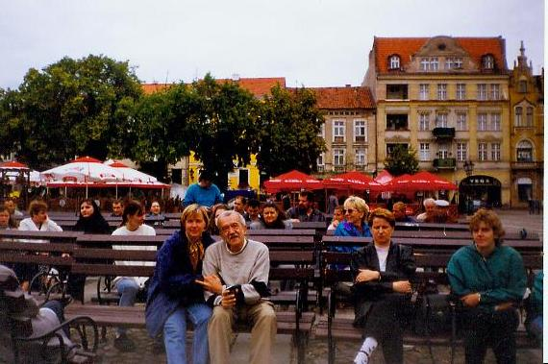
Chełmno

Slide 27
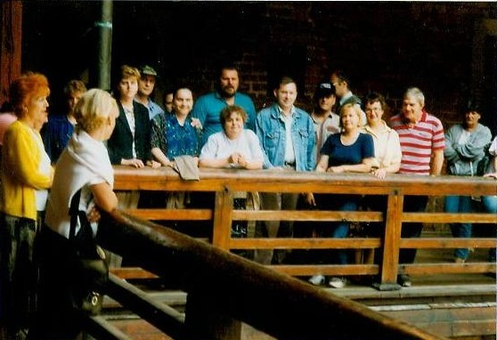
Golub – Dobrzyń

Slide 28
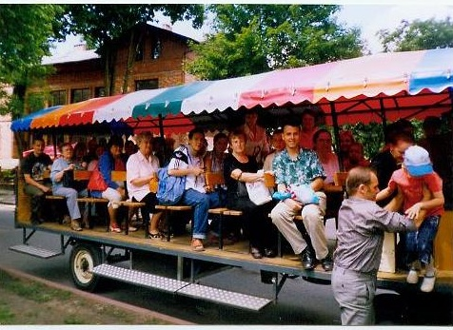
Ciechocinek

Slide 29
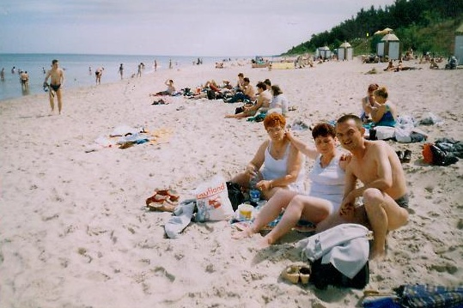
Stegna

Slide 30
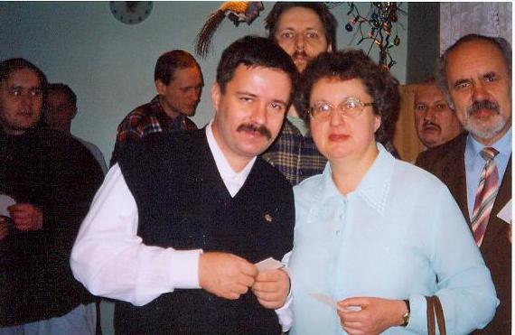
Club meetings

Slide 31
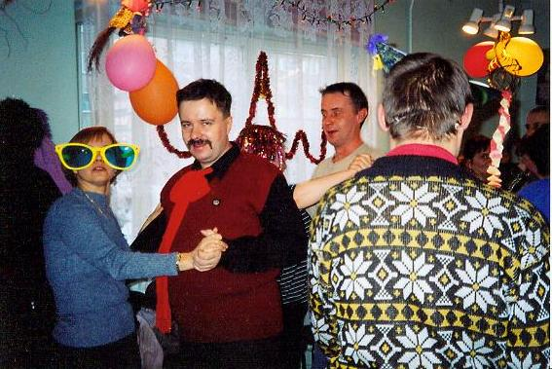
Club meetings

Slide 32
Schizophrenia "Open the Door"
The Global Schizophrenia Program "Open the Door" has been running around the world since 1997
The Psychiatric Day Ward takes an active part in its celebrations
Goal - integration of communities related to the treatment of schizophrenia, learning about the experiences of patients and their families, information campaign

Slide 33
Schizophrenia "Open the Door" cont
Friendly musicians prepare artistic performances
Competitions for children are organized
The guests of honor are the city authorities and the director of the hospital in Grudziądz
Every year the number of festival participants increases
There is a growing public interest in the problem of schizophrenia

Slide 34
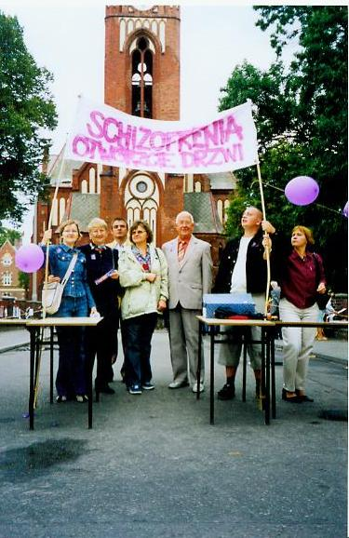
Schizophrenia "Open the Door" cont

Slide 35
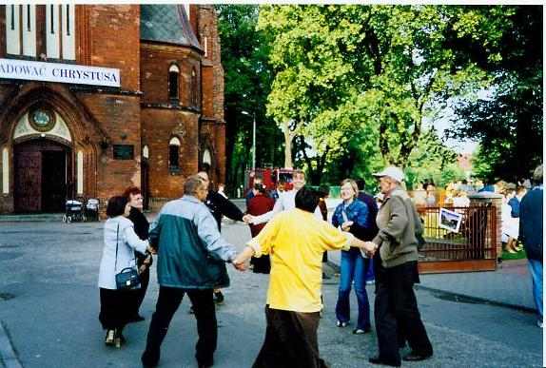
Schizophrenia "Open the Door" cont

Slide 36
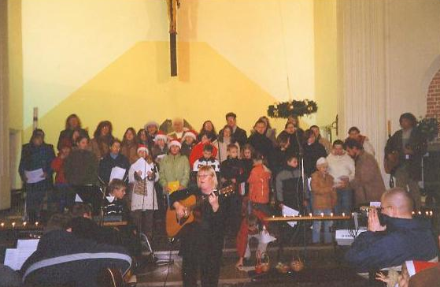
Charity concert

Slide 37
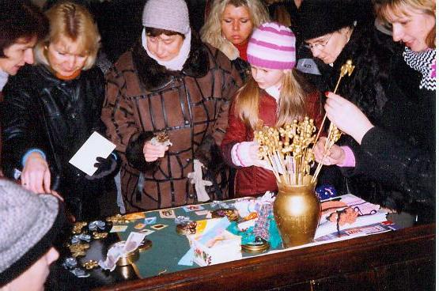
Fair

Slide 38
Training cycles conducted in the department
Conversation training
Budget training
Hygiene training
Psychoeducation
Training for active participation in your own pharmacological treatment
Culinary training

Slide 39
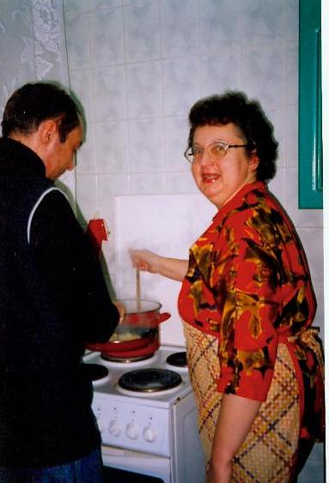
Culinary training

Slide 40
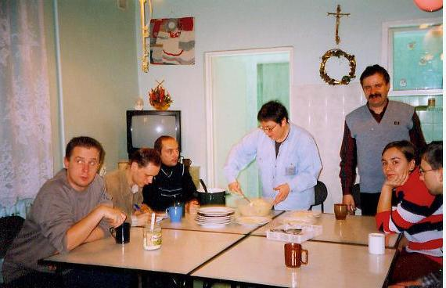
Culinary training cont

Slide 41
Conclusions
Schizophrenia begins at a young age and can last for life
Decisions made in early rehabilitation affect the patient's entire future
Stationary treatment should be intensive and as short as possible
In early rehabilitation, pharmacological treatment is more important, in late rehabilitation - non-pharmacological forms of influence

Slide 42
Conclusions continued
Rehabilitation can be provided by psychiatric hospitals, mental health clinics, community therapy, occupational therapy workshops and support groups
With proper treatment and rehabilitation, disease exacerbations are less frequent, their course is milder, and the hospitalization period is shorter (lower costs).

Slide 43
Thank you for your attention.

